Slide 1
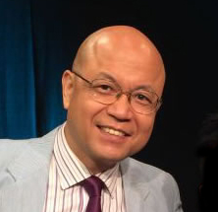

First-Person Influences on Third-Person Perceptions
Xinshu ZHAO, Xudong LIU, Yue Selene CHEN,
Wen Aquamarine JIAO, Song Harris AO, Fuyuan SHEN, Zhilong George ZHAO
xszhao@um.edu.mo
Department of Communication, Faculty of Social Sciences, University of Macau
澳門大學 社會科學學院 傳播系
International Communication Association (ICA)
Division: Journalism Studies
11 AM, 17 April 2022, Macau
Zoom Meeting ID：966 2059 2081
https://umac.zoom.us/j/96620592081
Recorded video available at https://drive.google.com/file/d/1LyluTz_2dvDDmlNkMstt0SXkVn5Y5dfp/view
1

Slide 2


Introduction
This study assessed the third-person perceptions (TPP) regarding attitude and knowledge among journalists in China and explored factors that may affect such perceptions.
Based on a stratified sample of media professionals in two different regions, it was found that TPP regarding attitude was present and stronger than TPP regarding knowledge.
The results also revealed that the media environment affected TPP regarding knowledge, while political identity and perceived news quality (PNQ) affected TPP regarding attitude.
In addition, the study found that key personal factors interacted with each other in affecting TPP through the mediation of two components, the perceived effect on others (PEO) and the perceived effect on self (PES).
2

Slide 3
Theory
The theory of third-person effect (TPE), aka third-person perception (TPP), hypothesizes that people overestimate the media effect on others (Davison, 1983; Perloff, 1993, 1999).
The theory of TPP is concerned with perceived effects on attitudes (Davison, 1983). Davison (1957) observed journalists’ perceptions that messages affected ordinary readers’ attitudes more than journalists’ own.
As journalists are professional carriers of information that the public may turn into knowledge (Nisbet & Fahy, 2015; Wihbey, 2017), journalists’ perception of their own influence on the knowledge of the public may warrant researchers’ attention.
3

Slide 4
Research questions and hypothesis
H1: Journalists would perceive larger media effects on the public’s attitude than on their own attitude.
H2: TPP regarding attitude is stronger than TPP regarding knowledge such that the respondents’ other-self differentials regarding attitude are stronger than the differentials regarding knowledge.
RQ1: Will respondents perceive larger media effects on the public’s knowledge than on their own knowledge?
RQ2: Does media environment (MDE), represented by Beijing vs. Hunan, affect third-person perception? How?
RQ3: Does political identity (PID), represented by CCP membership, affect the journalists’ third-person perceptions? How?
RQ4: Does perceived quality of news reporting (PNQ) affect Chinese media professionals’ third-person perceptions? How?
4

Slide 5
Data Collection
A survey was conducted in March 2018 in the capital city of Beijing and the southern province Hunan.
Stratified random sampling was used to select journalists from the two locales.
After compiling a list of news organizations in Beijing and Hunan, we employed simple random sampling to select 33 organizations, including newspaper, radio, television, and online news organizations. We then used simple random sampling again to select and invite 700 individuals from the staff rosters of the 33 organizations. With the assistance of research liaisons in each sampled news organization, 672 completed the online survey, yielding a response rate of 96%.
For two cities in China(Beijing and Hunan)
Sample Size | N=672
Survey Length | 10-15 mins
5

Slide 6
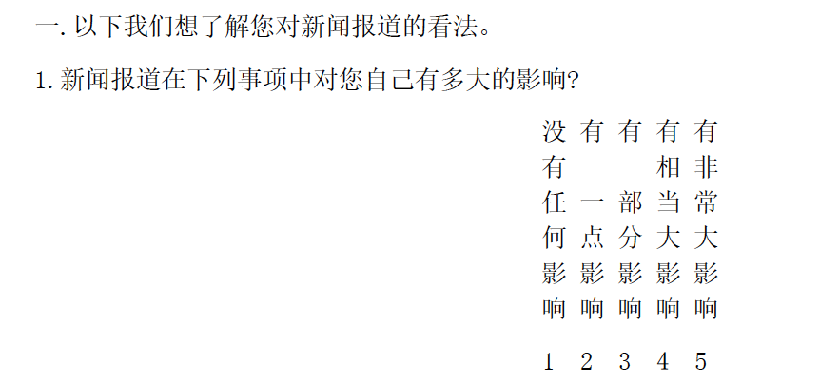
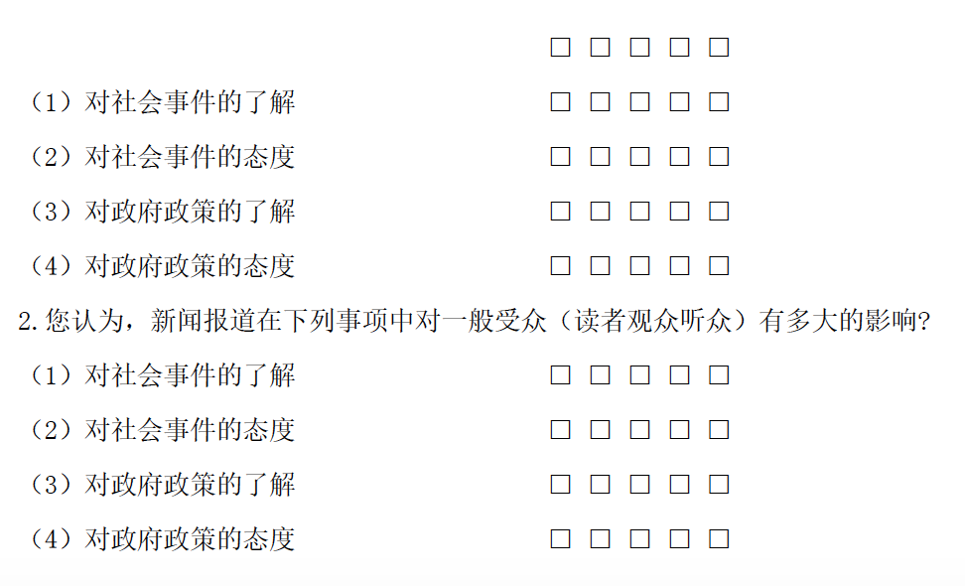
Measurement
The sample of questionnaires (5 point scale)
1. How strongly does the news report affect you in the following matters?
1) knowledge of social events
2) attitude of social events
3) knowledge of government policies
4) attitude of government policies
2. How strongly does the news report affect general audience in the following matters?
1) knowledge of social events
2) attitude of social events
3) knowledge of government policies
4) attitude of government policies
6

Slide 7
Descriptive Statistics
Table 1 Descriptive Information of Control Variables by Transforming to 0-1 Scale
Variable | Wording | Observed |  |  |  | Conceptual |  | Percentage scale (ps)
 |  | min | max | mean | stdv | min | max | min | max | mean | stdv
gender | What is your gender? 您的性別？ | 1 (male) 51.6% | 2 (female) 48.2% | 1.4829 | .5001 | 1 | 2 | 0 (male) 51.6% | 1 (female) 48.2% | .4829 | .5001
age | How old are you? 您的年齡？ | 18 | 58 | 34.1490 | 7.9091 | 0 | 100 | .18 | .58 | .3415 | .0791
marriage | marriage status 您的婚姻狀態？ | 1 (noª) 41.5% | 2 (yes) 58.5% | 1.5848 | .4931 | 1 | 2 | 0 (no) 41.5% | 1 (yes) 58.5% | .5848 | .4931
education | What is your highest degree? 您的最高學歷？ | 1 | 6 | 3.8224 | .6062 | 1 | 6 | 0 | 1 | .5645 | .1213
journalism major | Are you majoring in journalism, mass communication or related departments? 您在大學本科主修的科系是否為新聞學、大眾傳播學或相關科系？ | 1 (no) 55.7% | 2 (yes) 43.2% | 1.4367 | .4964 | 1 | 2 | 0 (no) 55.7% | 1 (yes) 43.2% | .4367 | .4964
journalism course | have you ever taken a course in journalism? 您是否曾修讀過雨新聞傳播專業相關的課程？ | 1 (no) 19.2% | 2 (yes) 80.7% | 1.8077 | .3944 | 1 | 2 | 0 (no) 19.2% | 1 (yes) 80.7% | .8077 | .3944
salary | What is your average monthly income (including salary, bonus, allowance, contribution fee, year-end bonus, etc.) in the current work organization? 您在目前工作機構的每月收入（含工資、獎金、津貼、稿費、年終獎等）平均約為多少人民幣？ | 1 | 8 | 2.5878 | 1.3433 | 1 | 8 | 0 | 1 | .2268 | .1919
journalism experience | how many years have you been in journalism? 您從事新聞工作已有多久？ | 0 | 38 | 10.1800 | 7.2125 | 0 | 50 | 0 | 0.76 | .2036 | .1443
ª including unmarried, divorced and others.
7

Slide 8
Descriptive Statistics
Table 2 Descriptive Information of Independent Variables and Dependent Variables by Transforming to 0-1 Scale
Variable | Wording | Observed |  |  |  | Conceptual |  | Percentage scale (ps)
 |  | min | max | mean | stdv | min | max | min | max | mean | stdv
Beijing vs Hunan (MDE) | Region 所在地區 | 1 (Hunan) 65.2% | 2 (Beijing) 34.8% | 1.3482 | .4768 | 1 | 2 | 0 (Hunan) 65.2% | 1 (Beijing) 34.8% | .3482 | .4768
Political identity (PID) | are you a member of Chinese Communist Party (CCP)？ 您是否為中共黨員？ | 1 (No) 55.8% | 2 (Yes) 44.2% | 1.4420 | .4970 | 1 | 2 | 0 (No) 55.8% | 1 (Yes) 44.2% | .4420 | .4970
Perceived news quality (PNQ) | please rate your work organization's performance in news reports, with a maximum of 100 points, a minimum of 0 points and a passing score of 60 points. What score will you give? 如果請您對您就職的工作機構在新聞報道表現上評分，最高為100分，最低為0分，您會給多少分？ | 1 | 7 | 5.6222 | 1.0741 | 1 | 7 | 0 | 1 | .7704 | .1790
3rd-person perception re attitude (3PA) | differences in scores between perceived media effects on attitudes of others and themselves （TPP in attitudes） 新聞報道對他人及自己態度影響的差異（第三人效果） | -.75 | 1 | .0153 | .1845 | -1 | 1 | .13 | 1 | .5076 | .0923
Others-attitude (OAtt) | perceived media effects on attitudes towards social events and government policies of others 新聞報道對他人態度(社會事件/政府政策)的影響 | 1 | 5 | 3.7626 | .8238 | 1 | 5 | 0 | 1 | .6907 | .2060
Self-attitude (SAtt) | perceived media effects on attitudes towards social events and government policies of themselves 新聞報道對自己態度(社會事件/政府政策)的影響 | 1 | 5 | 3.7016 | .8506 | 1 | 5 | 0 | 1 | .6754 | .2126
3rd-person perception re knowledge (3PK) | differences in scores between perceived effects on knowledge of others and themselves （TPP in knowledge）新聞報道對他人及自己了解影響的差異（第三人效果） | -.75 | .63 | .0026 | .1623 | -1 | 1 | .13 | .81 | .5013 | .0812
Others-knowledge (OKno) | perceived effects on knowledge of others towards social events and government policies新聞報導對他人了解(社會事件/政府政策)的影響 | 1 | 5 | 3.7921 | .8193 | 1 | 5 | 0 | 1 | .6980 | .2048
Self-knowledge (SKno) | perceived effects on knowledge of themselves towards social events and government policies 新聞報道對自己了解(社會事件/政府政策)的影響 | 1 | 5 | 3.7820 | .8269 | 1 | 5 | 0 | 1 | .6955 | .2067
8

Slide 9
Third Person and
Third People Perception
Table 3 Measuring Third-Person Perception About Attitude and Knowledge (N= 672) | No Effect (p_{s}=.00)ª | Weak Effect (p_{s}=.25) | Somewhat Strong Effect (p_{s}=.50) | Strong Effect (p_{s}=.75) | Very Strong Effect (p_{s}=1.00) | Total^{c}
Other-Attitude (OAtt) (Cronbach alpha = .799) | Q.I.2^{b}: How strongly does the news affect the following traits of the audience?
I.2.2.^{b} attitude re social events | 0.6 | 9.2 | 26.6 | 44.0 | 19.3 | 99.9
I.2.4. attitude re government policies | 1.0 | 6.5 | 26.8 | 42.1 | 23.4 | 99.9
Self-Attitude (SAtt) (Cronbach alpha = .771) | Q.I.1: How strongly does the news affect the following traits of yours?
I.1.2. attitude re social events | 1.8 | 8.3 | 29.6 | 42.3 | 18.0 | 100.0
I.1.4 attitude re government policies | 2.4 | 6.7 | 28.0 | 40.3 | 22.5 | 99.9
Other-Knowledge (OKno) (Cronbach alpha = .744) | Q.I.2: How strongly does the news report affect the following traits of the audience?
I.2.1 knowledge of social events | 1.3 | 7.3 | 23.8 | 46.1 | 21.3 | 99.9
I.2.3 knowledge of government policies | 0.6 | 7.0 | 28.9 | 39.1 | 24.3 | 99.9
Self-Knowledge (SKno) (Cronbach alpha = .783) | Q.I.1: How strongly does the news report affect the following traits of yours?
I.1.1 knowledge of social events | 1.3 | 7.1 | 25.3 | 45.5 | 20.7 | 100.0
I.1.3 knowledge of government policies | 0.9 | 6.7 | 29.5 | 38.1 | 24.9 | 100.0
Main cells are percentage occurrences. ª: p_{s}: percentage scores on 0-1 percentage scale ^{b}: Question ID indicates the question’s position in questionnaire. ^{c}: Total may not add up to 100% due to missing cases and/or rounding errors.
9

Slide 10
Third Person and
Third People Perception
Table 4 Third-Person Perception About Attitude & Knowledge | A Other (O) (0~1) | B Self (S) (0~1) | C ^{a,b} TPP:3rd-person perception (T) (T=O-S)(-1~1) | D ^{a,b} TPP on 0-1 scale (T₀₁=(T+1)/2) (1~0)
1.Attitude (A) | .6907*** | .6754*** | .0153* | .5076*
2.Knowledge (K) | .6980*** | .6955*** | .0025 | .5013
3ª.Attitude-Knowledge Gap (G) (G=A-K)(-1~1) | -.0073 | -.0201*** | .0128*
4.AKG on 0-1 scale (G₀₁=(G+1)/2)(0~1) | .4964 | .4900*** |  | .5032*
*: p<0.05; **: p<0.01; ***: p<0.001. Main cells are variable means. Cell A1, for example, indicates that the mean of Other-Attitude (EOA) is .6907 on 0-1 scale, which is different from zero at p<.001. ª In Columns C & D and Row 3 are results of paired-sample t tests. ^{b} TPP, traditionally defined as T=O-S, is on -1~1 directional percentage scale (p_{d}), where T=0 means no TPP, T>0 means TPP, and T<0 means reverse TPP. In contrast, T₀₁ is on 0~1 percentage scale (p_{s}), where T₀₁=0.5 means no TPP, T₀₁>0.5 means TPP, and T₀₁<0.5 means reverse TPP.
10

Slide 11
First-Person Influences
Table 5 First-Person Factors Influencing the Perceived Media Effects on Self and Others
Dependent Variable | Attitude |  |  | Knowledge
 | EOA | LSA | 3PA | EOK | LSK | 3PK
Control Blockª
1. gender (female) | -.033 (-.081)* | .044 ( .103)** | .005 ( .028) | -.015 (-.037) | .043 ( .105)** | .014 ( .087)*
2. age | -.093 (-.036) | -.160 (-.060) | .034 ( .029) | .047 ( .018) | -.119 (-.045) | .083 ( .081)
3. marriage (married) | -.020 (-.048) | -.032 (-.074) | .006 ( .032) | -.021 (-.051) | -.034 (-.081)* | .007 ( .040)
4. education | -.087 (-.051) | -.074 (-.042) | -.007 (-.009) | -.100 (-.059) | .010 ( .006) | -.055 (-.082)
5. journalism major | -.035 (-.086) | -.035 (-.083) | -.000 (-.000) | -.027 (-.066) | .028 ( .067) | .001 ( .003)
6. journalism course | .046 ( .087)* | -.027 (-.049) | .010 ( .041) | .044 ( .085)* | -.034 (-.065) | .005 ( .024)
7. Salary | .031 ( .029) | .045 ( .041) | .380 ( .079) | .026 ( .025) | .016 ( .015) | .021 ( .051)
8. journalism experience | .074 ( .052) | -.081 (-.055) | -.003 (-.005) | .047 ( .034) | .146 ( .101) | -.049 (-.088)
1st-Person Factor (Ind.)^{b}
10. Beijing vs Hunan (MDE) | -.051 (-.119)* | .035 ( .079) | -.008 (-.041) | -.063 (-.146)** | .022 ( .050) | -.020 (-.119)*
11. Party ID (PID) | -.006 (-.016) | -.028 (-.066) | -.017 (-.094)* | .018 ( .044) | -.036 (-.087)* | -.009 (-.056)
12. Perceived News Qlty. (PNQ) | .209 (.182)*** | -.343 (-.289)*** | -.067 (-.130)** | .272 ( .239)*** | .310 (-.268)*** | -.019 (-.042)
1st-Person Factors ^{c}
13. Beijing vs Hunan (MDE) | -.032 (-.075) | .004 ( .010) | -.014 (-.071) | -.039 (-.092)* | -.006 (-.013) | -.023 (-.133)**
14. Political identity (PID) | -.015 (-.036) | -.012 (-.028) | -.013 (-.072) | .007 ( .018) | -.021 (-.051) | -.007 (-.043)
15. Perceived News Qlty. (PNQ) | .196 ( .171)*** | -.337 (-.284)*** | -.070 (-.136)** | .249 ( .219)*** | -.306 (-.265)*** | -.028 (-.063)
16. Total r² of control block | .060*** | .106*** | .036* | .079*** | .095*** | .033*
17. Inc. r² due to FPF block | .035* | .079* | .025** | .057* | .067* | .015*
*: p<0.05; **: p<0.01; ***: p<0.001. ª The following eight rows are percentage coefficients (b_{p}) and standardized betas (in parentheses) when the eight control variables are entered as a block. ^{b} The following three rows are percentage coefficients (b_{p}) and standardized betas when each of the three variables is added separately and alternatively on top of the eight control variables. ^{c} The following three rows are percentage coefficients (b_{p}) and standardized betas when all three variables are added simultaneously as one block on top of the eight control variables.
11

Slide 12
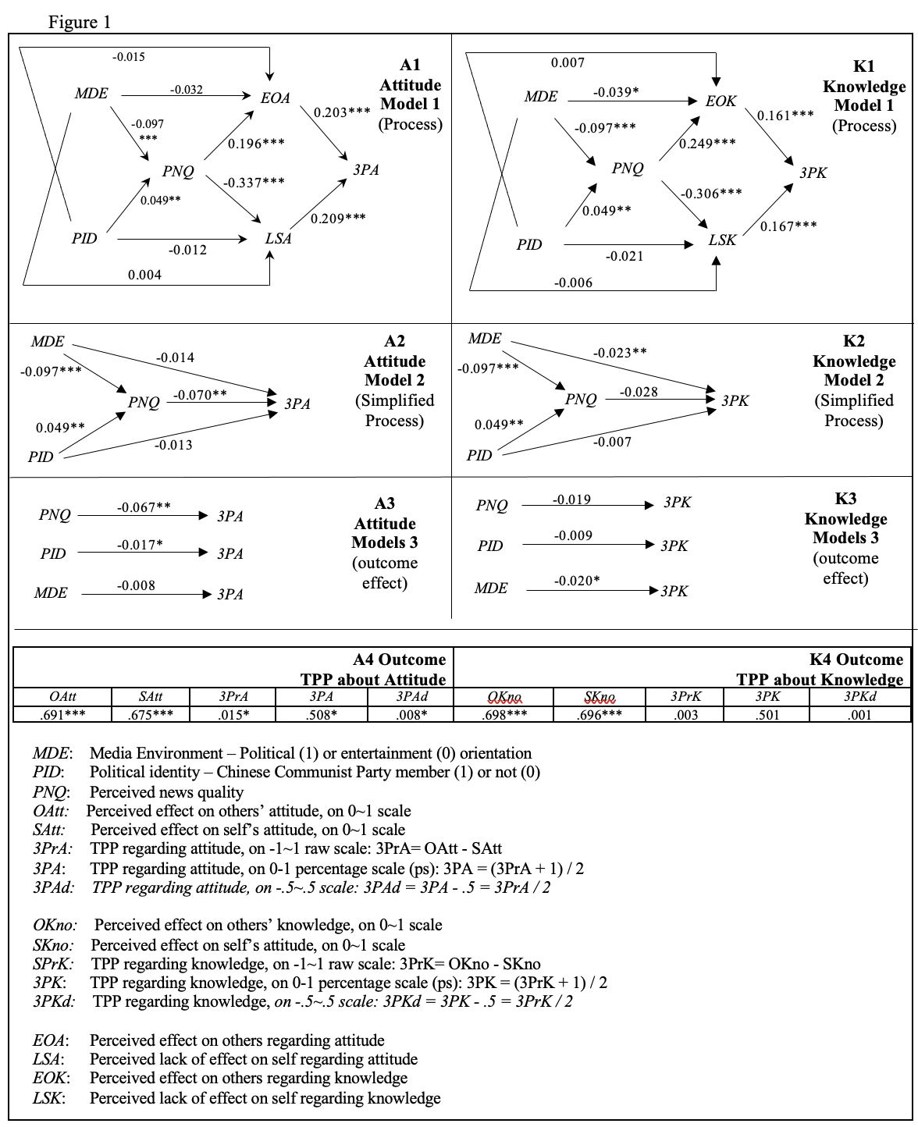
Other-Self Process and Outcome (OSPO) Model
12

Slide 13


Thank You
Avenida da Universidade, Taipa, Macau, China
Tel : (853) 8822 8833 Fax : (853) 8822 8822
Email : xszhao@um.edu.mo Website : www.um.edu.mo

