Slide 1

Charitable Interpretation and Self-Understanding
Benjamin Winokur
University of Macau
The Principle of Charity in Language, Thought, and Interpretation (Topoi Special Issue)
December 20th, 2024

Slide 2
“…if we cannot find a way to interpret the utterances and other behavior of a creature as revealing a set of beliefs largely consistent and true by our own standards, we have no reason to count the creature as rational, as having beliefs, or as saying anything”
(1984: 137)
Davidson’s Principle of Charity
Interesting implication: interpretees must be understood (to some degree) through successful interpretation

Slide 3
Does all understanding of all persons rest on charitably interpreting them?

Slide 4
Self-Understanding
Self-Understanding (of attitudes): recognizing not only that I believe/desire/intend something, but endorsing what I recognize as rational (by my own lights)

Slide 5
…A hearer interprets (normally without thought or pause) on the basis of many clues: the actions and other words of the speaker, what he assumes about the education, birthplace, wit, and profession of the speaker, the relation of the speaker to objects near and far, and so forth. The speaker, though he must bear many of these things in mind when he speaks, since it is up to him to try to be understood, cannot wonder whether he generally means what he says
(1984: 110)
Semantic Authority

Slide 6
“…the agent herself…is not in a position to wonder whether she is generally using her own words to apply to the right objects and events, since whatever she regularly does apply them to gives her words the meaning they have.”
(1987: 37-38)
Explaining Semantic Authority

Slide 7
From Semantic Authority to First-Person Authority
Assume that two agents, A and B, both know that A believes whatever A means by “P”
Both agents can, thus, correctly ascribe the belief that P to A
However, only A’s ascription is first-person authoritative, because only A is authoritative about what P means

Slide 8
Is self-understanding, like first-person authority, explained by semantic authority?*
*If so, self-understanding will also turn out to be non-interpretive

Slide 9
“…the agent herself…is not in a position to wonder whether she is generally using her own words to apply to the right objects and events, since whatever she regularly does apply them to gives her words the meaning they have.”
(1987: pp. 37-38)
Semantic Authority vs. Self-Understanding
Semantic authority does not (immediately) explain self-ascriptive authority
  But self-understanding requires self-ascription
Explaining semantic authority may not require any appeal to metarepresentations (cf. Jacobsen 2009)
  But self-understanding is a metarepresentational achievement

Slide 10
A Challenge from ‘Non-Epistemicism’ About Attitude Self-Ascriptions
“when I issue a mental self-ascription such as ‘I feel angry’ ‘in the avowing mode’ (as opposed to on the basis of self-interpretation, therapy, or what have you), I do not regard myself as being justified or unjustified in thinking that it’s anger I feel. The distinctive perspective of an avowing person, I would say, is not an epistemic perspective at all.”
(Bar-On 2010: 51)

Slide 11
An Argument Against Non-Epistemicism
Even if avowing does not require taking an epistemic perspective on one’s mental state, one can generally be led to take up that perspective
    E.g., I avow believing P, and someone asks “are you sure?”
In failing to understand our avowed attitudes in such cases, doubting them is prima facie reasonable
Doubting one’s avowals can undermine one’s FPA with respect to them
Therefore, self-understanding explains the non-fragility of FPA
    E.g., I avow believing P, and someone asks “are you sure?”…I then proceed to defend P…

Slide 12
How might non-interpretive self-understanding arise?*
*It would be odd if self-understanding requires self-interpretation, given that FPA partly consists in not needing to interpret oneself as having the attitudes one avows, and given that self-understanding contributes to FPA

Slide 13
Quietism About Self-Knowledge (and Self-Understanding?)
“…I normally know what I think without seeking or needing evidence, and without interpretation. But how…do I know it? What kind of answer could there be? In this respect, anyway, Wittgenstein was right: “The language game simply is the way it is.”
(2001: 301)

Slide 14
A Soft Problem for Empiricism About Self-Understanding
Empiricism about self-knowledge: one can non-inferentially know one’s attitudes via inner-sense (cf. Armstrong 1968; Lycan 1996; Nichols & Stich 2003), acquaintance (Gertler 2012; Giustina 2021), or other broadly ‘detectivist’ methods (cf. Finkelstein 2003)
  Problem: self-knowledge via self-detection is insufficient for self-understanding (Moran 2001; Boyle 2011, 2024; Doyle 2024; Kloosterboer 2024)
    Brie Gertler: empiricist accounts of self-knowledge are compatible with the possibility of self-understanding (2021)

Slide 15
Refining the Soft Problem for Empiricism About Self-Understanding
Suppose: an agent gains self-knowledge of her belief that P via inner-sense
The agent avows believing that P
A listener points out that some of the avower’s other behaviour is in tension with believing that P
Prior to understanding her belief that P, the avower may become skeptical of her self-knowledge
In turn, her self-doubt may destroy her self-knowledge; she may cease to hold the relevant self-belief (cf. Nagel 2021)
In such cases, she won’t go on to (try and) achieve self-understanding
Empiricist accounts of self-knowledge provide a fraught path to self-understanding

Slide 16
Three sketches of self-knowledge via self-understanding
Bottom up (e.g., Moran, Boyle)
Top-down (me)
Bidirectional (Davidson)

Slide 17

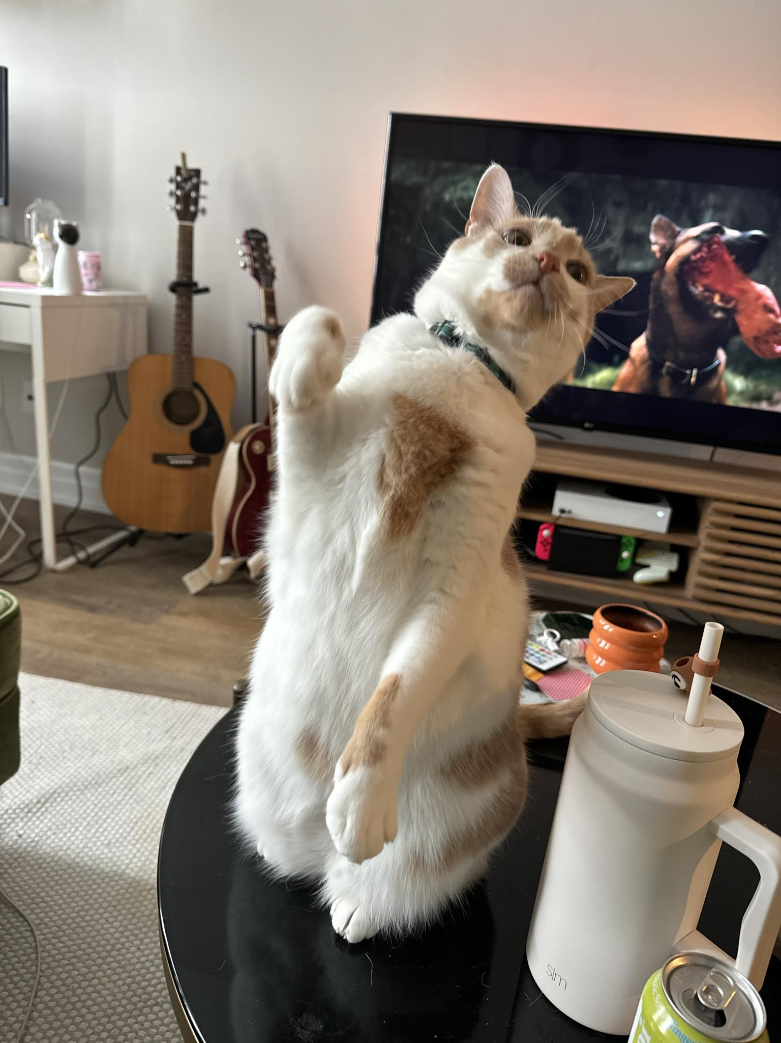


Thank you!
bwinokur@um.edu.mo | benwinokur.com
Feel free to contact me for a draft of my paper or a bibliography for this talk

Slide 18
Self-Knowledge Via Self-Understanding
Three sketches
Bottom up (e.g., Moran, Boyle)
Top-down (me)
Bidirectional (Davidson)

Slide 19
Self-Knowledge Via Self-Understanding
Three sketches
Bottom up (e.g., Moran, Boyle)
Top-down (me)
Bidirectional (Davidson)
“If my reflection (or deliberation) about X did not determine what it is that I believe about X, then why should I engage in such reflection? The purpose of rational thought is the acquisition of beliefs. It only makes sense to undertake such reflection or thought if this determines my beliefs...If the assumption is true, then I have the epistemic right to self-ascribe beliefs on the basis of my reflection about the world.”
(Fricke 2013: 5)

Slide 20
Self-Knowledge Via Self-Understanding
Three sketches
Bottom up (e.g., Moran, Boyle)
Top-down (me)
Bidirectional (Davidson)
We can reflectively consider whether an attitude is worthy of rational endorsement
In reflectively endorsing an attitude, one reflectively instantiates the very inferential dispositions that are constitutive of attitude endorsed
Reflective endorsement just is self-understanding
Self-understanding is both factive and extension-determining: it constitutes the attitude self-understood
(cf. Winokur 2023)

Slide 21
Self-Knowledge Via Self-Understanding
Three sketches
Bottom up (e.g., Moran, Boyle)
Top-down (me)
Bidirectional (Davidson)
“Knowledge of the propositional contents of our own minds is not possible without the other forms of knowledge since there is no propositional thought without communication…”
(Davidson 2001: 213-214)

