Slide 1
Evolution of EU Energy Law:
From Humble Beginnings to the REPowerEU Plan
Paulo Canelas de Castro
Jean Monnet Module – EU Environmental Law in Times of Transitions
Faculty of Law, University of Macau
pcanelas@umac.mo
Comparing Energy Transition in the European Union and China: Challenges and Opportunities
International Institute for Asian Studies & University of Amsterdam +
Institute of European Studies of Macau + Durham University
December 11, 2023

Slide 2
Outline
I. Historical Development of EU Energy Law
Origins of Energy Policy - the EU's Foundational Phase & afterwards
Contemporary EU Energy Law and Regulatory Landscape
II. General Overview of EU Energy Law and Policy Framework
Legal Basis
Main Objectives
EU Policy Framework & EU Legislative Framework
III. General Overview of EU Renewable Energy Law and Policy Framework
Key Facts
Timeline for Renewable Energy in the EU
Renewable Energy – Directive, Targets and Rules
V. Conclusions

Slide 3
I.1 Origins of Energy Policy in the EU's Foundational Phase
Post-World War II and the European Community:
The aftermath of World War II led to efforts to prevent future conflicts in Europe.
Robert Schuman's plan, focusing on coal and steel production, laid the foundation for political cooperation to avert wars and establish common supranational control, particularly in the Ruhr area​​.
Founding Treaties and Energy:
Two of the three original EU treaties specifically concerned energy:
Treaty establishing the European Coal and Steel Community (ECSC, 1951) and
the European Atomic Energy Treaty (Euratom, 1957).
Despite this, energy was considered too politically sensitive and closely tied to national sovereignty to be effectively regulated at the European level initially​​.
Energy Sector Exclusion from EU Integration:
energy : excluded from the process of European integration for a long time, protecting national energy monopolies from the effects of EU law.
Changes in the late 1980s, influenced by market liberalization in the US and UK, led to a gradual shift towards a market-oriented approach in the EU energy sector​​.
First Energy Package: Adopted in the 1990s, it was the initial step towards regulation but had limited ambition. It introduced key ideas like functional unbundling​​.
Evolution of the EU and Energy Law:
The evolution of the EU from its early days to a community of 28 (after 2020, 27) Member States indicates a shift from mere economic integration to encompassing broader areas like criminal law, social matters, and human rights.
The EU's continuous expansion and developments in law and policy have significantly impacted the substance and application of the EU's legal system, including energy law​​.
Transition to Regulated Competition:
Initially, the idea of opening national markets to competition was intended to increase efficiency and consumer benefits. However, in practice, EU energy markets have consistently seen increased regulation.
The term "regulated competition" more accurately describes the current state of EU energy markets, which have seen a continuous introduction of new regulatory instruments​​.
Public Control and Future/Present Directions:
The shift towards greater public control over competition is evident in decisions on licensing, new network infrastructure, and government intervention in energy markets through state subsidies.
Current regulatory frameworks focus on specific areas like renewable energy and energy security.

Slide 4
I.2 Contemporary EU Energy Law and Regulatory Landscape
Exclusion – sovereignty
In the 90s the EU gradually opened national markets to competition.
First Energy Package: Adopted in the 1990s, it was the initial step towards regulation but had limited ambition. It introduced key issues like functional unbundling​​.
3. (2000s - Present): Further Liberalization and Regulation
  Second Energy Package (2003): Aimed to create competitive gas and electricity markets with more detailed obligations for further liberalization.
  Third Energy Package (2009): Introduced extensive regulation, including internal market directives for electricity and gas, rules on ownership unbundling, new powers for national regulators, and the establishment of ACER (Agency for the Cooperation of Energy Regulators). More powers for the Commission-monitoring . Only the gas part of the third energy package rules is still in force.
  Fourth Energy Package (“Clean Energy for All European” Package, 2019): Intended to enable Europe to meet its energy and climate targets, includes eight different legislative proposals covering Energy Union governance, electricity market design, rules for the ACER and security of supply.
  Fifth Energy Pacakage (“Fit for 55” Package, 2021): Aimed to align the EU’s energy targets with the new European climate ambitions for 2030 and 2050.
  REPowerEU Plan (2022): States the EU’s intention to phase out its dependency on Russian fossil fuels; puts forward actions to save energy, diversify supplies, increase security of energy supply and replace fossil fuels by accelerating the roll-out of renewable energy.
  Environmental + Climate Regulation: Concurrent with market regulation, environmental + climate aspects of EU energy law and policy have become increasingly relevant.
  Ongoing/Future Developments: New regulations focusing on renewable energy and energy security.

Slide 5
I.2 Contemporary EU Energy Law and Regulatory Landscape
3. REPowerEU Plan:
The EU has adjusted its energy strategy with the introduction of the REPowerEU Plan. Following the outbreak of the Russia-Ukraine conflict in February 2022, the EU implemented a series of sanctions against Russia, striving to reduce its dependence on Russian energy imports as soon as possible. REPowerEU, built upon the "Fit for 55" framework, further refines actions on energy supply and storage security, proposing a set of new measures: energy conservation; diversification of energy imports; rapid substitution of fossil fuels through an accelerated transition to clean energy in Europe; and better integration of investment and reform.
Compared to the "Fit for 55" framework, REPowerEU sets new tasks and targets in many energy domains. The new tasks primarily include: firstly, a faster reduction in the EU's natural gas usage than envisaged in the "Fit for 55" framework; secondly, an accelerated transition to a more diversified fuel mix, particularly through increased use of renewable energy sources (including direct substitutes for natural gas, such as biomethane and hydrogen), as well as more extensive energy conservation than in the "Fit for 55" framework.
A comparison of the main energy targets between REPowerEU and the "Fit for 55" Package:
Energy Domain | REPowerEU Plan | “Fit for 55” Package
By 2030, the share of renewable energy generation | 45% | 40%
By 2030, the amount of energy savings achieved through increased efficiency (compared to the EU's 2020 reference scenario projections | 13% | 9%
By 2030, the development target for renewable hydrogen (including domestic production and imports, in thousand tonnes) | 2,000 | 67
Overall, the REPowerEU plan adjustments to energy policy targets are based on medium to long-term considerations, balancing the acceleration of the "de-Russification" of fossil fuel reliance with the assurance of effectively achieving the objectives of the EU Green Deal. This is distinct from the short-term emergency measures for energy supply currently in place in Europe. In other words, while the EU has not lost sight of its original commitment to climate and clean energy transformation, it confronts the energy security challenges posed by the full outbreak of the Russia-Ukraine conflict in the short term.

Slide 6
II. General Overview of EU Energy Law and Policy Framework
II.1 Legal Basis
  Article 194 of the Treaty on the Functioning of the European Union (TFEU):
  “1. In the context of the establishment and functioning of the internal market and with regard for the need to preserve and improve the environment, Union policy on energy shall aim, in a spirit of solidarity between Member States, to:
  (a) ensure the functioning of the energy market;
  (b) ensure security of energy supply in the Union;
  (c) promote energy efficiency and energy saving and the development of new and renewable forms of energy; and
  (d) promote the interconnection of energy networks.
  2. Without prejudice to the application of other provisions of the Treaties, the European Parliament and the Council, acting in accordance with the ordinary legislative procedure, shall establish the measures necessary to achieve the objectives in paragraph Such measures shall be adopted after consultation of the Economic and Social Committee and the Committee of the Regions.
  Such measures shall not affect a Member State's right to determine the conditions for exploiting its energy resources, its choice between different energy sources and the general structure of its energy supply, without prejudice to Article 192(2)(c).
  3. By way of derogation from paragraph 2, the Council, acting in accordance with a special legislative procedure, shall unanimously and after consulting the European Parliament, establish the measures referred to therein when they are primarily of a fiscal nature.”

Slide 7
II. General Overview of EU Energy Law and Policy Framework
II.1 Legal Basis
  Past: competences deriving from internal market & environment mandates
  Article 194 of the Treaty on the Functioning of the European Union (TFEU):
  Article 194 states that energy is a shared responsibility between EU Member States and the EU.
  However, each Member State has the right to decide the conditions for exploiting its own energy resources, choose between different energy sources and decide the general structure of its energy supply.
  It generally mandates that EU secondary law is adopted via the ordinary legislative procedure (co-decision).

Slide 8
II. General Overview of EU Energy Law and Policy Framework
II.2 Main Objectives (in Article 194 of the TFEU)
The EU’s energy policy aims to promote sustainable, secure and affordable energy, by:
  Ensuring the efficient operation of the energy market;
  Ensuring the security of supply of energy in the European Union;
  Promoting energy efficiency and energy savings, as well as the development of new and renewable energy sources;
  Promoting the interconnection of energy networks to ensure solidarity between Member States.

Slide 9
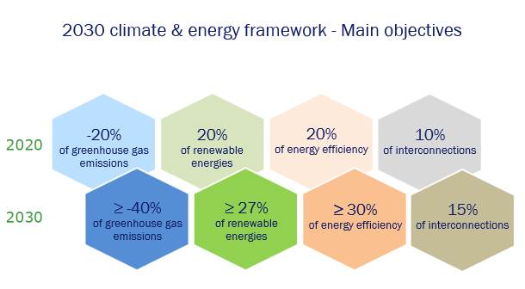
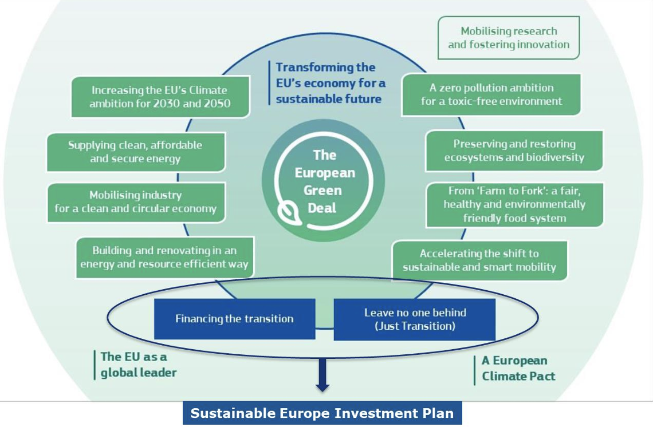
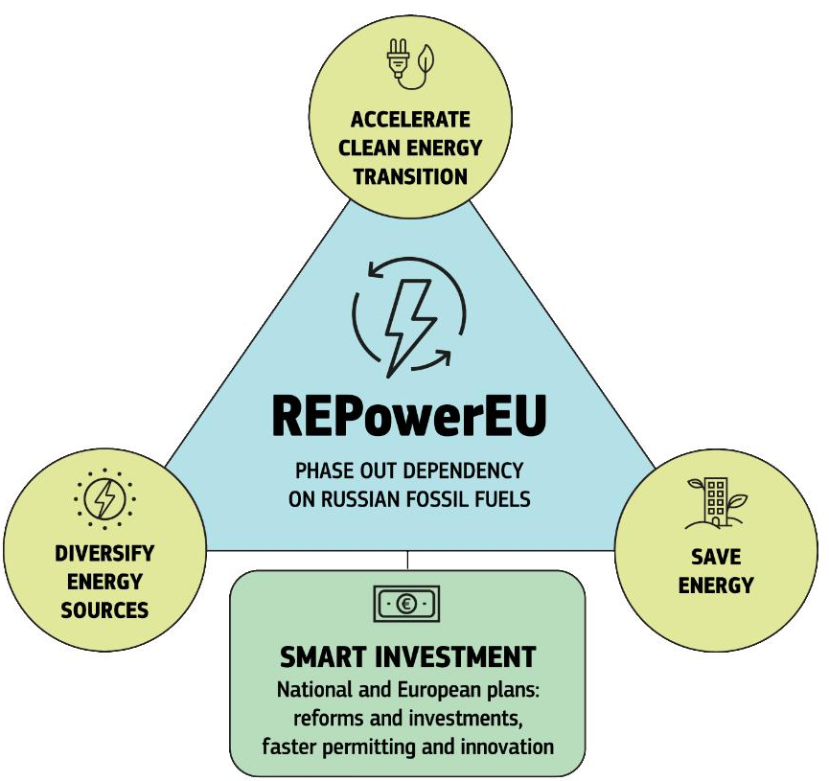
II. General Overview of EU Energy Law and Policy Framework
II.3
EU Policy Framework
EU Legislative Framework (Overview most important Regulations/Directives)

Slide 10
Policy Framework | 2030 Climate & Energy Framework (2014) This framework encompasses the European Union's forthcoming action plan and policy objectives for the period 2021 to 2030.
 | European Green Deal (2019) It represents one of the European Commission's primary tasks, aiming to achieve carbon neutrality in the European region and protect the natural ecosystem. To realize this goal, the European Commission has proposed a series of sustainable transformation measures.
 | European Climate Law (2021) It aims to make the EU's goal of becoming climate neutral by 2050 legally binding. It also sets an intermediate target of reducing net greenhouse gas emissions by at least 55% by 2030.
Legislative Framework (Main Regulations/Directives) | Regulation – Internal Market for Electricity | Regulation – Risk-Preparedness in the Electricity | Renewable Energy Directives | Directives – Energy Performance of Buildings
 | Regulation – Guidelines Electricity Transmission System Operation | Directives – Electricity Market | Directive – Agency for the Cooperation of Energy Regulator (ACER) | Directive – Alternative Fuels Infrastructure Directive
 | Regulation / Directives – Greenhouse Gas Emission Allowance Trading | Directives – Energy Efficiency | Directive – Energy Tax | Directive – Ecodesign
 | Regulation – Governance Energy Union and Climate Action | Regulation/Directive – Energy Efficiency Labelling | Directive – Industrial Emissions | Directive – Trans-European Energy Infrastructure
 | Regulation – Natural Gas Supply Security / Transmission Systems | Directive – Carbon Capture and Storage | Directive – Environmental Impact Assessment | Directive – Habitats and Birds Protection Directive
Plans | Ten-Year Network Development Plan (TYNDP, 2010) The European Network of Transmission System Operators for Gas (ENTSOG) publishes a non-binding TYNDP every two years. The TYNDP is a plan that provides an overview of the European gas infrastructure and its future developments.
 | REPowerEU (2022) It aims to rapidly decrease the EU's dependence on Russian fossil fuels and accelerate the green transition. It will assist the EU in conserving energy, generating clean energy, and diversifying its energy sources.

Slide 11
II. General Overview of EU Energy Law and Policy Framework
EU Policy Framework
  The EU Energy Legislative Framework is an integrated approach designed to create a unified internal energy market, encompassing specific sectors such as gas, electricity, energy efficiency, renewables, oil/hydrocarbons, nuclear energy, and trans-European networks.
  This comprehensive system aims to deliver high performance, cost-effectiveness, and sustainability across all energy domains.
  It also addresses external energy relations to diversify sources and enhance the EU's energy independence.
  Underpinning this is a robust energy security strategy, which includes contingency measures for supply disruptions and market stability.
  The framework is further strengthened by research and innovation support through programs like Horizon Europe and the Strategic Energy Technology Plan and financial support by EIB, aligning with the European Climate Law to meet ambitious climate and energy targets.
  Collectively, these components ensure a secure, competitive, and sustainable energy supply while fostering the transition towards a low-carbon economy within and beyond the EU's borders.

Slide 12
II. General Overview of EU Energy Law and Policy Framework
Energy Union
It is a political concept that aims to provide secure, sustainable, and affordable energy for the European Union and its citizens. The European Commission introduced the Energy Union strategy in 2015.
Based on three objectives: Security of supply; Sustainability; Competitiveness.
Five dimensions of the
Energy Union
Internal Energy Market
(A fully integrated European energy marker)
Energy Security
(Energy security, solidarity and trust)
Decarbonisation (Decarbonising the economy)
GHG Reduction
Energy Efficiency
(Energy efficiency and contributing to moderation of demand)
Research, Innovation and Competitiveness
Renewable Energy

Slide 13
II. General Overview of EU Energy Law and Policy Framework
EU Legislative Framework (Overview most important Regulations/Directives)
  It is covering key areas such as the internal market for electricity, risk preparedness, transmission system operations, and the governance of the Energy Union and climate action.
  It incorporates directives that address environmental concerns, stipulating standards for energy efficiency, natural gas supply security, and the framework for greenhouse gas emissions trading.
    Additional directives also focus on renewable energy, energy performance in buildings, and infrastructure for alternative fuels, underscoring the EU's commitment to sustainability and environmental protection.

Slide 14
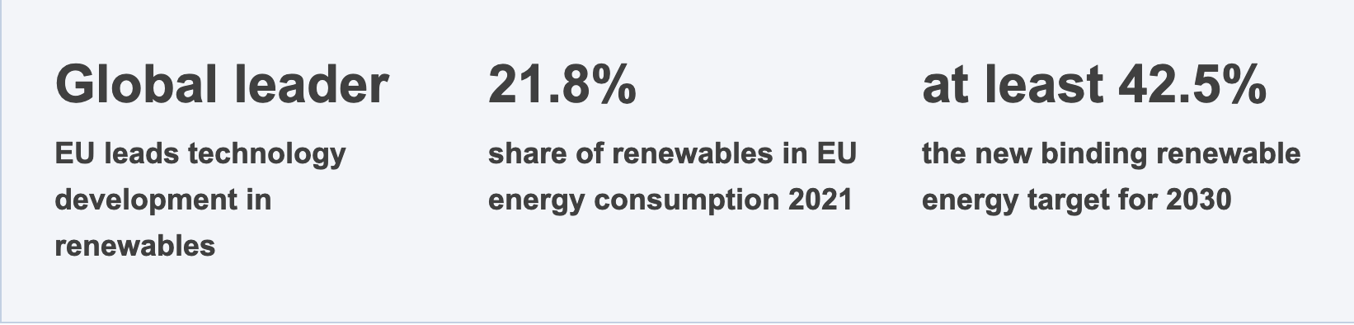
III. General Overview of EU Renewable Energy Law and Policy Framework
III.1
Renewable Energy Sources: Wind, solar, hydroelectric, ocean energy, geothermal, biomass, and biofuels as sustainable alternatives to fossil fuels, contributing to emission reduction and supply diversification.
Key Facts: The EU is already a global leader on renewables when it comes to technology development and deployment. However, its competitiveness on global renewable energy markets could be further strengthened. Under the European Green Deal, renewable energy is a pillar of the clean energy transition. It comes at a low cost and is home-grown, which reduces Europe’s dependency on external suppliers. This is why the EU’s level of ambition on increasing the share of renewables in its energy mix and the measures needed to achieve this are regularly revisited.

Slide 15
III. General Overview of EU Renewable Energy Law and Policy Framework
III.2
Timeline for Renewable Energy in the EU
1991
Germany introduces first feed-in-tariff for renewables
1997
Energy for the future: renewable sources of energy: indicative EU target of 12% renewables by 2010
2000
First large-scale offshore wind farm (Denmark)
2001
Directive on electricity production from renewables: national indicative targets
2003
Directive on biofuels and renewable fuels for transport: national tar­gets for biofuels
2008
Olmedilla Photovoltaic park (Spain) - largest power plant (60MW) in the world - generates enough to power 40 000 homes/year
2009
Renewable Energy Directive: EU target of 20% renewables by 2020 and national binding targets
2014
Onshore wind is cheap­er than coal, gas and nuclear energy
2018
Revised Renewable Energy Directive: 32% renewables target for 2030
2019
EU power production from wind and solar surpass coal for the first time
2021
Fit for 55: EC proposal to revise the directive and raise the target for 2030 to 40%
2022
REPowerEU Plan: new EC proposal to further raise the renewable energy target
20 November 2023
Revised Directive EU/2023/2413
entered into force

Slide 16
III. General Overview of EU Renewable Energy Law and Policy Framework
Legislative Milestones:
  Renewable Energy Directive (RED I): towards 2020
    Mandated a 20% share from renewable sources in EU energy consumption by 2020, with specific targets and mechanisms for member states​​.
    Revised Renewable Energy Directive (EU 2018/2001): Increased the binding target to 32% by 2030 and promoted further integration of renewable energy into various sectors​​.
  Renewable Energy Directive (RED II/III/IV): towards 2030
    In July 2021, as part of the ‘Fit for 55’ package, the Commission proposed an amendment (RED II) to the Renewable Energy Directive to align its renewable energy targets with its new climate ambition.
    In May 2022, as part of its REPowerEU plan, the Commission proposed a first amendment (RED III) to accelerate the clean energy transition in line with the phase-out of Russian fossil fuel dependence.
    On 9 November 2022, the Commission proposed a second amendment (RED IV) for a Council Regulation to accelerate the deployment of renewable energy.
    In March 2023, Parliament and the Council informally agreed to raise the 2030 renewable energy sources target to 42.5% by 2030, with Member States striving to achieve 45%.

Slide 17
III. General Overview of EU Renewable Energy Law and Policy Framework
III.3
Renewable Energy – Directive, Targets and Cooperation Mechanisms
  The Renewable Energy Directive establishes common rules and targets for the development of renewable energy across all sectors of the economy.
Renewable Energy Directive
  The Renewable Energy Directive is the legal framework for the development of clean energy across all sectors of the EU economy, supporting cooperation between EU countries towards this goal.
  Since the introduction of the Renewable Energy Directive (2009/28/EC), the share of renewable energy sources in EU energy consumption has increased from 12.5% in 2010 to 21.8% in 2021.
  Given the need to speed up the EU’s clean energy transition, the Renewable Energy Directive EU/2018/2001 was revised in 2023. The revised Directive EU/2023/2413 entered into force on 20 November 2023. There will be an 18-month period to transpose most of the directive's provisions into national law, with a shorter deadline of July 2024 for some provisions related to permitting for renewables. It sets an overall renewable energy target of at least 42.5% binding at EU level by 2030 - but aiming for 45%.
  New measures for further uptake of renewables: The revised directive builds on its 2009 and 2018 predecessors to implement stronger measures, ensuring comprehensive development and utilization of renewable energy, which is essential for meeting the EU's 2050 climate neutrality goal and bolstering energy security. It sets an ambitious new target to double renewable energy use and introduces specific goals across sectors, including heating, cooling, transport, and industry, while supporting the integration of electric vehicles and smart charging solutions. The directive incorporates principles from the energy system integration and hydrogen strategies to foster an efficient and renewable-powered system, setting binding targets for renewable fuels in sectors less suited to electrification. Streamlining permitting procedures and enhancing sustainability criteria for bioenergy, the directive accelerates renewable energy deployment and infrastructure development.

Slide 18
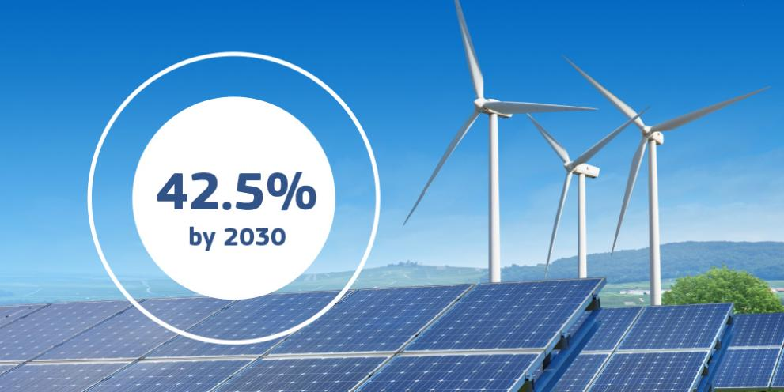
III. General Overview of EU Renewable Energy Law and Policy Framework
Renewable Energy – Directive, Targets and Cooperation Mechanisms
Renewable Energy Targets
  EU wants to accelerate the take-up of renewables to contribute and reach the goal of reducing net greenhouse gas emissions by at least 55% by 2030: the energy sector being a primary focus due to its high contribution to EU emissions.
  The recast Renewable Energy Directive 2018/2001/EU introduced a binding target of at least 32% renewable energy by 2030, which was later proposed to increase to 40% under the European Green Deal, and further to 45% as part of the REPowerEU plan.
  Comparison of The 2030 Target and The 2020 Target: While the 2020 target aimed for a 20% share of renewable energy, successfully overachieved at 22.1%, the revised target for 2030 aspires to nearly double this share to 42.5%, with an ambition to reach 45%, reflecting a significant escalation in the EU's renewable energy and climate goals.

Slide 19
III. General Overview of EU Renewable Energy Law and Policy Framework
Renewable Energy – Directive, Targets and Cooperation Mechanisms
Renewable Energy Cooperation Mechanisms
  Enabling EU countries to collaborate towards achieving their national renewable energy targets.
  Europe's internal energy market creates the opportunity for countries to work together to exploit these renewable resources and meet their national renewable energy targets.
  Three cooperation mechanisms set up under the Renewable Energy Directive (EC/2018/2001) support this collaboration:
    Statistical Transfers: This mechanism allows for the accounting of renewable energy amounts from one EU country to be attributed to another's progress toward their target without the physical exchange of energy, providing a financial incentive for countries to exceed their renewable goals and enabling others to meet targets cost-effectively.
    Joint Projects between EU countries or EU countries and non-EU countries: EU countries can collaborate on renewable energy projects, sharing the resulting energy to meet their respective targets. These projects may include cross-border energy transfer and can extend to joint ventures with non-EU countries, provided the energy contributes to the EU's consumption.
    Joint Support Schemes: EU countries can establish joint funding schemes to promote renewable energy production within their territories, utilizing common support measures like tariffs or trading regimes. Additionally, EU countries can open their national support schemes to producers in other member states, fostering broader cooperation in renewable energy production and support.

Slide 20
V. Conclusion
The progression of Europe towards a low-carbon society, transitioning from a fossil fuel-based economy, has been significant in recent years.
This shift is steadily bringing the European Commission's concept of an Energy Union closer to fruition. Policies that were once theoretical are increasingly being realized in tangible ways.
The adoption of new legislative measures and the introduction of various non-legislative initiatives are key steps in achieving the goal of securing clean energy across Europe.

