Slide 1
Bubbles and Solow Growth Model - II
Oct 2023

Slide 2

Now, we add bubbles (泡沫) to the model.
What are bubbles ?
It is something without intrinsic value.
People buy / own it just because they
expect to sell it in future to make profit.

Slide 3
In macro / growth literature, bubbles are usually modelled as an asset that stores values or acts as a saving vehicle, just like savings.
Savings (S) → Investment (I) → Capital stock (K) used in Y.
Unlike savings, bubbles (b) play no role in production.

Slide 4
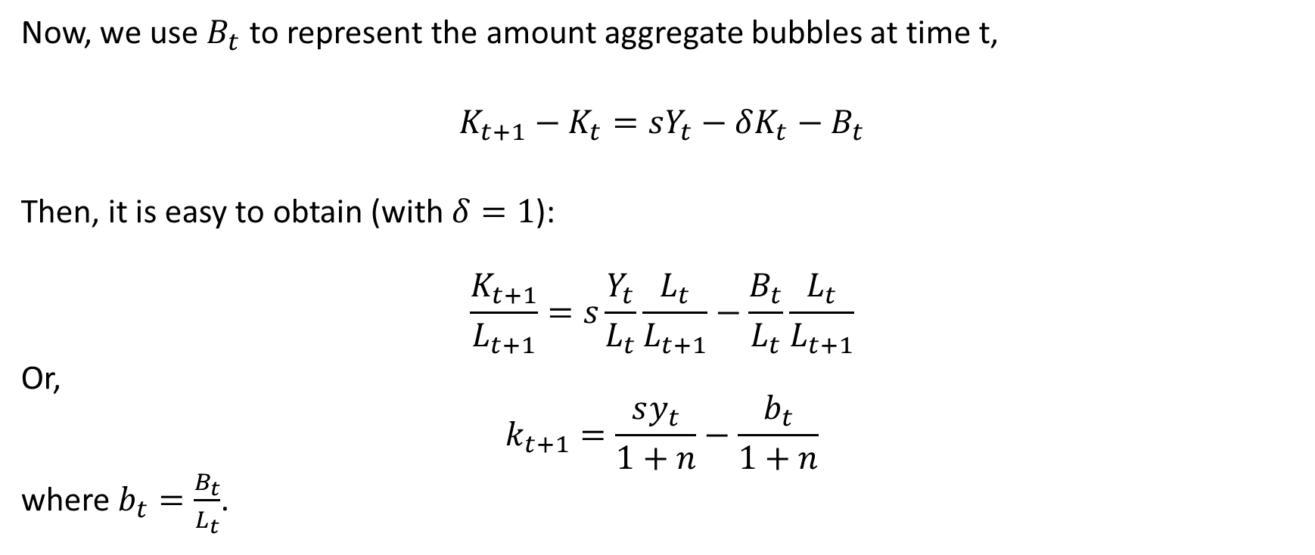
Now, we use $B_{t}$ to represent the amount aggregate bubbles at time t,
$K_{t+1}−K_{t}=sY_{t}−δK_{t}−B_{t}$
Then, it is easy to obtain (with $δ=1$):
$$\frac{K_{t+1}}{L_{t+1}}=s\frac{Y_{t}}{L_{t}}\frac{L_{t}}{L_{t+1}}−\frac{B_{t}}{L_{t}}\frac{L_{t}}{L_{t+1}}$$
Or,
$$k_{t+1}=\frac{sy_{t}}{1+n}−\frac{b_{t}}{1+n}$$
where $b_{t}=\frac{B_{t}}{L_{t}}$.

Slide 5
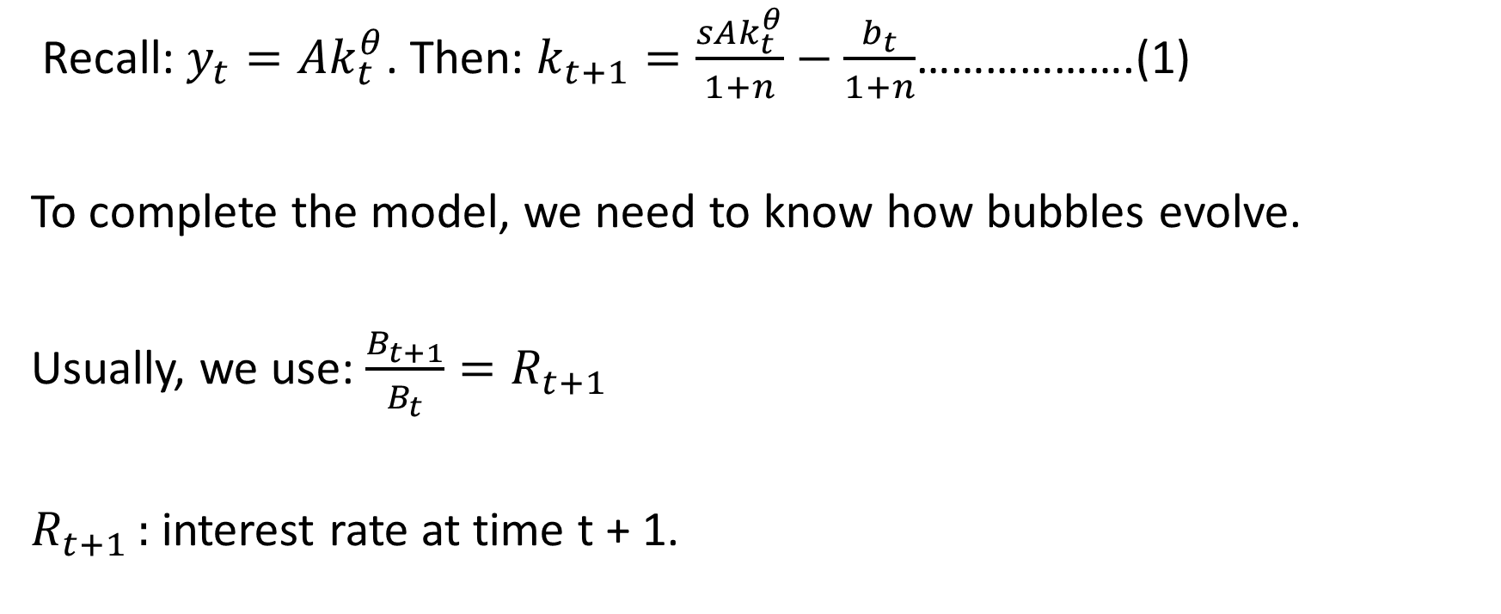
Recall: $y_{t}=Ak_{t}^{θ}$. Then: $k_{t+1}=\frac{sAk_{t}^{θ}}{1+n}−\frac{b_{t}}{1+n}$……………….(1)
To complete the model, we need to know how bubbles evolve.
Usually, we use: $\frac{B_{t+1}}{B_{t}}=R_{t+1}$
$R_{t+1 }:$interest rate at time t + 1.

Slide 6
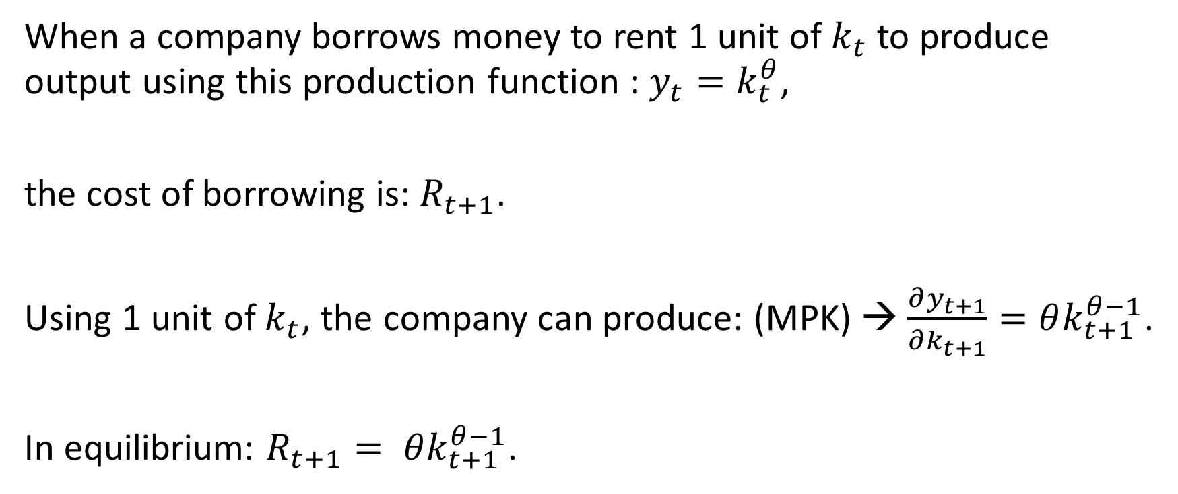
When a company borrows money to rent 1 unit of $k_{t}$ to produce output using this production function : $y_{t}=k_{t}^{θ}$,
the cost of borrowing is: $R_{t+1}$.
Using 1 unit of $k_{t}$, the company can produce: (MPK) → $\frac{∂y_{t+1}}{∂k_{t+1}}=θk_{t+1}^{θ−1}$.
In equilibrium: $R_{t+1}= θk_{t+1}^{θ−1}$.

Slide 7
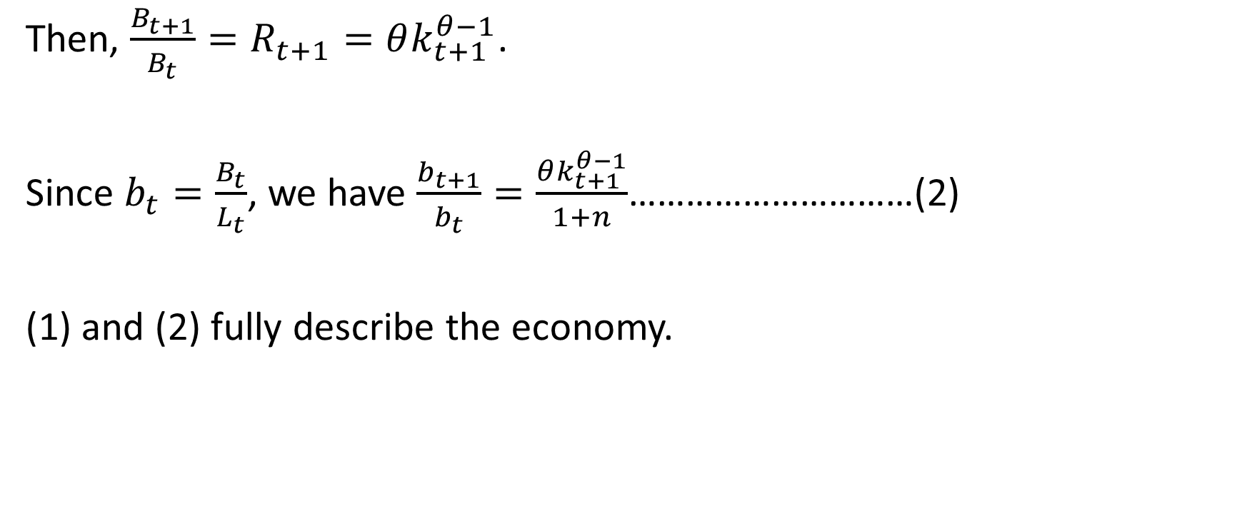
Then, $\frac{B_{t+1}}{B_{t}}=R_{t+1}=θk_{t+1}^{θ−1}$.
Since $b_{t}=\frac{B_{t}}{L_{t}}$, we have $\frac{b_{t+1}}{b_{t}}=\frac{θk_{t+1}^{θ−1}}{1+n}$…………………………(2)
(1) and (2) fully describe the economy.

Slide 8
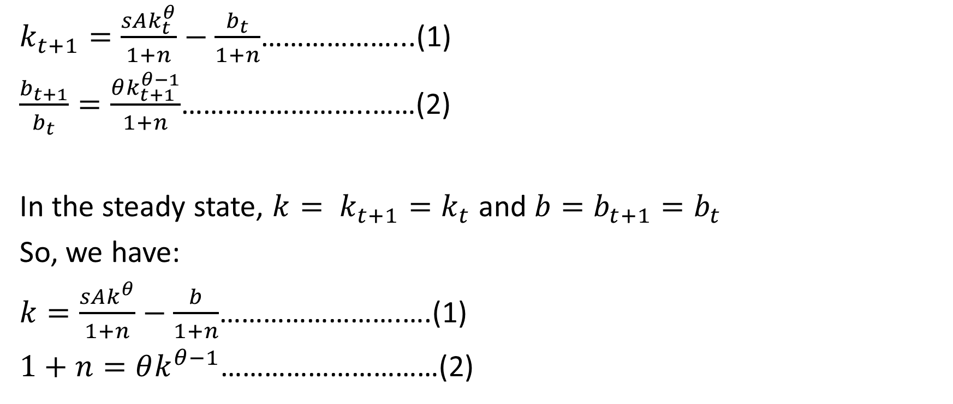
$k_{t+1}=\frac{sAk_{t}^{θ}}{1+n}−\frac{b_{t}}{1+n}$………………...(1)
$\frac{b_{t+1}}{b_{t}}=\frac{θk_{t+1}^{θ−1}}{1+n}$……………………..……(2)
In the steady state, $k= k_{t+1}=k_{t}$ and $b=b_{t+1}=b_{t}$
So, we have:
$k=\frac{sAk^{θ}}{1+n}−\frac{b}{1+n}$…………………….….(1)
$1+n=θk^{θ−1}$…………………………(2)

Slide 9

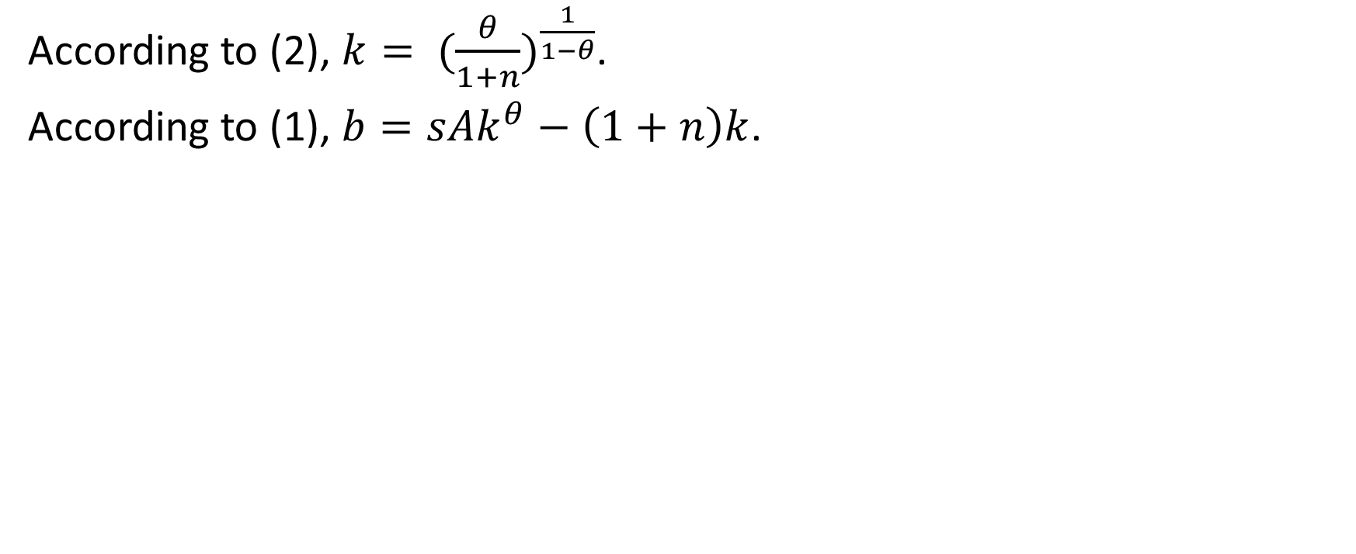
According to (2), $k= {(\frac{θ}{1+n})}^{\frac{1}{1−θ}}$.
According to (1), $b=sAk^{θ}−\left(1+n\right)k$.
b
Point E is not stable !
z
E
Where the economy will end up depending
on the initial situation.
x
k
$${(\frac{θ}{1+n})}^{\frac{1}{1−θ}}$$

Slide 10
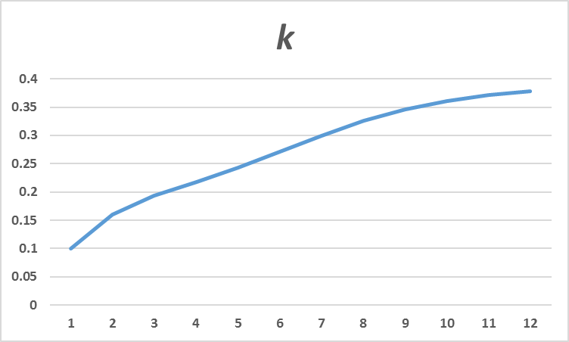
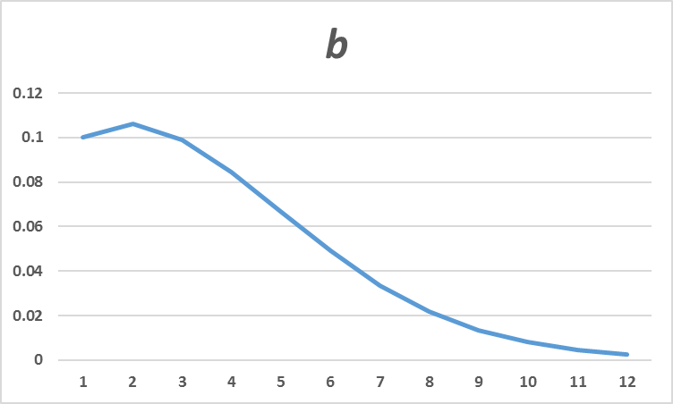

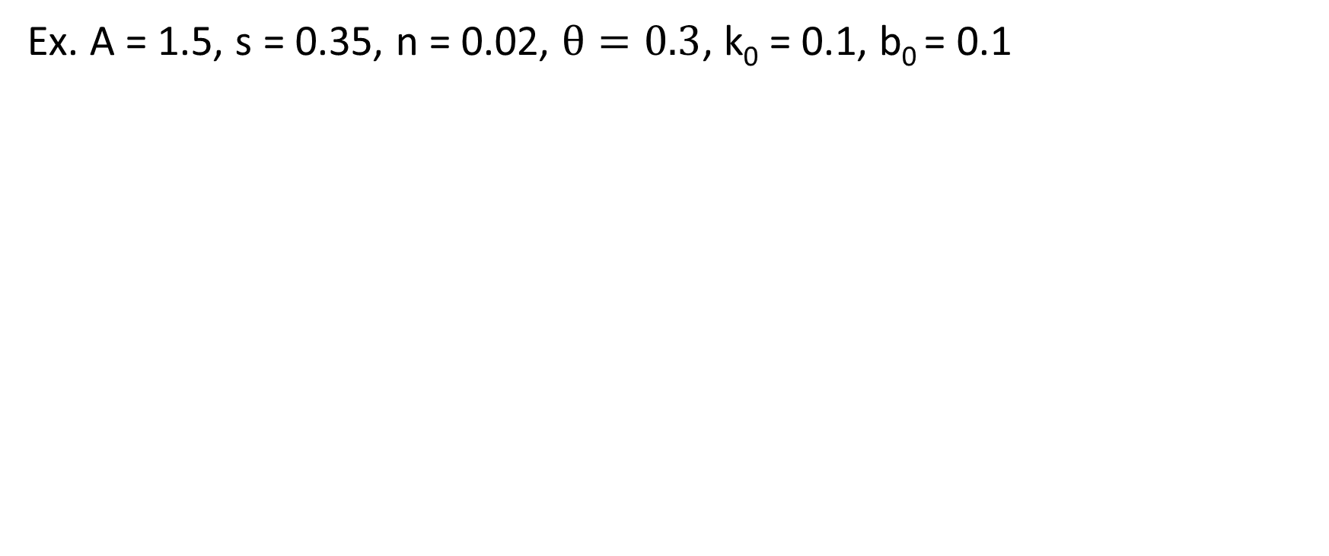
Ex. A = 1.5, s = 0.35, n = 0.02, $θ=0.3$, k₀ = 0.1, b₀ = 0.1
b
E
0.1741
k
$${(\frac{θ}{1+n})}^{\frac{1}{1−θ}} =0.1332$$

Slide 11
Note that at E (with bubbles), k* = 0.1741 and y* = 0.592.
But at E (without bubbles), k* = 0.3872 and y* = 0.75.
Therefore, bubbles have a negative effect on the economy’s living standard !

Slide 12
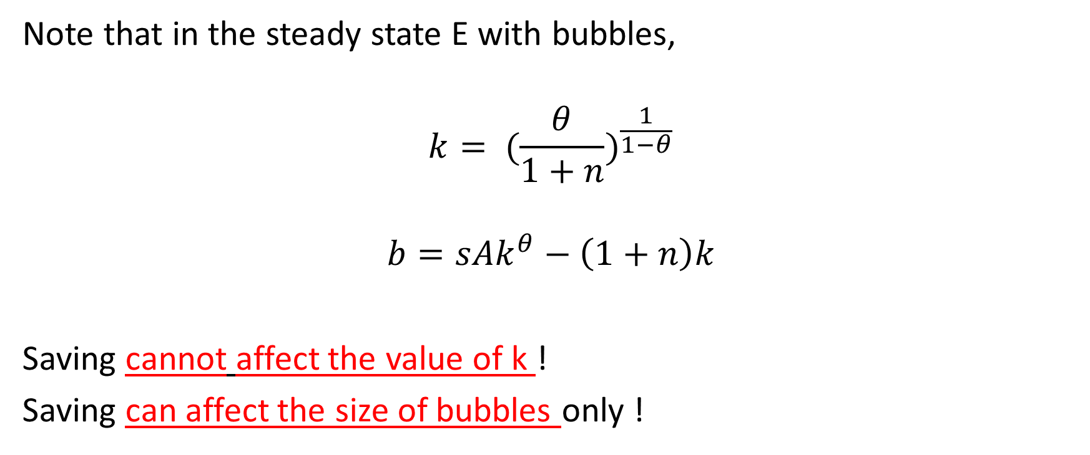
Note that in the steady state E with bubbles,
$$k= {(\frac{θ}{1+n})}^{\frac{1}{1−θ}}$$
$$b=sAk^{θ}−\left(1+n\right)k$$
Saving cannot affect the value of k !
Saving can affect the size of bubbles only !

Slide 13
Lesson:
The economy with bubbles and the one without bubbles have very different characteristics.
These differences have important policy implications !

Slide 14
Recent contributions
Are bubbles always damaging ?
Not necessary.
In Martin & Ventura (2012), they show that, if there exists two different type of investors (one productive and one un-productive) and credit market are imperfect, bubbles may become growth-enhancing.

Slide 15


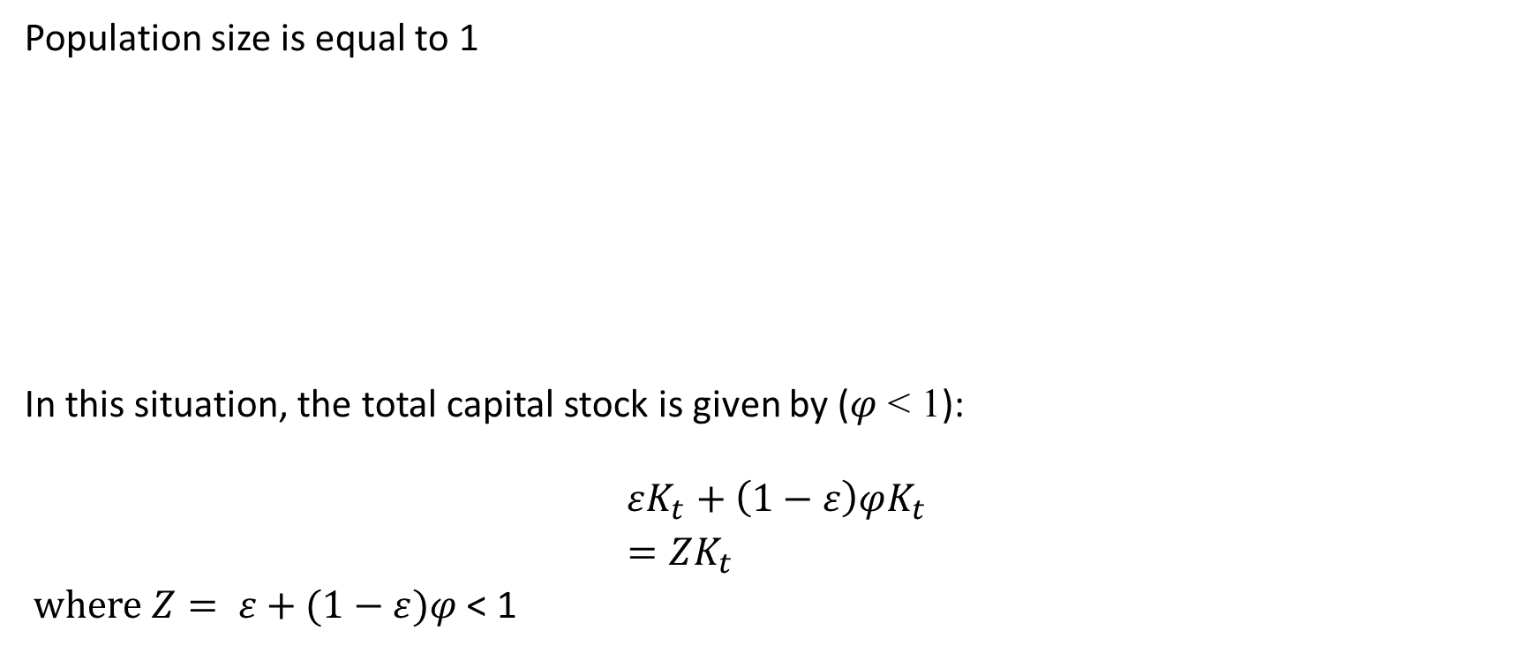
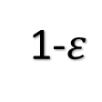

$$ε$$
Population size is equal to 1
In this situation, the total capital stock is given by ($φ$ < 1):
$$εK_{t}+\left(1−ε\right)φK_{t}$$
$=ZK_{t}$
$where Z= ε+(1−ε)φ$ < 1
1-$ε$
Un-
productive investors
1-ε
Productive investors ε

Slide 16

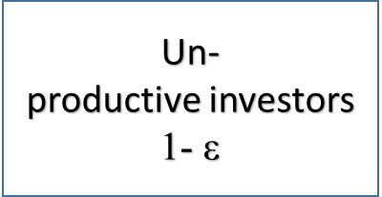
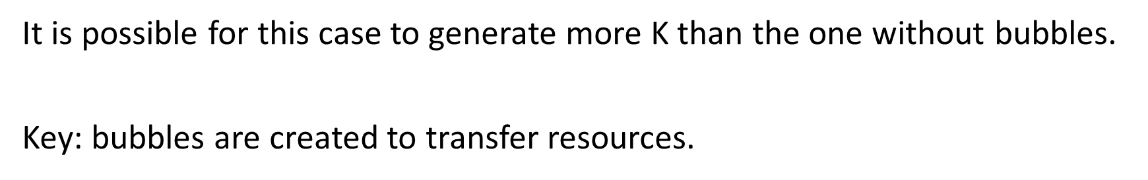
Sell bubbles
Use savings or income
to buy bubbles

Slide 17
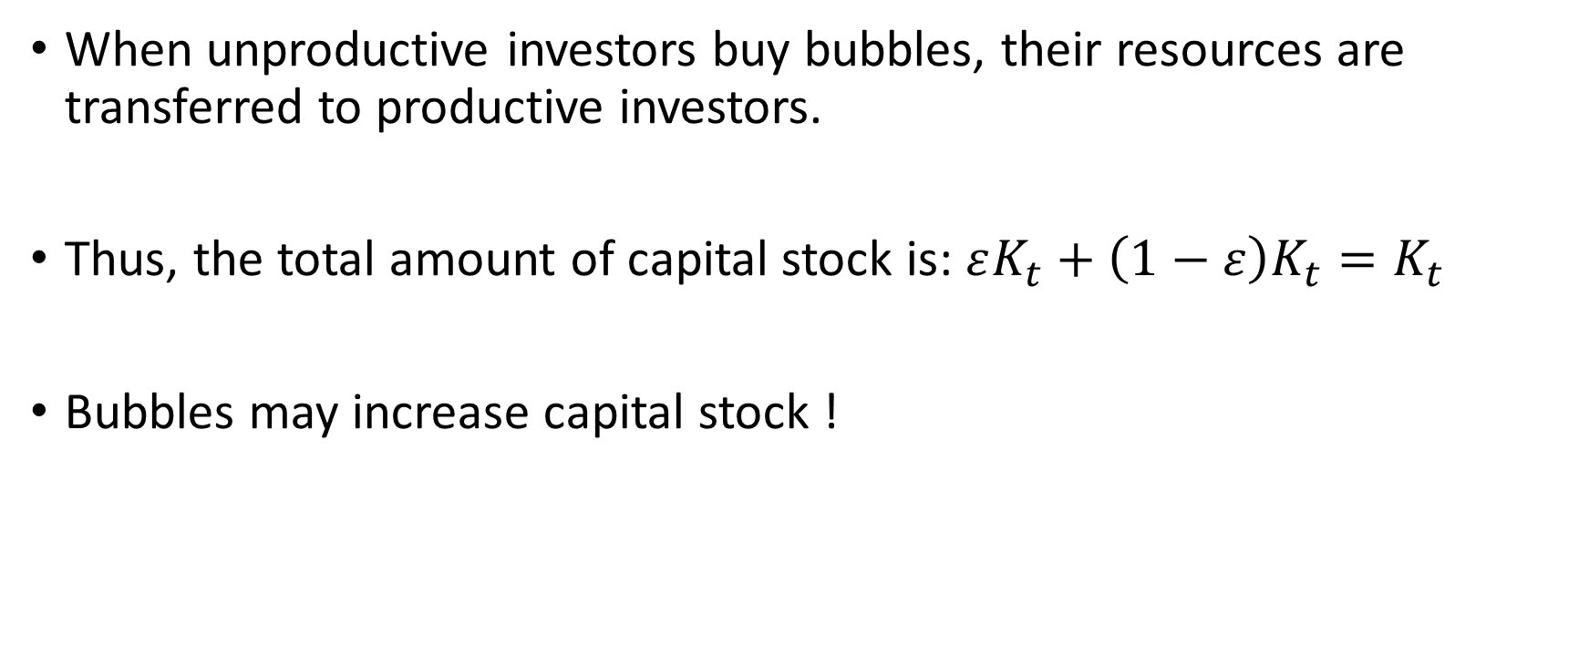
When unproductive investors buy bubbles, their resources are transferred to productive investors.
Thus, the total amount of capital stock is: $εK_{t}+\left(1−ε\right)K_{t}=K_{t}$
Bubbles may increase capital stock !

