Slide 1
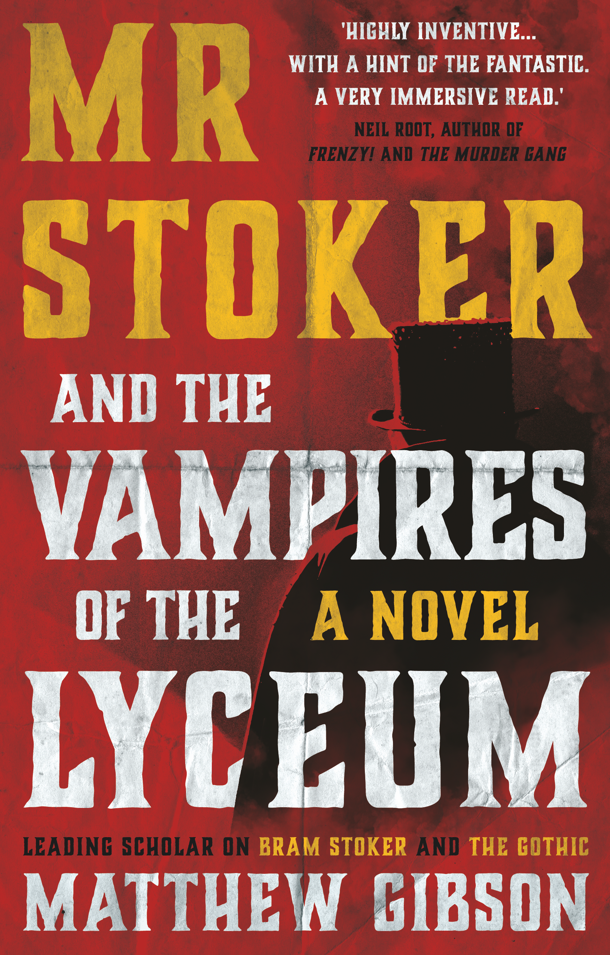

Slide 2
My path to Dracula
Following completion of my PhD, and publication of my first academic book, on poets Samuel Taylor Coleridge and William Butler Yeats, I turned my attention to another Irish writer, Bram Stoker.
After working in Poland as an academic, I moved to the American University in Bulgaria, teaching Bram Stoker’s masterpiece to Balkan students.
I decided to counter the idea that Dracula was a reaction to Ireland, and became more interested in seeing the work as a reaction to ‘the Eastern Question’.
Also became interested in earlier ‘Balkan’ vampire tale – Irish writer, J Sheridan Le Fanu’s, Carmilla (1871–72).

Slide 3
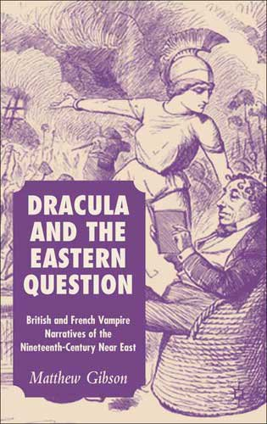
My second monograph
Dracula and the Eastern Question (2006)

Slide 4
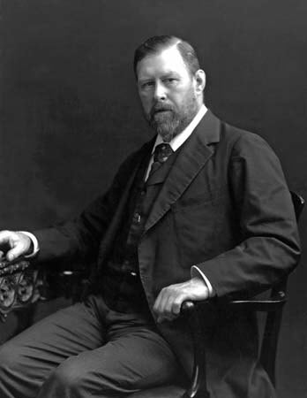
Abraham ‘Bram’ Stoker
(1847–1912)

Slide 5
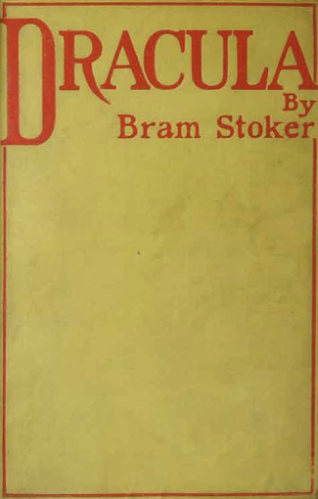
Bram Stoker and first edition of Dracula, 1897

Slide 6
Stoker’s path to Dracula
Stoker holidays in Whitby, August 1890. Reads about strange storms, and hears of the case of the shipwrecked Russian vessel, ‘Dimetry’ [Dmitry].
Reads William Wilkinson’s An Account of the Principalitites of Wallachia and Moldavia (1820) at Whitby.
Researches other sources in the London Library, including EC Johnson On the Track of the Crescent (1885), and Emily Gerard, ‘Transylvanian Superstitions’, in The Nineteenth Century (1885).
Interest in earlier vampire tales; notably, Le Fanu’s Carmilla (1871–72).

Slide 7
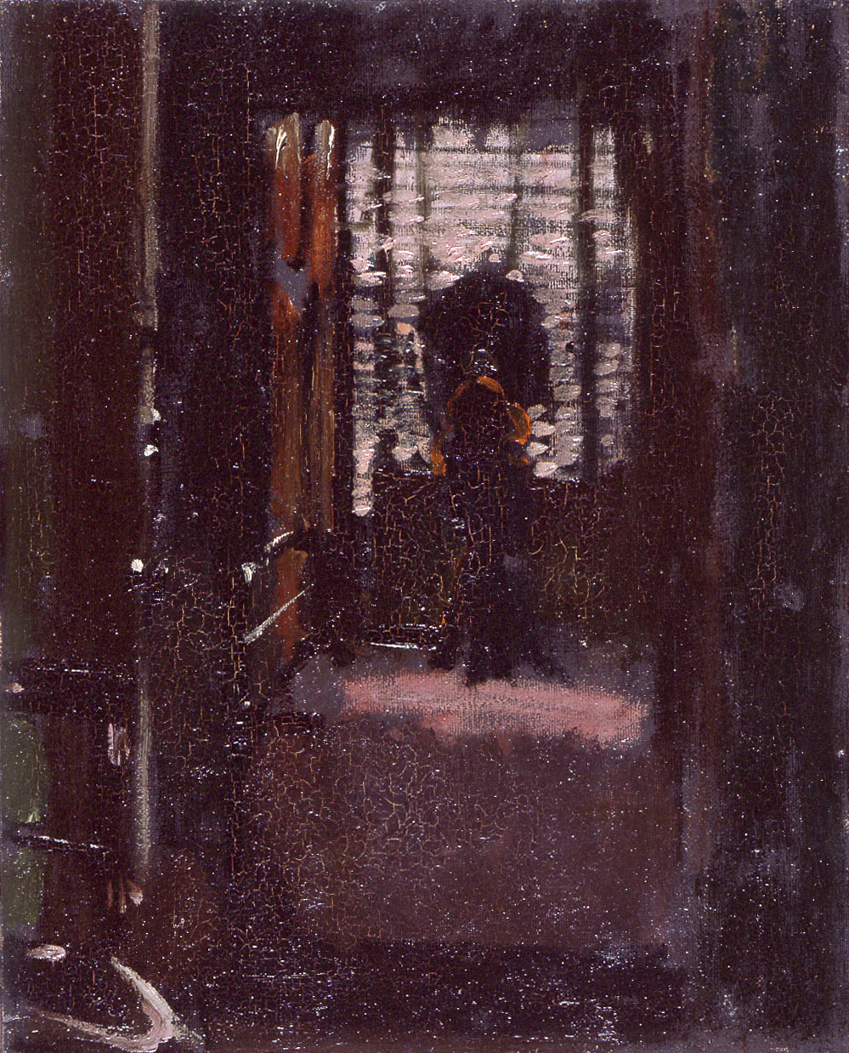
Walter Sickert
(1860–1942)
Jack the Ripper’s Bedroom (1907)
Painter Walter Sickert was originally an actor in Henry Irving’s company, as were Edward Craig, and his older sister Edith, some years later

Slide 8
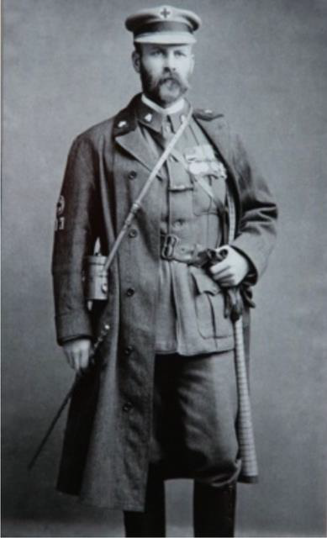
Dr George Stoker
(1854–1920)
Younger brother of Bram Stoker
Author of With ‘the Unspeakables’ (1878)
Founder of the Oxygen Hospital, Fitzrovia

Slide 9
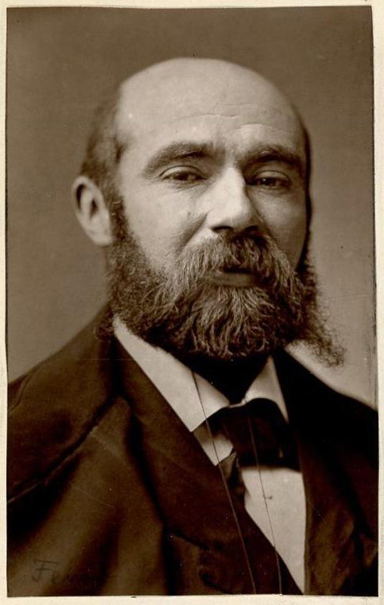
Paul Féval, père
French novelist, author of La Vampire (1856; 1865)
Le Chevalier Ténèbre (1860)
La Ville Vampire (1874)
Vampire stories which combine the Fantastique with real history
Some might say, the first ‘mash-up’ novel!

Slide 10
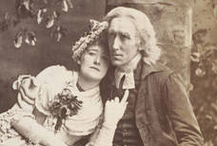
Ellen Terry and Henry Irving in The Vicar of Wakefield ingcostumefor “The Bells”

