Slide 1

Enregistering translanguaging as a named language: Kongish in Kongish Daily
Jun-Jie, Ma and Brian, Hok-Shing, Chan (Department of English, FAH, University of Macau)

Slide 2
Background of Kongish research: translanguaging lens
Kongish is a hybrid language that has gained popularity on Facebook.
Kongish is an ‘identity project’ of Hongkongers as a whole despite the fact that its online dissemination is not exclusively tied to a definite place or identity (e.g. late modernity) (Sewell & Chan, 2017).
Existing studies highlight the translanguaging (Cantonese, English, image) character of Kongish that cannot be pinned down as a (bounded) language or variety (Li et al., 2020).

Slide 3
Background of Kongish research: translanguaging lens
Kongish is perceived as witty (e.g. translingual and multimodal playful choreographies and satirical comments on topical social events) (T. Lee, 2023).
Other studies suggest that Kongish conveys a strong sense of local (Hongkonger) identity and political resistance (C. Lee, 2023; Jones & Chau, 2022).
We aim to explore the meaning-making processes of underlying the ludicity and resistance Kongish.

Slide 4
Research gap
While translanguaging is creative and critical, it is not necessarily ludic or recalcitrant. It was originally intended to support language learning (a means of crossing language boundaries) (Li, 2018).
Overemphasizing translanguaging obscures other meaning-making processes of Kongish.
The name - ‘Kong + ish’ – suggests that it is a/the language of HK or Hongkongers. (Existing studies all deny that it is a variety of English – Li et al., 2020; Sewell and Chan, 2017)

Slide 5
Research gap
Comprehending Kongish requires understanding the author’s presuppositions and stances as well as other non-Kongish parts of the online post (including Chinese, images).
We focus on the enregisterment of Kongish, especially how Kongish is associated to ludicity, political resistance, and the voice of Hongkongers.

Slide 6

1. Extextualization
The Kongish comment (Post 2) is simply a metadiscourse (Text 3) commenting on an embedded post (Post 1).
Text 3’s translation: Your friend big brother Jackie Chan didn’t say that! He said things made in China will bomb.
The meaning relationship between Kongish comments and embedded post plays a key role in the meaning-making of the post. The original post is about the news that Eric Tsang was presented with a new BYD electric car, and he praised it for being easy to drive (Text 1), whereas the Kongish comment (Text 3) quotes his friend Jackie Chan who said in public (Boao Forum in Asia 2009) to ridicule Tsang: “Electric products made in China are easy to explode”.

Slide 7
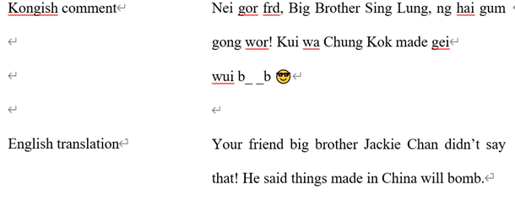
Translanguaging does contribute to the jocosity.
(1) Romanized Cantonese and abbreviations: Nei gor frd = your friend
(2) Romanized Cantonese as obfuscation: Chung Kok (China), Sing Lung (Jackie Chan);
(3) Emoticons of seeming disapproval :(b_ _b = bomb)
What about resistance?
Commenting on forwarded posts in enregistering Kongish: it is an entextualization process that changes the meaning of the original post (Bauman & Briggs, 1990). It describes how semiotic resources are extracted and attitudes are imposed to form new meanings in the original contexts.

Slide 8
The original post is propaganda for BYD, while Kongish turns the new post into an anti-propaganda for the ‘made in China’ brand.
Political resistance (and humour): readers need to see the mocked BYD as a showcase of China’s technological prowess; Tsang and Jackie Chan are seen as pro-China celebrities. Even so, Jackie Chan is quoted to be dismissive of China’s electric products. In any case, Jackie Chan’s words contribute to humour and resistance (to pro-China propaganda).

Slide 9
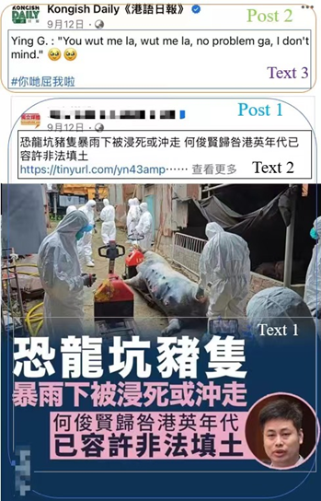
2. Stance-making
Kongish posts take stances that consistently generate resistance by expressing disapproval of government public figures. By stance: the positioning and assessment of the Kongish writer in relation to event participants and local Hongkongers (i.e., target readers) (Du Bois, 2007).
The embedded post: the drowning of many pigs in a ditch in Hung Lung Hang during torrential rainstorms, thus causing property loss. The current Legislative Councillor Mr. Ho attributed this to the flooding caused by illegal landfilling allowed during the colonial era of British HK.
Kongish’s translation: The UK says: ‘You wrong me. Wrong me, and there’s no problem with that, since I don’t mind.

Slide 10
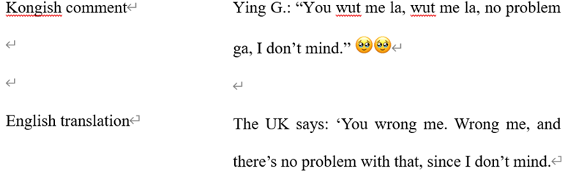
Translanguaging does contribute to the ludicity:
(1) Romanized Cantonese and abbreviations: ‘Ying G.’ (United Kingdom), ‘G.’ (Gwok, Nation); You wut me la (You wrong me)
(2) Cantonese particles ‘ga’, ‘la’
(3) Emoticons: sadness with added frolic

Slide 11
Political resistance can only be inferred in the proper context: Ho is seen as a pro-establishment figure. Instead of reviewing the inadequacy of the government’s measures, he criticized the colonial government which was no longer in power.
Kongish had the hilarious effect in representing the voice of the UK.
Aligning with the Hongkongers and the former colonizers conveys political resistance. By defending the ex-colonizers, Kongish gives a strong voice to resist Ho and the government (Agha, 2005).

Slide 12
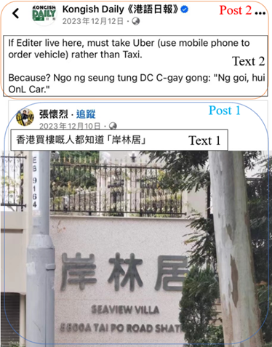
3. Taboo creation and breaking
This example does not ridicule or comment on social events or people, but it conveys ludicity and resistance by breaking taboos of sex and taboos publicly on the Internet.
Kongish translation: If I (‘Editor’) live here, I must take Uber (which I order by phone) rather than taxi. Why? I don’t want to tell the taxi driver: “Go to On Lam Kui, please.”
Post 1 – Kongish comment means ‘HK’s property owners all know the place’: a mockery of the name of the residence, because ‘岸林居’ [ɔn lɐm gœ] close to the expletive ‘憨撚居’ [ɔŋ lɐn gœ] (‘fucking stupid’).
Kongish (Text 2): The writer said that if he lived here, he would prefer to use Uber rather than taxis. The reason: the taxi driver may mistake the name as swearing. But you only type the address on the Uber app.

Slide 13
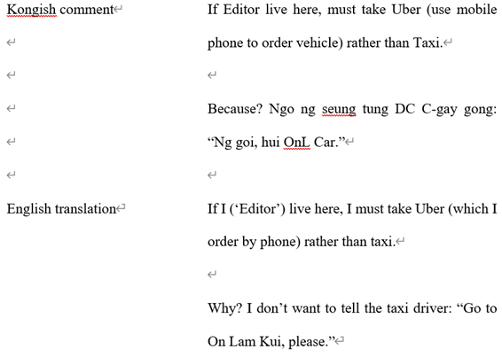
mainly Romanised Cantonese words:
(1) Cantonese ‘的士’ [dIk si] (‘taxi’) as ‘DC’ [di si] (the acronym activate the meaning ‘Washington DC’)
(2) Cantonese ‘司機’ [si geI] (‘driver’) as ‘C-gay’ (‘homosexual’ may be retrieved)
(3) The swearing ‘憨撚居’ [ɔŋ lɐn gœ] (‘fucking stupid’) as ‘OnL Car’ (euphemism of the expletive ‘撚’ and the transliteration of the Cantonese word ‘車’ [gœ] ‘car’)
The translanguaging here (non-standard English, romanised Cantonese and a few translingualisms) adds fun of reading the post.
However, the humour mainly stems from the name of the residence (homophonic with the profane form of Cantonese word ‘stupid’).

Slide 14
A clear person/party to ridicule is lacking – is the post still politically resistant? Despite the indirect reference to expletive by the Kongish writers, the act of deliberately alluding obscene language (e.g. expletive) and content (sexual, excremental) on public social media is itself an act of resistance. It “creates” and breaks taboos, and challenges community norms about taboos.
In this process, Kongish writers empower am imagined community (i.e. Hongkongers) with which they identify (fantasising a utopia - in which people have equal rights and power - to resist hegemony) (Bakhtin, 1984).

Slide 15
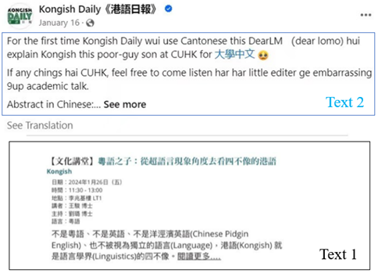
4. Languagizing Kongish
Posts about academic lectures on Kongish. The writer may comment on these events but there is no embedded post.
The Kongish translation:
For the first time, Kongish Daily will explain Kongish – the son of a bitch – in Cantonese, his dear mother, at the Chinese University of Hong Kong (CUHK) for the course University Chinese.
If there are any brothers at CUHK, feel free to come and listen to the little editor’s embarrassing and fucking nonsense academic talk.
Text 1 translation: A look at Kongish – which is unlike four other (languages) – in the translanguaging lens

Slide 16
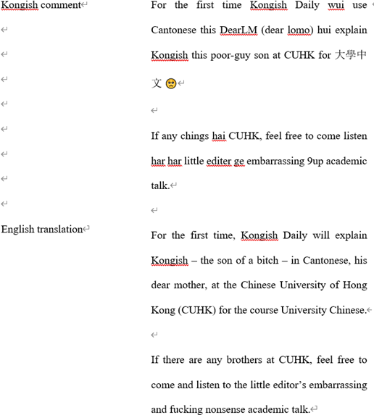
The Kongish comment introduces readers to the ‘University Chinese’ (a course about talking Kongish) at CUHK and invites people around campus to attend the talk.
The main attention-getters are still translingualisms:
(1) Kongish as ‘Dear LM’ (Dear lomo) (lomo 老母): ‘dear mum’ and Cantonese expletive [diu (neI) lou mou] ‘fuck (you) mum’) (the paradoxical relation of Kongish with Cantonese)
(2) Kongish as ‘poor-guy’ son (‘son of a bitch’) (a similarly pronounced Cantonese curse word ‘扑街’ [pok gaI] ‘stumbling on the street’)
(3) 9up is a transliteration of Cantonese ‘鳩噏’ [gɐu ɐp] (‘fucking bollocks’)
(4) internet slang ‘ching’ (‘bros’, from Cantonese ‘師兄’ [si hiŋ], ‘elder brother ‘)
(5) Reduplication of the Cantonese word ‘har har’ located after the verb ‘listen’ (the author’s stuttering due to trembling during his speech)
(6) Aberrant spelling of ‘editor’ (i.e. ‘editer’) is likely an intentional deviation from English norms

Slide 17
Translanguaging makes reading Kongish visually and linguistically amusing, and using Cantonese swearing expressions is playful in taboo-breaking; self-mockery is not only humorous, but also expresses humility (Bi & Ren, 2023).
Its resistance: self-mockery is for attention. Research on Kongish and its dissemination in the digital media confirms all efforts to elevate it to a named language status. While not ridiculing any person, the author wants to subvert the perception that Kongish is not an independent language.
We use ‘languagizing’ to describe the process of turning a register into a named language (i.e. promoting Kongish in social media and academia).

Slide 18
Discussion and conclusion
The ludicity and recalcitrance of Kongish is reduplicatively enregistered through entextualizing primitive events, shaping oppositional stance to the pro-establishment figures, transgressing taboos, and languagizing it.
Kongish is not translanguaging in the original sense, and it does not facilitate smooth communication. On the other hand, it creates ‘a space that excludes outsiders’ through obfuscation.
Its ludicity: incomprehensible Romanized Cantonese, non-standard English, and transliterations. To fully understand the humour, readers needs to know Cantonese, English, and have contextual knowledge of the events.
It is an online discourse produced by its creators to empower Hongkongers (politically): Kongish demonstrates an oppositional stance (disdain for institutional authority) and a transgression of taboos, which can be seen as an empowering act for Hongkongers to make their voices heard.

Slide 19
Discussion and conclusion
It is a natural response of some Hongkongers seeking autonomy after entering the post-colonial era. At a time when the local media was tightly controlled, Kongish offers soft resistance to politics and norms in the digital media.
Kongish illustrates linguistic citizenship (Stroud, 2015) as it is enregistered as a ‘stylized and exclusive discourse for Hongkongers’. Moreover, its main purpose is to foster HK users’ shared identity in the imagined community. The effort to languagize it is to confer a local and unique identity on Hongkongers.
Therefore, the enregisterment of Kongish should be regarded as a translanguaging practice that has undergone sedimentation (Pennycook, 2004). It confuses the English and Cantonese repertoires to express independent voices in a playful manner, and in so doing Kongish is enregistered as a named language standing for Hongkongers.

Slide 20
Discussion and conclusion
Kongish is not the language most Hongkongers use daily, and the fetishization of Kongish may further catalyze its use as an ‘elitist discourse that is difficult to master’.

Slide 21
References
Agha, A. (2005). Voice, Footing, Enregisterment. Journal of Linguistic Anthropology, 15(1), 38-59.
Agha, A. (2007). Language and social relations. Cambridge: Cambridge University Press.
Bakhtin, M. (1984). Rabelais and his world. Bloomington: Indiana University Press.
Bi, X. Y., & Ren. W. (2023). Metapragmatic comments deconstructing the concept of selfmockery in Chinese on social media. Language and Communication, 23, 91-104.
Du Bois, J. (2007). The stance triangle. In R. Englebretson (Ed.), Stancetaking in discourse: Subjectivity, evaluation, interaction (pp. 139-182). Amsterdam: John Benjamins.
Jones, R., & Chau, D. (2022). Metalinguistic tactics in the Hong Kong protest movement. Journal of Language and Politics, 21(1), 143-172.
Li, W. (2018). Translanguaging as a practical theory of language. Applied Linguistics, 39(1), 9-30.
Li, W., Tsang, A., Wong, N., & Lok, P. (2020). Kongish Daily: Researching translanguaging creativity and subversiveness. International Journal of Multilingualism, 17(3), 309-335.
Lee, T. K. (2023). Kongish: Translanguaging and the commodification of an urban dialect. Cambridge: Cambridge University Press.

Slide 22
References
Lee, C. (2023). English is our 2nd language, Konglish is our mother tongue’: Recolonizing English through translingual activism in a social movement. Applied Linguistics, 44(5), 900-915.
Pennycook, A. (2004). Performativity and language studies. Critical Inquiry in Language Studies: An International Journal, 1(1), 1-19.
Sewell, A., & Chan, J. (2017). Hong Kong English, but not as we know it: Kongish and language in late modernity. International Journal of Applied Linguistics, 27(3), 596-607.
Stroud, C. (2015). Linguistic citizenship as utopia. Multilingual Margins, 2(2), 20-37.

Slide 23

Thank You!
Contact:
Jun-Jie Ma (yc37718@um.edu.mo)
Brian Hok-Shing Chan (bhschan@um.edu.mo)

