Slide 1
Understand mechanistic reasoning from a complex system perspective
Xiaowei Tang

Slide 2
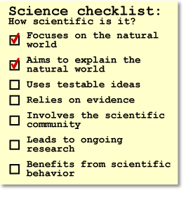
Science as a collective institution aims to produce more and more accurate natural explanations of how the natural world works, what its components are, and how the world got to be the way it is now.

Slide 3
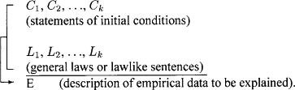
Different understandings of explanation
The deductive–nomological (D–N) / “Covering Law” Model （Hempel and Oppenheim，1948）
Deductive arguments explaining events as natural, logical results of regularities expressed by laws.
Graphite allows free electrons to move about through the ϖ bonds
Material that allows the flow of charged particles to move in one or more directions can conduct electricity
Graphite can conduct electricity
Notes:
Mendel noticed the pattern that parental characters will be expressed in the F2 generation in the ratio 3:1 and came up with an explanation based on alleles. And aligning with the evolutionary mechanism on the origin of species, we would expect specific patterns in fossils that involve transition species.
Hume
There is nothing in the cause that will ever imply the effect in an experiential vacuum； Hume does not hold that, having never seen a game of billiards before, we cannot know what the effect of the collision will be. Rather, we can use resemblance, for instance, to infer an analogous case from our past experiences of transferred momentum, deflection, and so forth. We are still relying on previous impressions to predict the effect and therefore do not violate the Copy Principle. As we experience enough cases of a particular constant conjunction, our minds begin to pass a natural determination from cause to effect, adding a little more “oomph” to the prediction of the effect every time, a growing certitude that the effect will follow again. It is the internal impression of this “oomph” that gives rise to our idea of necessity, the mere feeling of certainty that the conjunction will stay constant.
(D1) An object precedent and contiguous to another, and where all the objects resembling the former are placed in like relations of precedency and contiguity to those objects that resemble the latter.
(D2) An object precedent and contiguous to another, and so united with it, that the idea of the one determined the mind to form the idea of the other, and the impression of the one to form a more lively idea of the other. (T 1.3.14.31; SBN 170)

Slide 4
Different understandings of explanation
The deductive–nomological (D–N) / “Covering Law” Model （Hempel and Oppenheim，1948）
Deductive arguments explaining events as natural, logical results of regularities expressed by laws.
The problem of limitedness
very few “covering laws” exist (e.g., heat expansion; animals are heterotrophic)
The problem of symmetry
C1: elevation of the sun in the sky; C2: length of the flagpole shadow of l’
L1: tanα=l/l’
E: length of the flagpole l (does l’ explain l?)
Notes:
Mendel noticed the pattern that parental characters will be expressed in the F2 generation in the ratio 3:1 and came up with an explanation based on alleles. And aligning with the evolutionary mechanism on the origin of species, we would expect specific patterns in fossils that involve transition species.
Hume
There is nothing in the cause that will ever imply the effect in an experiential vacuum； Hume does not hold that, having never seen a game of billiards before, we cannot know what the effect of the collision will be. Rather, we can use resemblance, for instance, to infer an analogous case from our past experiences of transferred momentum, deflection, and so forth. We are still relying on previous impressions to predict the effect and therefore do not violate the Copy Principle. As we experience enough cases of a particular constant conjunction, our minds begin to pass a natural determination from cause to effect, adding a little more “oomph” to the prediction of the effect every time, a growing certitude that the effect will follow again. It is the internal impression of this “oomph” that gives rise to our idea of necessity, the mere feeling of certainty that the conjunction will stay constant.
(D1) An object precedent and contiguous to another, and where all the objects resembling the former are placed in like relations of precedency and contiguity to those objects that resemble the latter.
(D2) An object precedent and contiguous to another, and so united with it, that the idea of the one determined the mind to form the idea of the other, and the impression of the one to form a more lively idea of the other. (T 1.3.14.31; SBN 170)

Slide 5
Different understandings of explanation
Statistical-probabilistic model (Hempel, 1965)
Coherent induction from a trend or pattern in data, which may or may not seek underlying causes for events.
People who smoke are more likely to die of cancer, since nicotine in cigarettes are carcinogenic, meaning that it would increase the risk of lung cancer
The problem of distinguish causation from correlation
e.g., all patients recovered from their colds after a week of vitamin C treatments → Vitamin C is a cure of common cold

Slide 6
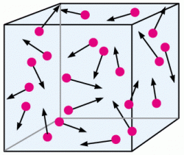
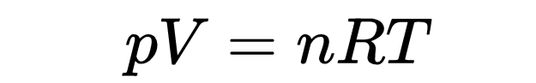
Different understandings of explanation
Causal Model (Salmon, 1978, 1989)
Induction from patterns in data, but explicitly seek underlying causes for events, treating causation as a key attribute of explanatory power.
e.g. gravity causes tides; molecular kinetics causes gas to behave as following the gas equation
The problem of inference
A degree of inference is required to establish connections between causes and effects

Slide 7
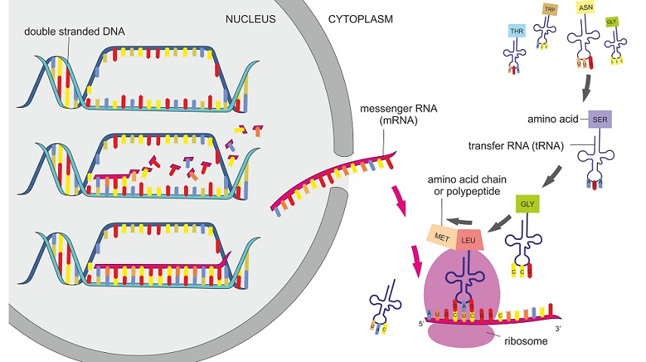
Different understandings of explanation
Mechanistic explanation (MDC, 2000)
A series of activities of entities that bring about the finish or termination conditions [from the set-up conditions] a regular way
e.g. protein synthesis
The problem of inference
A degree of inference is required to establish connections between causes and effects
“Bottom out”
Explanations are at various levels; explanation for one level can be the phenomenon to be explained for a lower level. Levels can be both inter- and intradisciplinary

Slide 8
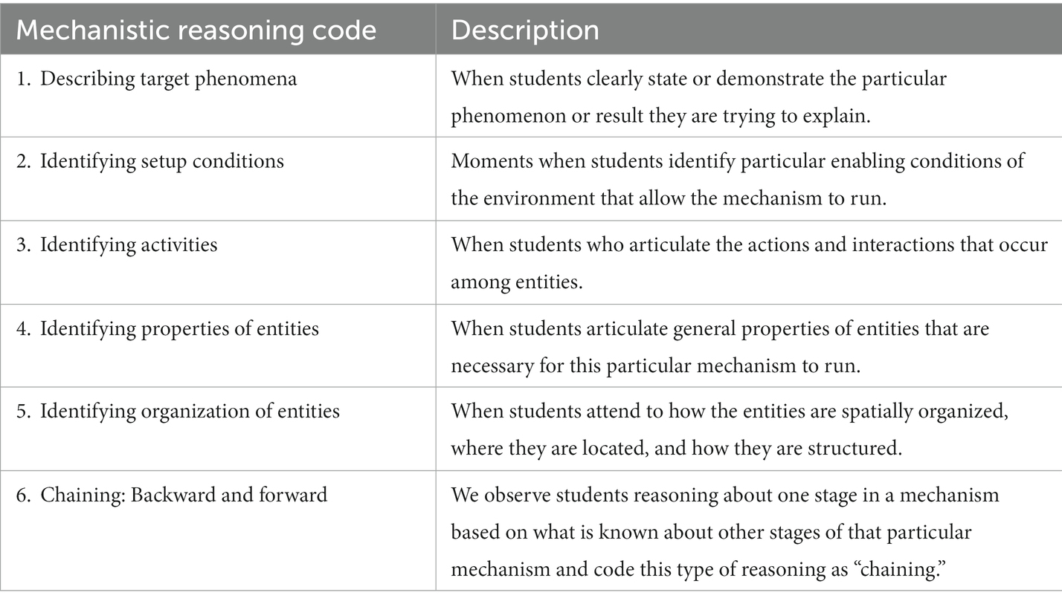
Different understandings of explanation
Mechanistic explanation (MDC, 2000; Russ, 2008)
A series of activities of entities that bring about the finish or termination conditions [from the setup conditions] a regular way

Slide 9
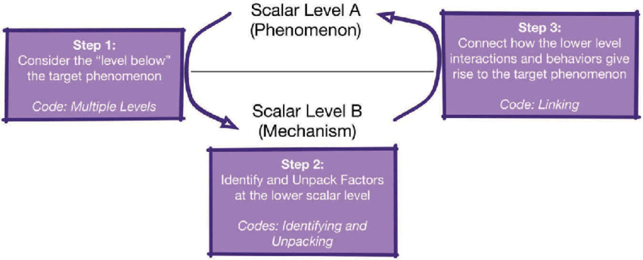
Different understandings of explanation
Mechanistic explanation (MDC, 2000)
A series of activities of entities that bring about the finish or termination conditions [from the set-up conditions] a regular way

Slide 10
Different understandings of explanation
S1：我觉得应该是热水产生了很多热气[entity]，然后热气往乒乓球里面传送[organization/activity]。然后呢，乒乓球里面的热气过多就会往外涨[activity]，然后呢，那个缺口然后就会恢复[terminal condition]
T： Ok。听明白了么？【记录】热水产生了很多的热气，然后呢这个热气进入到乒乓球里面，所以乒乓球就复原了。好，这是第一个观点。还有没有其他的观点，或者你也可以对他的观点发表你的意见、问题，都可以。你说。【S2：因为它-】面对他，声音大一点说。
S2：就是那个乒乓球它是一个东西包着的[evidence]，它又没有缝隙，空气怎么能进去？[organization/rebuttal]
S3：那说不定你看不见-，那你怎么知道没有缝隙？【rebuttal】
T：好，有没有同学同样想问这个问题？【示意S1】你觉得呢？
S1：……【很嘈杂 T：听听听听，注意听】我觉得应该是有缝隙的
T：好，还有想法，我想请这位同学来说。
S5：【听不清】……空气，里面就砰的一声，然后被踩了的时候，它就有一个地方压下去了[evidence]，我的意思是这样它才能凹进去，然后再把它弄起来的时候，空气[entity]就从那个小缝里面进去[activity/organization]了。[chaining backwards]
T：你的意思是说，踩了的那个地方有个小缝，好。
S4：老师它那个地方有一条竖线。[evidence]
S1：我觉得应该是热水产生了很多热气，然后热气往乒乓球里面传送。然后呢，乒乓球里面的热气过多就会往外涨，然后呢，那个缺口然后就会恢复
T： Ok。听明白了么？【记录】热水产生了很多的热气，然后呢这个热气进入到乒乓球里面，所以乒乓球就复原了。好，这是第一个观点。还有没有其他的观点，或者你也可以对他的观点发表你的意见、问题，都可以。你说。【S2：因为它-】面对他，声音大一点说。
S2：就是那个乒乓球它是一个东西包着的，它又没有缝隙，空气怎么能进去？
S3：那说不定你看不见-，那你怎么知道没有缝隙？
T：好，有没有同学同样想问这个问题？【示意S1】你觉得呢？
S1：……【很嘈杂 T：听听听听，注意听】我觉得应该是有缝隙的
T：好，还有想法，我想请这位同学来说。
S5：【听不清】……空气，里面就砰的一声，然后被踩了的时候，它就有一个地方压下去了，我的意思是这样它才能凹进去，然后再把它弄起来的时候，空气就从那个小缝里面进去了。
T：你的意思是说，踩了的那个地方有个小缝，好。
S4：老师它那个地方有一条竖线。
At lower scalar level
Mechanistic reasoning coding
Argumentation coding

Slide 11
Different understandings of explanation
John: I think it, like us, I think it has special cells in it that change color … [teacher requests clarification] … I don’t think there’s like a special type of warmth … I think there are basically cells in every type of living thing.
Christian: I think … when it’s like gets really cold, like the veins, like, make it change all kinds of colors. 63. Teacher: This side of the room is full with ideas.
Beatrice: I think, um, the trees’ color, because of the sun and the veins, the sun makes the veins turn, um, like yellow or red or any color. And then, it changes color because the sun, it’s really hot, and then it’s like …
T: Let’s move onto the second question. The question was … “What is going on inside of the leaf that is making the leaf change color?
Morgan: I think, … when it changes colors it sorta means like, I think it just sorta means like growing up … And, like, in Fall it like, it might be like the leaf’s birthday. And, it’s telling that it will have to fall off soon. …
T: How is it happening? How is it happening?
Morgan: It’s happening because, I think because of the weather, and because of the sun and water and because … For some reason I think of the seasons. I don’t know why, but …
T: That’s a “why” question. What’s going on inside the leave? Pass to someone if you’re not prepared to answer. What’s going on inside of the leaf that is making it change color?
Camille: I think that it’s … it’s, um … it’s getting food from the trees, so it, so it’s like … I agree with Morgan because it’s kinda like a life cycle of a caterpillar having … only changing colors.
Megan: Um … I think what’s going inside a leaf, it’s like if you like leave an apple out for a long while and it starts to change its color, I think that’s how, um, it works with the same way as food, how it rottens …
Pragmatics of Explanation
The context surrounding the request for an explanation determines whether or not a response “counts” as a satisfactory explanation.
e.g. leaves changing color
T:Think about it this way. Say I’m making cookies for my birthday because my birthday is coming up, right Kristina? And so I was making cookies for my birthday and the question was “Why am I making cookies?” What’s the answer? Because it’s my birthday. How am I going to make these cookies? Well, I’m going to put together a bunch of ingredients, put them inside of a bowl, mix it all up, put it into the oven, take it out of the oven, lay it out to cool off. They are two different questions. We talked about the “why” question. People said it gets cold, it’s getting old, it’s drying up, the wind is happening. Now I’m asking you the “how” question. How are the leaves changing color? How are the leaves changing colors? What process is it going through? What steps are happening inside of the leaf?

Slide 12
Different understandings of explanation
Explanatory Unification View
Unify diff
e.g. leaves changing color
T: Let’s move onto the second question. The question was … “What is going on inside of the leaf that is making the leaf change color?
Morgan: I think, … when it changes colors it sorta means like, I think it just sorta means like growing up … And, like, in Fall it like, it might be like the leaf’s birthday. And, it’s telling that it will have to fall off soon. …
T: How is it happening? How is it happening?
Morgan: It’s happening because, I think because of the weather, and because of the sun and water and because … For some reason I think of the seasons. I don’t know why, but …
T: That’s a “why” question. What’s going on inside the leave? Pass to someone if you’re not prepared to answer. What’s going on inside of the leaf that is making it change color?
Camille: I think that it’s … it’s, um … it’s getting food from the trees, so it, so it’s like … I agree with Morgan because it’s kinda like a life cycle of a caterpillar having … only changing colors.
Megan: Um … I think what’s going inside a leaf, it’s like if you like leave an apple out for a long while and it starts to change its color, I think that’s how, um, it works with the same way as food, how it rottens …

Slide 13
Different understandings on what explanation is
(Braateen & Windschitl, 2011)
Pattern-seeking
(covering law or statistic)
predict
Goal :
Construct coherent, mechanistic account of natural phenomenon
Render it into familiar conjunctions of objects
（Hume）
(Hammer, et al, 2008; Ford, 2015)
explain
Mechanistic reasoning
(Braateen & Windschitl, 2011)
Notes:
Mendel noticed the pattern that parental characters will be expressed in the F2 generation in the ratio 3:1 and came up with an explanation based on alleles. And aligning with the evolutionary mechanism on the origin of species, we would expect specific patterns in fossils that involve transition species.
Hume
There is nothing in the cause that will ever imply the effect in an experiential vacuum； Hume does not hold that, having never seen a game of billiards before, we cannot know what the effect of the collision will be. Rather, we can use resemblance, for instance, to infer an analogous case from our past experiences of transferred momentum, deflection, and so forth. We are still relying on previous impressions to predict the effect and therefore do not violate the Copy Principle. As we experience enough cases of a particular constant conjunction, our minds begin to pass a natural determination from cause to effect, adding a little more “oomph” to the prediction of the effect every time, a growing certitude that the effect will follow again. It is the internal impression of this “oomph” that gives rise to our idea of necessity, the mere feeling of certainty that the conjunction will stay constant.
(D1) An object precedent and contiguous to another, and where all the objects resembling the former are placed in like relations of precedency and contiguity to those objects that resemble the latter.
(D2) An object precedent and contiguous to another, and so united with it, that the idea of the one determined the mind to form the idea of the other, and the impression of the one to form a more lively idea of the other. (T 1.3.14.31; SBN 170)

Slide 14
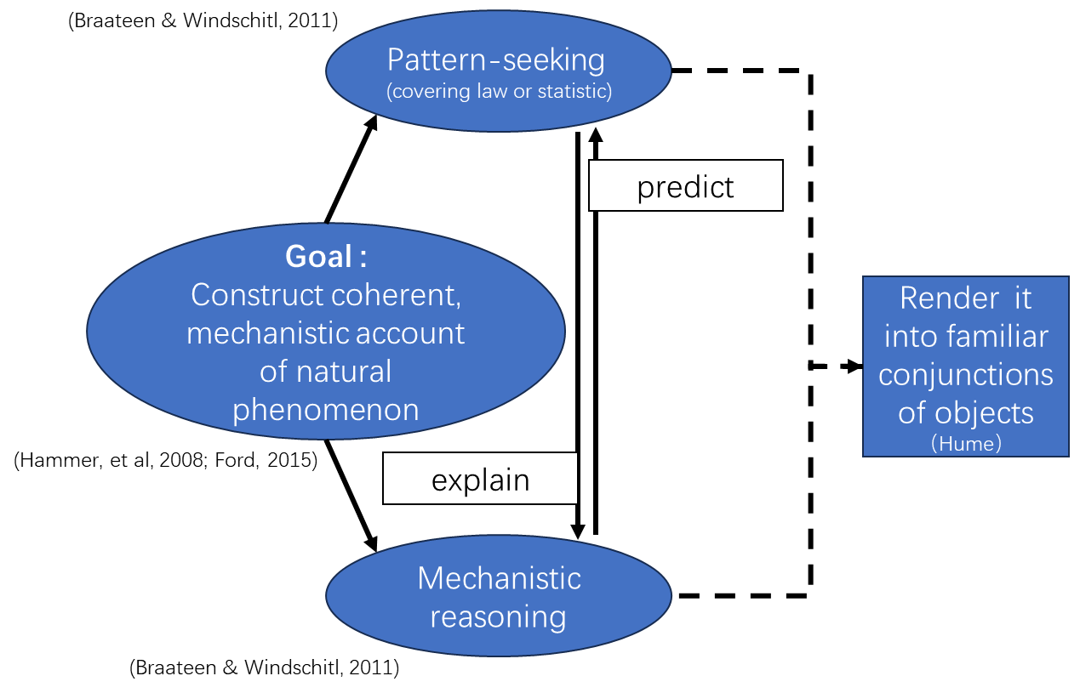
Different understandings on explanation
Context-dependent epistemological framework (Louca, Elby, Hammer, & Kagey, 2004)
MDC, 2000; Russ, eta l., 2008
Processes underlying the regular changes from the start conditions to finish conditions:
Entities, features, and activities
Spatial and temporal organization
Chaining forwards/backwards
Empirical evidence
Krist, 2019; Braaten & Windschitl, 2011
Think across scalar levels, usually involving unobservable elements and calling for reasonable imagination
Prior knowledge in science
Mechanistic reasoning
diSessa, 1993; 2014
Craver, 2006; McAllister, 1999
P-prim
Resources
Characterization of products
Often in terms of mechanistic sketches; may evaluate based on plausibility and elegance in certain contexts
Prior social knowledge/
experience
Notes:
. There is nothing in the cause that will ever imply the effect in an experiential vacuum； Hume does not hold that, having never seen a game of billiards before, we cannot know what the effect of the collision will be. Rather, we can use resemblance, for instance, to infer an analogous case from our past experiences of transferred momentum, deflection, and so forth. We are still relying on previous impressions to predict the effect and therefore do not violate the Copy Principle. As we experience enough cases of a particular constant conjunction, our minds begin to pass a natural determination from cause to effect, adding a little more “oomph” to the prediction of the effect every time, a growing certitude that the effect will follow again. It is the internal impression of this “oomph” that gives rise to our idea of necessity, the mere feeling of certainty that the conjunction will stay constant.
(D1) An object precedent and contiguous to another, and where all the objects resembling the former are placed in like relations of precedency and contiguity to those objects that resemble the latter.
(D2) An object precedent and contiguous to another, and so united with it, that the idea of the one determined the mind to form the idea of the other, and the impression of the one to form a more lively idea of the other. (T 1.3.14.31; SBN 170)

Slide 15
On the space for mechanistic reasoning
An example: Lighting the lightbulb (G4)
students tried to connect the parts and light the lightbulb
-“it needs to form a circle”
- Two contact points on the lightbulb have to touch the two ends of the battery

Slide 16
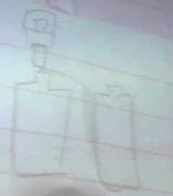
On the space for mechanistic reasoning
Would this connection work?”

Slide 17
On the space for mechanistic reasoning
Students were thinking actively and raising questions
The teacher attended to student thinking and provided space for further exploration
Students engaged in argumentation and solving their own problems
What characterize their explanation construction practices?

Slide 18
On the space for mechanistic reasoning
when you have electricity and the string
Z: In what situation can the lightbulb be lit?
so it [the electricity](entity) has a path to move forward (activity)
Z：I thought Keyi and Jiangya were expressing the same idea in different words, from different aspects. I thought so until I saw what happened next.
Keyi: it [the circuit] needs to form a circle
Jiangya: Two contact points on the lightbulb have to touch the two ends of the battery
【pattern-seeking】
【mechanistic reasoning】
【identify patterns】
Notes:
An initial pattern-seeking question
One student provided a piece of mechanistic reasoning
The construction of explanation did not turn into one about mechanism

Slide 19
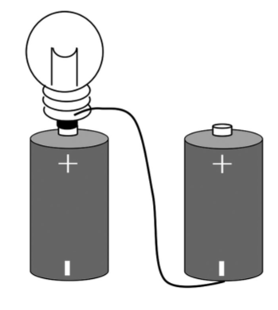
On the space for mechanistic reasoning
The electricity (entity) needs to circulate (activity) in order to light the lightbulb
Z: They were going to find out that the connection couldn't work, and that should solve their disagreement. They can then try to make two batteries work, and they will see if the working connections have the same patterns they suggested before. This, I think, can help them understand what matters for a working circuit.
No, the circuit is not fully formed
Lumin：“Can this connection work”
Yes, both ends are connected
electricity (entity) flows (activity) from both ends of the batteries, colliding (activity) and generating light (activity) in the filament (spatial)
【apply patterns】
【apply pattern】
【mechanistic reasoning】
Z: We can look at how to light the lightbulb with two batteries.
Z: Draw down the connection that works
Z:What do they have in common in terms of connection
【pattern-seeking】
Notes:
卢敏：如果正电和负电【实体】是从不同的电池中来的。还能点亮小灯泡么？
may involve mechanistic reasoning
Students initiated mechanistic reasoning
Teacher refocused the class on pattern-seeking
The space of mechanistic reasoning is reduced

Slide 20
On the space for mechanistic reasoning
The lack of space for mechanistic reasoning in the standards
coding | frequency | instances
Pattern seeking | 2001-8 2017-2 | “construct an explanation through simple thought processing on the basis of existing knowledge, experience and information, and understand that what has been constructed should be repeatedly testable“
Mechanistic reasoning | 2001-4 | As part of a single exemplar case from Inquiry and the National Science Education Standards (NRC, 2000)
Explication | 2001-1 2017-1 | “can explain the meaning of natural selection and survival the fittest”
Unclear | 2001-8 2017-2 | “know that science can already explain many myths of the world, and there are more waiting for exploration” “explain why a quilt can both keep you warm and keep the ice cream from melting”
Notes:
This element was later illustrated by an example: a student observed that all the chickens his family raised were dying except for the few thathappened to eat some leek leaves, and so the student constructed the hypothetical explanation that leek can serve as a cure for whatever disease was killing the chickens.
教材和教参上都让学生“猜想电是怎么流的”这个环节，但课堂探究中很少得到关注.课标中相关的学习内容是“电路是包括电源在内的闭合回路”以及“说出电源、导线、
用电器和开关是构成电路的必要元件，说明形成电路的条件”

Slide 21
On the space for mechanistic reasoning
In Chinese elementary classroom, there is little space for mechanistic reasoning because of the dominating focus on pattern-seeking
The focus on pattern-seeking is contextualized by standards/ textbooks that marginalize mechanistic reasoning
This seems to be not just the case in China
Tang, X., Elby, A., & Hammer, D. (2020). The tension between pattern‐seeking and mechanistic reasoning in explanation construction: A case from Chinese elementary science classroom. Science Education, 104(6), 1071-1099.

Slide 22
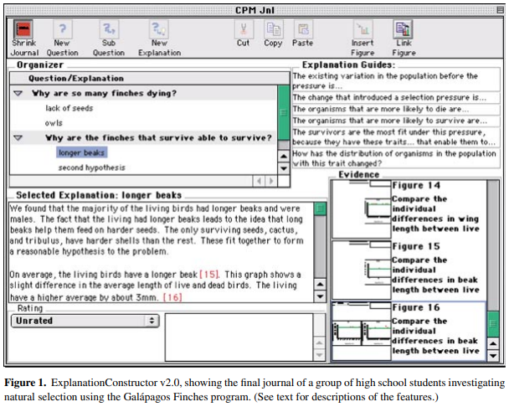
On guiding explanation construction
Explanation-Driven Inquiry (Sandoval & Reiser, 2004)
Frame students’ inquiry as an effort to explain phenomena
-Frame explanation as answering the inquiry question throughout the process
Suggest the form of explanation
-the articulation of coherent, causal accounts
-the use of data to support causal claims
-description of entities and activities on a lower scalar level
Represent Theories as Explanatory Frameworks
Link evidence with causal claims
Opportunities for epistemic reflection

Slide 23
Would young students be able to do it?

Slide 24

Would it be productive to engage young students in mechanistic reasoning
Mom: Oh, so the holes are where it looks black when you draw. But what does the air have to do with the holes?
Walnut: Because those-, when I drew, the air said, the air said, “Ah, there is a hole, let’s go inside!” So they came in. And then when you soak it in water, they said, “Ah, water!” So they came out. And then they dig a hole, it is too small, so they have to squeeze out. And then they rose and became bubbles, and they just jumped around here and there.
Mom: So how come there is also the sizzling sound?
Walnut: Because they squeeze out, so there is the sizzling sound.
Tang, X., Hammer, D. (2023). “I think of it that way and it helps me understand”: Anthropomorphism in elementary students’ mechanistic stories. Under revision with Science Education.

Slide 25
Mechanistic reasoning and anthropomorphism
There is a shared ground for mechanistic reasoning and storytelling
-both focus on describing processes
-involve components that bear functional similarities
Characters (entities) and their actions and reactions (activities) are organized to form plots, that is, causal links that rationalize the changes from the beginning to the end of the event sequence
- coherence is essential to both modes of thinking
Storytelling draw on particular resources to create coherence
Students can shift from mechanistic reasoning to storytelling through anthropomorphism, covering the gaps in a mechanism and forming “mechanistic story” that brings intuitive completeness

Slide 26
Mechanistic reasoning and anthropomorphism
This strategy allows temporary framing of explanation construction as the activity of forming a story of how something happens (Hammer & Elby, 2002)
Although mechanistic stories do not provide fully mechanistic explanations, we see their value in allowing students to invent science (Russ & Berland, 2019) based on their existing knowledge and framing explanation construction as a practice close to and connected with their everyday activities.
Notes:
lowering the bar for proposing a seemingly complete and coherent account.

