Slide 1
Translanguaging Practices of Macau Junior-One Students in a Remedial Class
Brian, Hok-Shing, Chan (Department of English, FAH, University of Macau)
Chris, Ion-Pang, Chou (Instituto Salesiano, Macau SAR)
Paper presented at the 6th International Symposium of Chinese Language and Discourse (ISCLD6), December 9, 2022.

Slide 2
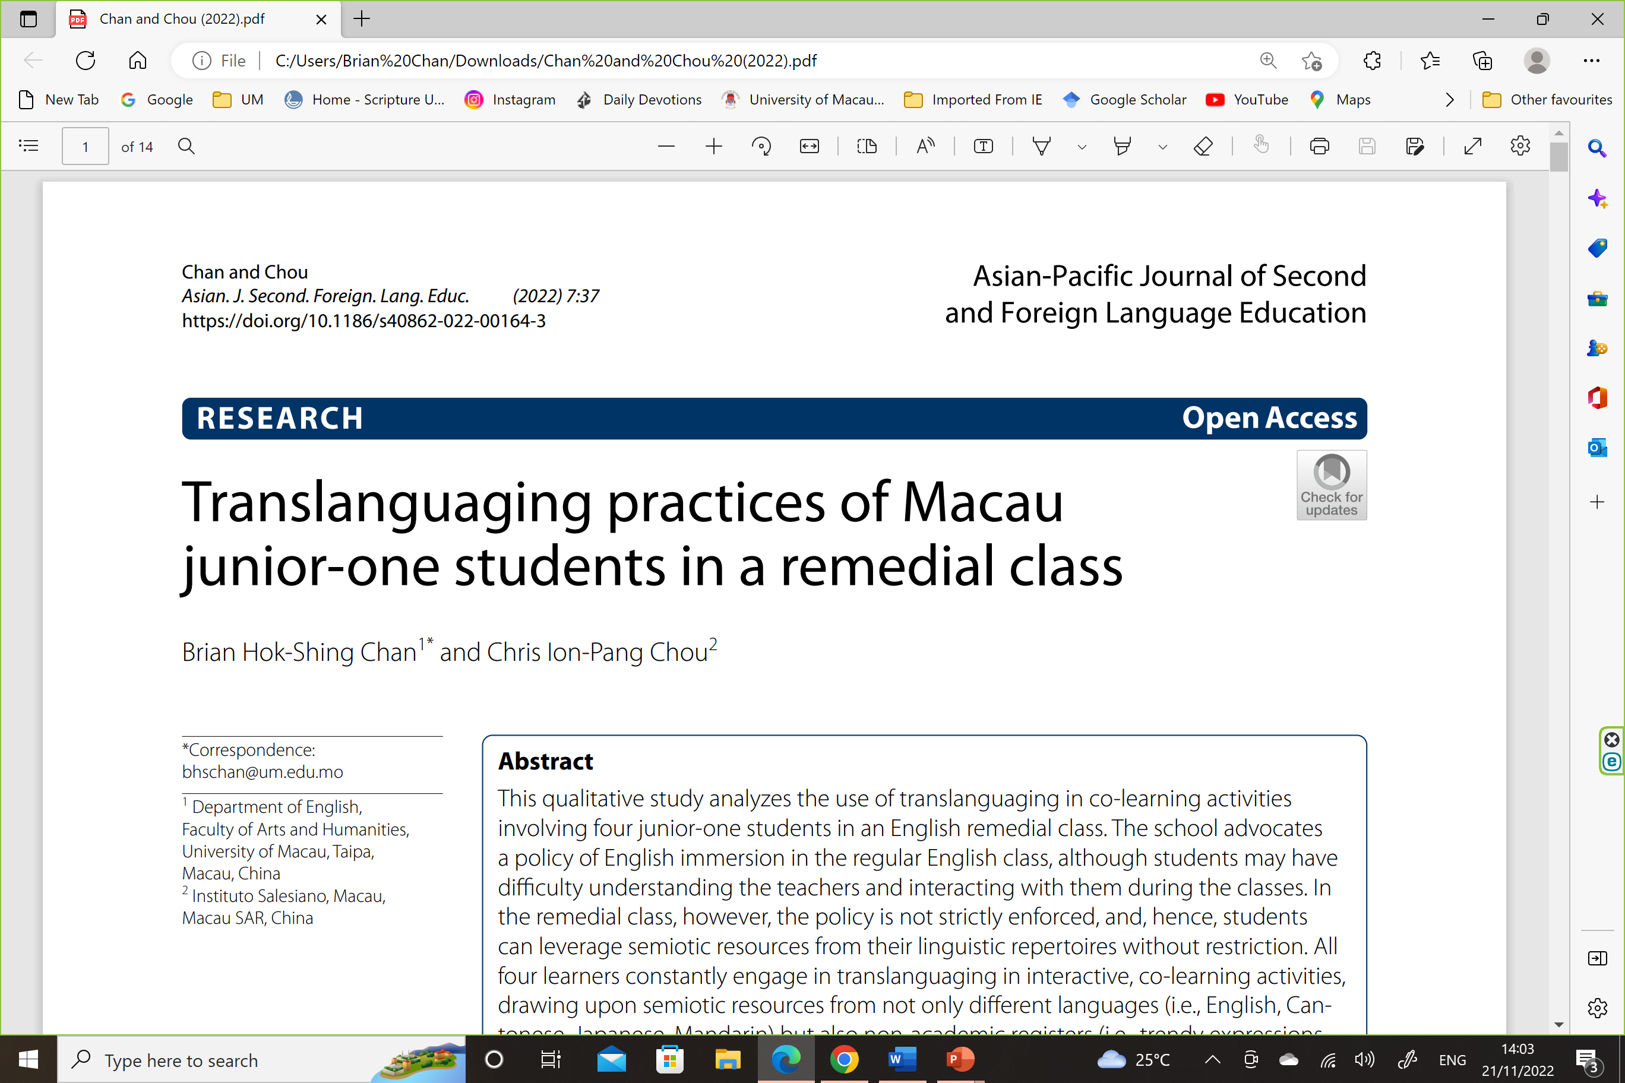

Slide 3
Sociolinguistic Background of Macau
The majority of Macau residents are bi/multilingual (Census data – most people speak Cantonese as usual language and over half of respondents claim to speak Putonghua and/or English as “Another Language”).
Multilingual practices of Macau people are nonetheless less studied and understood (than people in neighboring Hong Kong where there are many more studies on CS/CM and people apparently engage in language mixing much more frequently).
“Separate multilingualism” (Zhang and Chan, 2017)
Multilingual practices of Macau people have been reported in the younger generations (Chan, 2015; various MA theses).

Slide 4
Language policy in Macau’s education system
Latest figures from DSEDJ – 2021/2022
(https://portal.dsedj.gov.mo/webdsejspace/internet/Inter_main_page.jsp?id=8525)
Non-tertiary educational institutions
Chinese-medium 100
Portuguese-medium 5
English-medium 15

Slide 5
Language policy in Macau’s education system
The numbers hardly represent how languages are actually used as MOI in schools in Macau, because:
many Chinese-medium schools also run an English section under the same school name.
Putonghua and Cantonese are used to various extents in the CMI schools.
Cantonese can be widely used in teaching in an officially EMI school.

Slide 6
Research site
A secondary school in Macau
Despite being an EMI school, Cantonese has been widely used by teachers in class, including English classes.
The chair of the English panel has pushed for an English-only policy.
The remedial class has been set up as an “extra-curricular activity” for those who have problems coping with the regular English classes.
Students are free to use whatever language they prefer in communicating in these remedial classes.
Students do some collaborative tasks in groups/pairs before they report to the teacher.

Slide 7
Research Questions
(1) How do the students make use of different semiotic resources in their translanguaging practice in a remedial class?
(2) What are the purposes of the students’ translanguaging practice in the remedial class?

Slide 8
Subjects
Nathaniel (14), Marco (14), Joshua (13), Aska (13)
They were selected as subjects because they were the most outspoken in the remedial class, while others were largely quiet in the classes.
The second author – an observer but not the teacher in this particular class – made three audio-recordings in which they communicated among themselves and with others.
The second author sought the consent of the teacher of this class and the four students who were a bit surprised but who found the research interesting.

Slide 9
Excerpt 1—The teacher (T), Nathaniel (N) and Marco (M)
Turn Speaker
1 T: Next one, how to pronounce the word S-A-C-H-E-T?
(What is the pronunciation of the word S-A-C-H-E-T?)
2 N: <emphasized the word by reading it aloud>SKETCH
3 T: <pronounced the word>It is sachet /sæʃeɪ/
4 M: <laughed at Nathaniel> 唓! 唔掂囉! 你 “好雷”呀!
(Tsk! You are very weak. You are such a slacker.)
5 N: <replied to Marco seriously> 你話我 “雷”!
(You say that I am such a slacker!)
6 T: <chuckled>Students! Don’t argue
Focus on your textbook and discuss it with your partner
7 M: <felt irritated>Umm

Slide 10
Excerpt 2—Joshua (J) and Aska (A)
Turn Speaker
1 A: <chuckled and pointed to the pictures on that page>呢度有三包薯片,
呢度兩罐唔知乜野魚, 好難食. 仲有兩樽唔知咩, 跟著一打三文魚
(Here are three bags of crisps, and here are two tins of fish that I do not know how to call;
they taste bad. There are also two bottles of unidentified things and a dozen salmon sashimi.)
2 J: <chuckled> 嗰個係唔係解一打三文魚呀?
(Does it mean a dozen of salmon sashimi?)
3 A: A dozen 呀嗎 [A dozen……
(It is a dozen.)
4 J: <chuckled> [係一千呀?
(Is it a thousand?)
5 A: 咦, 唔係. A dozen係一打定半打呀?
(No. Does ‘a dozen’ mean a dozen or half a dozen?)
J: <spelt the word>D-O-Z-E-N 呀, 一打呀. (3.0)
(D-O-Z-E-N, a dozen)
<murmured to himself> 咁 “辣雞” 嘅
(You are a piece of ‘spicy chicken’.)
7 A: 咩 “辣雞” 呀?
(What does ‘spicy chicken’ mean?)
8 J: <repeated the words>你咪“辣雞”囉! 垃圾!
(You are a piece of ‘spicy chicken’. Rubbish!)
9 A: <showed Joshua an irritated facial expression>

Slide 11
Excerpt 3—Nathaniel (N) and Aska (A)
(Sentence 1—He makes us happy)
Turn Speaker
1 N: <asked Aska>你試下define 個 ‘happy’先
(You can define ‘happy’ first.)
2 A: <felt confident>‘happy’ 好肯定係另一個 object. Pattern three喎, SVOO, 仲唔係答案?
(I am sure that ‘happy’ is another object. This is pattern three, SVOO. Is it the answer?)
3 N: <chuckled>你呢個係一個很好嘅嘗試, 但答案係錯嘅!
(You have made a good try, but the answer is wrong.)
4 A: <felt surprised and said Japanese> なに……
(What?)
5 N: 梗係唔係啦. ‘Happy’ 係adjective, 唔係noun呀
(It is wrong. ‘Happy is an adjective. It is not a noun.)
6 A: <looked at the handout>(3.0) Pattern [fo…
7 N: [Pattern four 呀. 咁即係咩呀?
(It is pattern four. So what is ‘happy’ in this sentence?)
8 A: <read the word>Complement. /kɒmplɪment/
<wrote the phrase ‘object complement’ on the answer paper>

Slide 12
Conclusions
“Translanguaging” is more appropriate than “code-switching” in describing the language practices of the students, who draw upon not only different languages (Cantonese, English, Japanese, Mandarin) but also non-academic registers (trendy expressions, internet slang) and body language (gestures, facial expressions) in the interactions.

Slide 13
Conclusions
By translanguaging students assumed multiple roles (as “little teachers” and “peers”) and multiple relationships with other classmates (teacher-student, peer-peer).
The choice of language or expressions (e.g. Japanese, internet slang) projects a personal identity/image in relation to the teacher and other students.

Slide 14
Conclusion
Translanguaging also allows the students to project multiple frames to the current interaction (teaching/learning and peer conversation), making the class more entertaining and less stressful.

Slide 15
Broader implication
As many Macau secondary schools are moving towards an “English-only” policy at least in English classes or beyond, this small study calls for more reflection and rethinking of implementing English-only education across the board. Also worth rethinking is the presumption that the diversity of MOI practices that has existed in Macau is outdated and undesirable for students and Macau.

Slide 16
Reference
Chan, Brian, Hok-Shing & Chou, Chris, Ion-Pang (2022). Translanguaging Practices of Macau Junior-One Students in a Remedial Class. Asian-Pacific Journal of Second and Foreign Language Education 7, 37. https://doi.org/10.1186/s40862-022-00164-3 [Springer - ESCI/Scopus-indexed].
Open-access article available on the Journal website, my ResearchGate page and UM Scholar page.

