Slide 1
香港粵語裡的which/which is關係子句
Revisiting which/which-is relatives in Hong Kong Cantonese
陳學成/Brian Hok-Shing Chan
澳門大學人文學院英文系
Department of English, FAH, University of Macau
Paper presented at 2nd Macau Roundtable on linguistics
第二屆鏡海語言學圓桌會議
University of Macau, December 5, 2022

Slide 2
Code-switching in Hong Kong
Cantonese-English code-switching has been a common feature of Hong Kong Cantonese, and it has been well documented and studied.
This contact phenomenon most probably arose in the late 1970s (Gibbons 1979, 1987; Luke and Richards, 1982) though the linguists used different names (MIX, code-mixing).
In Hong Kong, CS is largely spontaneous, unconscious and intra-sentential, echoing what Gumperz (1982) calls conversational code-switching.

Slide 3
Code-switching in Hong Kong: Some examples
你呢個semester take 咗幾個course呀？
一陣落堂要見professor
嗰科勁多quiz同presentations
你要keep住做運動
我最中意嘅係嗰個home-made嘅感覺
我嘅party food最受歡迎嘅係炸雞卷
大家記住畀like同埋subscribe我哋嘅channel

Slide 4


Slide 5
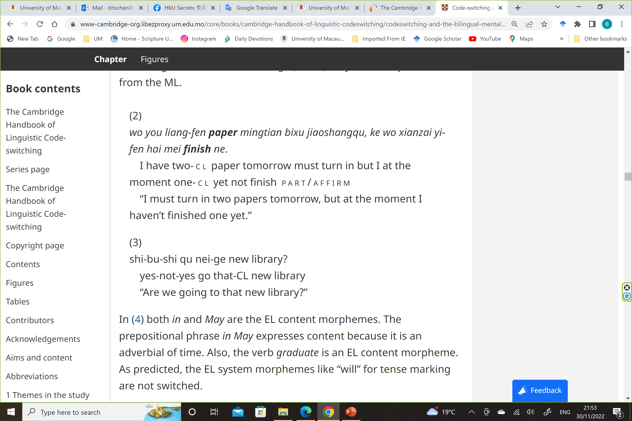

Slide 6


Slide 7
Code-switching in Hong Kong
The sentence is largely Cantonese in structure but single words or short phrases are inserted into that structure.
Cantonese (clause)
English (word/phrase)
Insertion (Muysken 2000)

Slide 8
The Matrix Language Frame model
(Myers-Scotton 1993, 2002, etc.)
The Matrix Language sets the grammatical structure of a code-switched sentence by determining its word order and supplying the function words and bound morphemes, technically known as the system morphemes in the MLF Model.
The Embedded Language only supplies content words or content morphemes to a code-switched sentence.
A large part of Cantonese-English CS data documented so far fit into the MLF model with Cantonese being the Matrix Language and English being the Embedded Language.

Slide 9
Structural borrowing?
In other words, the grammar/syntax of Cantonese remains intact despite code-switching. Cantonese-English mixing in Hong Kong remains largely a lexical phenomenon.
Remaining puzzles:
Is it possible that English syntax can be transferred to Cantonese with CS?
Are there exceptions of the Matrix Language Frame Model in Cantonese-English code-switching?

Slide 10
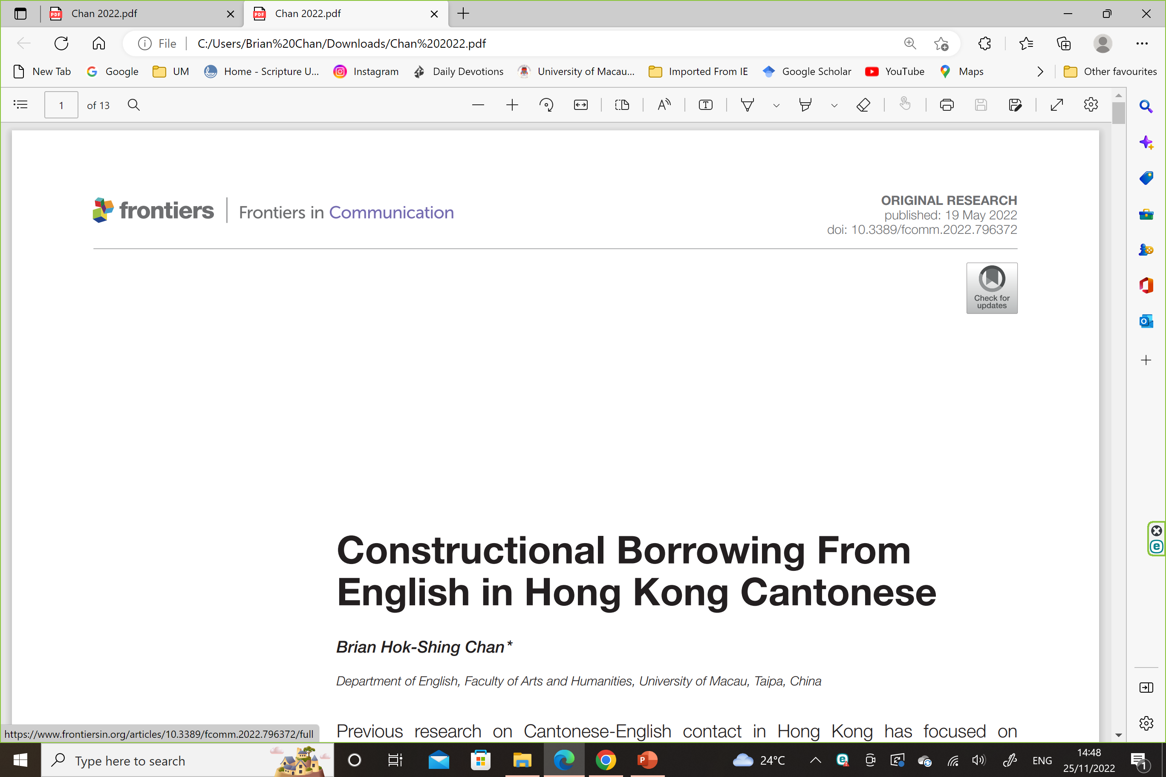

Slide 11
Violations of the MLF Model in Hong Kong Cantonese
3 patterns of structural borrowing, which I recast as constructional borrowing (Chan 2022)
Which/which is-relative (Leung 2010)
Complex NP involving a PP postmodifier with an English preposition (Chan 2015)
NP hai6 P(English) NP (Chan 2018)

Slide 12
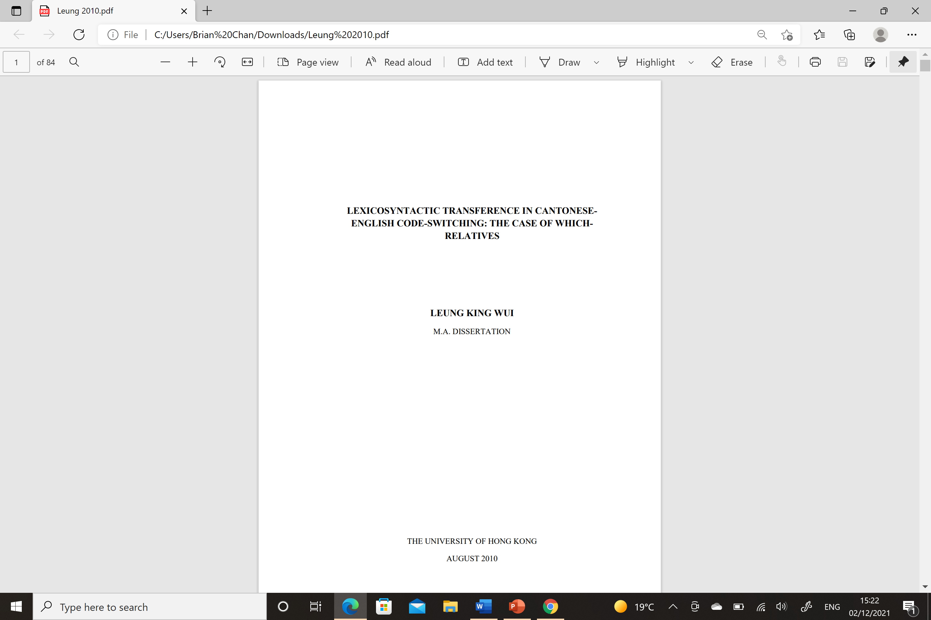

Slide 13
Which-relative in Hong Kong Cantonese (Leung 2010)
In Chinese varieties, including Cantonese, relative clauses are largely premodifying and prenominal whereas relative clauses in English are postmodifying.
Which refers to a preceding clause
除非 佢哋 係 會 覆 人 嘅 機構
ceoi4-fei1 [keoi5-dei6 hai6 wui2 fuk1 jan4 ge3 gei1-kau3]CLAUSE,
Which 我 唔 知 係 唔 係 咁 啊
which ngo5 m4 zi1 hai6-m4-hai6 gam2 aa3…
“Unless they are an organization who will make replies (to inquiries), which I don’t know is true or not…” (Leung 2010: 71)

Slide 14
Which-relative in Hong Kong Cantonese (Leung 2010)
(2) Which refers to a preceding NP
張 紙 上 面 嘅 問 題
[zoeng1 zi2 soeng6-min6 ge3 man6-tai4]NP
個 camp 裡 面 已 經 講 咗 啲 啲
go3 camp jap6-min6 ji5-ging1 gong2 zo2 dit1-dit1,
Which 我 覺 得 唔 駛 再 要 recap
which ngo5 gok3 dak1 m4 sai2 zoi3 jiu3 recap
“We already discussed the questions a bit on this sheet in the camp, which I think (we) don’t have to recapitulate.” (Leung 2010: 74)

Slide 15
Observations
Relative clauses are prenominal in Cantonese (a general characteristic of Sinitic languages). The post-nominal/post-clausal relative clauses most likely draws on English grammar.
Which serves as a connective between two clauses; it does not involve insertion (Muysken 2000).

Slide 16
Observations
There are no data of the more typical English relative clauses, restrictive or non-restrictive, in which the relative clause immediately follows the head noun in a complex NP within a sentence.
e.g. The man [whom you talked to]RCL is her husband.
Other relative pronouns (e.g. who, where) are not found either.
Only a certain type of relative clause is transferred from English, which is not a problem – in language contact, borrowing/transfer is usually not a complete one (e.g. only some specific sense(s) of a word is/are retained when borrowed into a different language).

Slide 17
Observations
The optionality of which in (1) and (2) is interesting. Without which, the gaps would need to be filled by a pronoun. This is not necessary in Cantonese (or other Chinese languages) because the pronouns can be overt or phonetically null (e.g. pro).
But if we treat the gaps to be an empty pronoun in (1) and (2), then which does not really move from below (i.e. within the relative clause) as in standard analysis of English relative clauses in generative grammar.
Which in Hong Kong Cantonese (e.g. (1) and (2)) is syntactically more of a conjunction though semantically it may very well be anaphoric.

Slide 18
Which as conjunction
The conjunction/connective hypothesis seems to fit well into a new variant of which – which is whose origin remains mysterious.

Slide 19
The which-is variant
(3) Which refers to a preceding clause
佢 嚟 咗 啲 老 師 就 開 始 分 黨 分 派
keoi5 lei4 zo2 [di1 lou5-si1 zau6 hoi1-ci2 fan1-dong2-fan1-paai3]CLAUSE,
Which is 之 前 冇 嘅
which is zi1-cin4 mou5 ge3.
“After she came, the teachers had started to divide themselves up into different parties, which did not happen in the past.” (Leung 2010: 73)

Slide 20
Which-relatives in Hong Kong Cantonese (Leung 2010)
(4) Which refers to a preceding NP
同 埋 側 邊 都 有 好 多 呢 啲 特 色 嘅 shops
tung4-maai4 zak1-bin1 dou1 jau6 [hou5 do1 ni1 di1 dak6-sik1 ge3 shops,
好 British 嘅 shops
hou2 British ge3 shops]NP,
Which is 係 你 喺 Leicester 唔 係 好 見 到
which is hai6 nei5 hai2 Leicester m4 hai6 hou2 gin3 dou2
“And at the side (of the road) there are many characterful shops, very “British” shops, which you don’t come across very often in Leicester.”
(A Youtuber is paying a visit to Nottingham, anecdotal data, 2021)

Slide 21
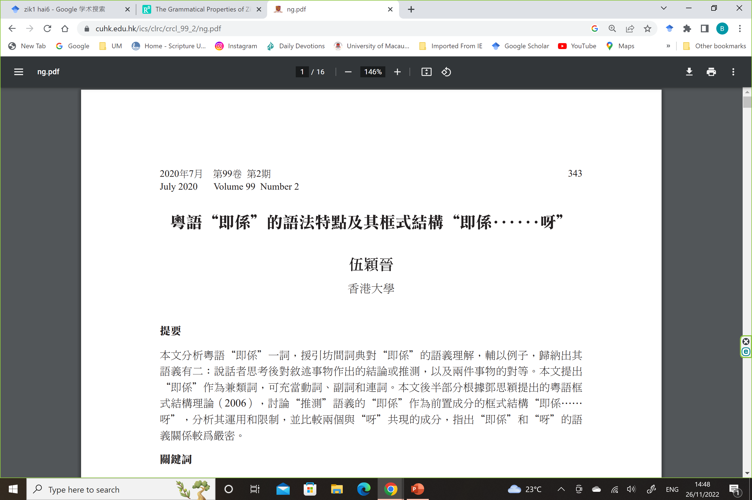

Slide 22
Motivations for the construction
Leung (2010)
Principle of Economy (Li 1999)
“Economy” refers to least linguistic effort in terms of less words/morphemes.
As we saw above, the main ideas can still be expressed without which albeit in two separate clauses. The Principle of Economy does not apply.

Slide 23
Motivation for the construction
The which/which-is relative clause introduces a personal assessment of the situation expressed in the first clause.
Which/which-is is a discourse marker (Schifferin 1987), prompting the hearer of the forthcoming verbal action of the speaker.
In light of this, the construction is indeed more economical, as the discourse marker spares the hearer of some processing effort (Sperber and Wilson 1995), acting as a contextualization cue (Gumperz 1982).

Slide 24
Constructional borrowing
FORM/CONSTRUCTION MEANING (PROTOTYPICAL)
CLAUSE which/which is CLAUSE The speaker is giving a personal
assessment of a situation or
entity presented in the first
clause
In line with Constructional Grammar (Croft 2001)

Slide 25
Origin?
[ngo5 m4 tung4-ji3 keoi5 ge3 ji3-gin3]CLAUSE,
1 NEG agree 3 NOM opinion
which does not mean ngo5 zaang1 keoi5
which does not mean 1 hate 3
“I don’t agree with his/her opinions, which does not mean I hate him/her.” (Chan 1992)

Slide 26
Origin?
Loss and Wicklund (2022)
https://www-cambridge-org.libezproxy.um.edu.mo/core/journals/english-language-and-linguistics/article/is-there-a-new-which-in-town/962BB75BE5CAE8B3C1EA4B6B30302C80

Slide 27
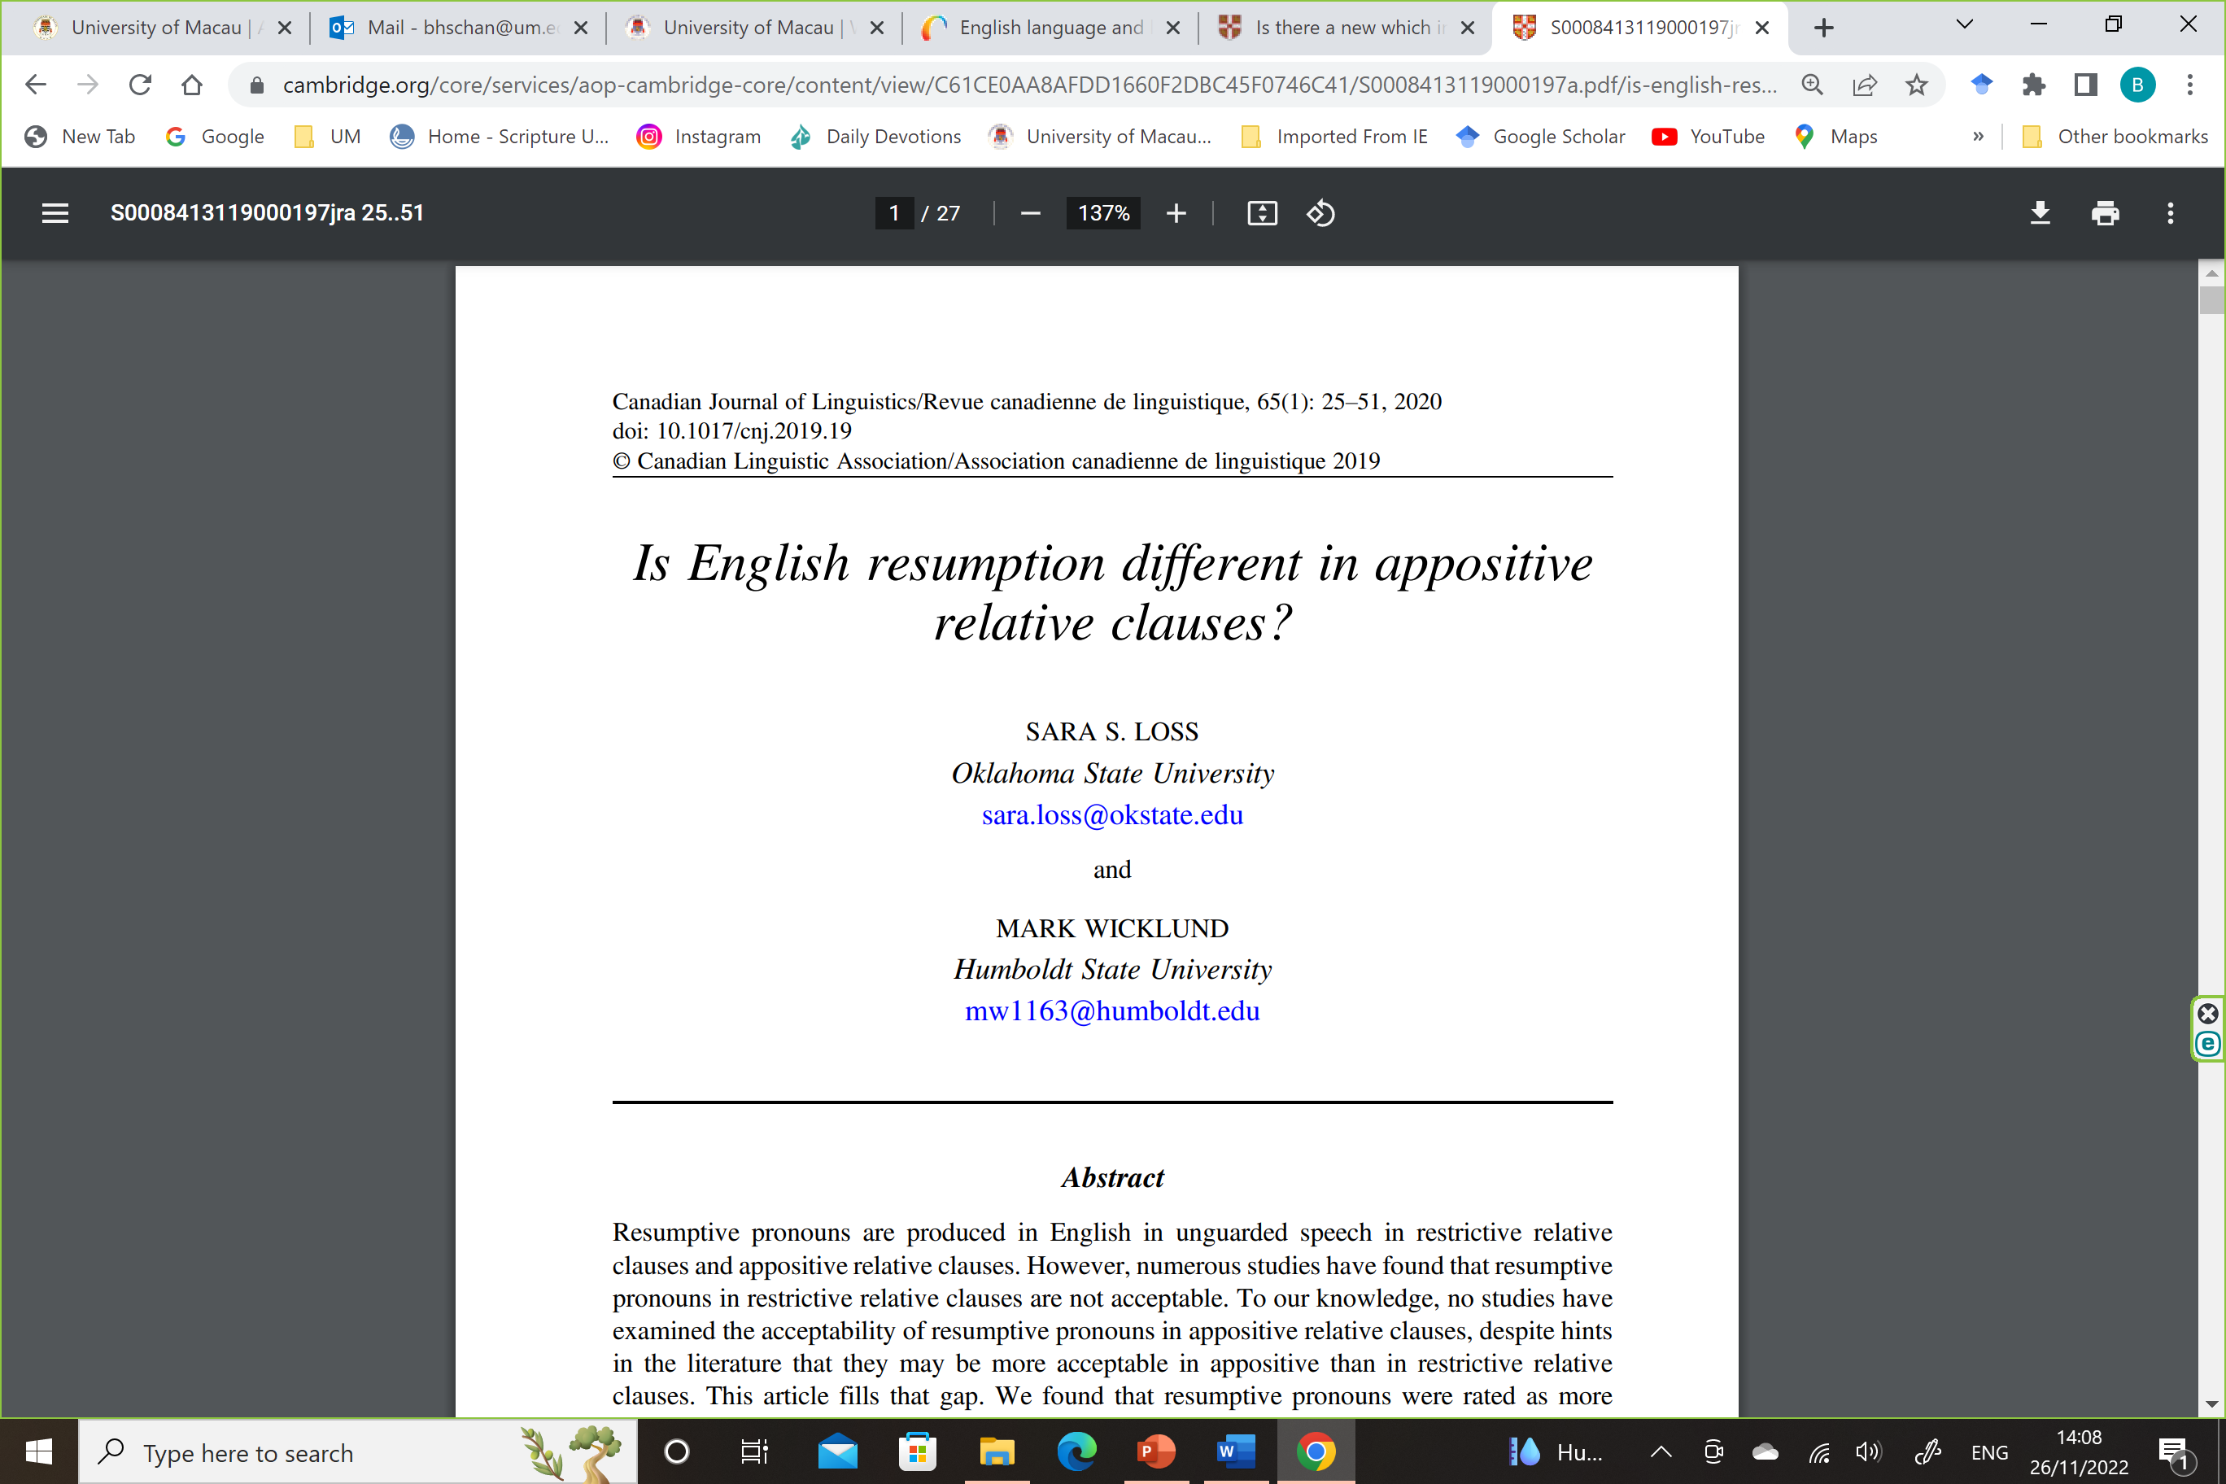

Slide 28
Origin?
Loss and Wicklund (2020, 2022) analyze a set of English data in which the resumptive pronouns are spelt out in relative clauses and which behaves like a co-ordinating conjunction.
Hong Kong bilinguals who first borrowed the construction into Cantonese are probably those who have access to such usage and native speakers who use this construction in English.

Slide 29
Postscript
Although the which/which-is relative clause is a relatively infrequent construction in Hong Kong Cantonese, it has remained in the repertoire of at least some Hong Kong Cantonese-English bilinguals.
The construction prompts us to revisit the “standard” analysis of relative clauses.
The “periphery” (the bilingual construction) may actually help us gain insight of the “core” (relative clauses in English).

Slide 30
