Slide 1
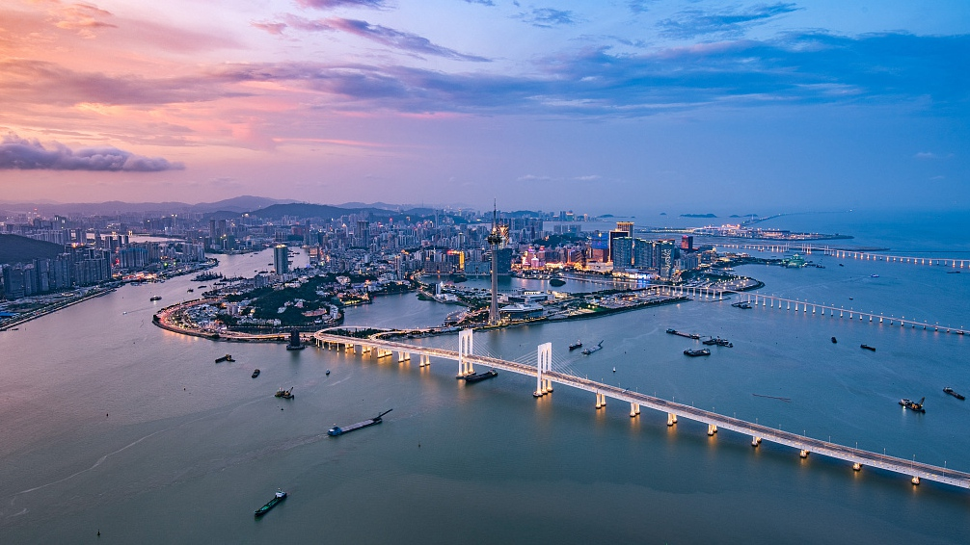
Insight into the
Greater Bay Area project
Paulo Canelas de Castro
Jean Monnet Chair
Faculty of Law, Universidade de Macau
pcanelas@umac.mo
Webinar on New Developments in Greater Bay Area
PEARL RIVER DELTA ACADEMY OF INTERNATIONAL TRADE AND INVESTMENT LAW (PRAIA) 2021
Institute of European Studies of Macau + Peking University School of Transnational Law
November 5, 2021

Slide 2
Insight into the Greater Bay Area project
Contents:
Some disingenuous, modest, disparate, fragmentary thoughts on the GBA grandiose project
Questions more than answers
Context: comparable experiences

Slide 3
Insight into the Greater Bay Area project
The GBA (project)
  Exercise in (mega) planning
  Ambitious vision
  At the creation of a megalopolis
  Which shall showcase and lend impetus to
  the advancement and rejuvenation
  of China

Slide 4
Insight into the Greater Bay Area project
The GBA (project)
  Exercise in (mega) planning
  In line with and complementary to other grandiose visions under current leadership:
  Dual-circulation economy
  BRI
  Moderately prosperous society
  Ecological integrity

Slide 5
Insight into the Greater Bay Area project
The GBA (project)
  Outcome:
  Materialise in integrated 10^{th -} 12th economy of the world
  Gigantic (in Chinese terms, in world terms)
  A seat at the G-20?

Slide 6
Insight into the Greater Bay Area project
Taking stock of developments so far:
  General outlook:
  economic cooperation – integration
  Recognising distinct realities

Slide 7
Insight into the Greater Bay Area project
Taking stock of developments so far:
  General outlook:
  economic cooperation – integration
  More closely: Recognising distinct realities
  Core cities – other cities
  Honouring ‘one country, two systems’ principle

Slide 8
Insight into the Greater Bay Area project
Taking stock of developments so far:
  More closely: Recognising distinct realities
  Honouring ‘one country, two systems’ principle
  Allowing for diversity and competition
  (examples)

Slide 9
Insight into the Greater Bay Area project
Taking stock of developments so far:
  Tapping on past and established strengths ( examples)
  A source of synergetic enhanced overall development (examples)

Slide 10
Insight into the Greater Bay Area project
Taking stock of developments so far:
  Rooted on past experiences :
- Special Economic Zones
- CEPA
- Pearl River Delta

Slide 11
Insight into the Greater Bay Area project
Taking stock of developments so far:
  Rooted on past experiences :
  Building on lessons learned :
- internationalisation
- opening
- Laboratory for further ventures (spillover)

Slide 12
Insight into the Greater Bay Area project
Taking stock of developments so far:
  Rooted on past experiences :
  At par with more intense experiments/developments
    Example: Guangdong-Macau In-Depth Cooperation Zone in Hengqin

Slide 13
Insight into the Greater Bay Area project
Taking stock of developments so far:
  Inference/Comparison:
    Economic development
    Enhanced cooperation/integration

Slide 14
Insight into the Greater Bay Area project
Taking stock of developments so far:
  Inference/Comparison:
    Reminiscent of ‘concentric circles’ model of European integration
    (step-by-step integration + spillover)

Slide 15
Insight into the Greater Bay Area project
Assessing the progress:
  Positive:
  Focus / emphasis on economy stricto sensu
  Examples:
  Trade (CEPA)
  Investment (special economic zones; BRI)

Slide 16
Insight into the Greater Bay Area project
Assessing the progress:
  Focus / emphasis on economy stricto sensu
  Sufficiency?:
  Tensions reality – ideals
  Powerhouses – MSMEs
  Standards – diverse regulatory experiences

Slide 17
Insight into the Greater Bay Area project
Assessing the progress:
  Focus / emphasis on economy stricto sensu
  Lagging behind in integration?:
  The other dimensions in a holistic development

Slide 18
Insight into the Greater Bay Area project
Assessing the progress:
  The other dimensions in a holistic development
  Looking back at governing documents:
  - international standards (SDG)
  - Chinese visions (moderately prosperous society, ecological integrity)

Slide 19
Insight into the Greater Bay Area project
Assessing the progress:
  The other dimensions in a holistic development
  Areas where project may be lagging behind:
  - environmental protection
  Climate justice
  Social integration
  governance

Slide 20
Insight into the Greater Bay Area project
Looking ahead
  Inroads into future?

Slide 21
Insight into the Greater Bay Area project
Looking ahead
  Environmental protection
  Looking at EU experience as a source of inspiration for the right solutions for the GBA context?

Slide 22
Insight into the Greater Bay Area project
Looking ahead
  Environmental protection
  Of negative and positive integration
  Of flanking policies
  Even more meaningful in a SD(Gs) context?

Slide 23
Insight into the Greater Bay Area project
Looking ahead
  Environmental protection
  Examples: air/ water pollution
        climate change
        Main directives

Slide 24
Insight into the Greater Bay Area project
Looking ahead
  Environmental protection
  Methods:
    Awareness
    Goals – obligations
    Factor time
    Procedures
    Institutions
    OMC + consensual decision-making
    Information – participation – access
    integration

Slide 25
Insight into the Greater Bay Area project
Looking ahead
  Environmental protection
  Governance:
    Importance of courts
    ADR
    Relevance of network of CITAC-branches-commissions
    Relevance of the mediation initiative
    Sufficient?
  Legal culture?
  Legal environment?

Slide 26
Insight into the Greater Bay Area project
Thinking outside of the box
Ongoing research
Humble call for action – the input of Universities
Outlook : cross-fertilisation

Slide 27
Insight into the
Greater Bay Area project
Thank you!

