Slide 1
English in Multilingual Macao
Paper presented at the Roundtable of English in Multilingual, Globalized Asia, “The Sociolinguistics of Globalization” Conference, HKU, June5, 2015.

Slide 2
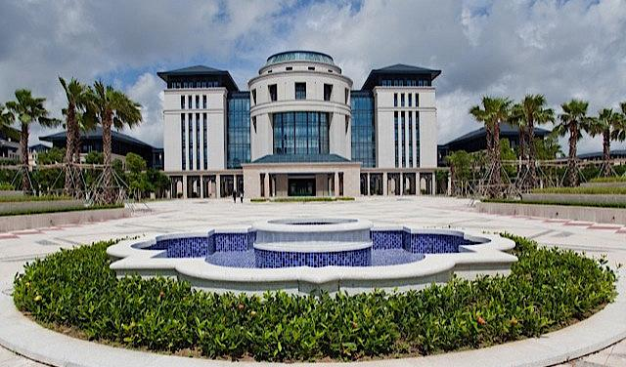
Brian Hok-Shing Chan
Department of English, Faculty of Arts and Humanities, University of Macau

Slide 3
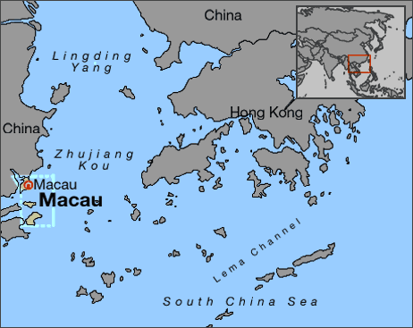
Where is Macao?

Slide 4
Macao is a small place
A total area of 31.3 km² (DSEJ, 2014), already increased from continuing reclamation in recent years.
The small size of Macau implies limited resources and that forces Macao to look outside for norms in many spheres, including policy-making, media, and educational models and probably language practices too (Moody, 2008).
It has contributed to its reliance on service industries, in particular tourism and gaming in the recent decades.
Another related consequence is that the Macao population have been very mobile, especially in times of economic and political turmoil, but it could be a “safe haven” as well.
A transient place (and narratives of the transience of Macau are still running strong).

Slide 5
A small place, but a complicated history: Macao in a nutshell
A small fishing village on the southern coast in China.
Portuguese traders came and built a settlement in 1557, paying an annual rent to the Chinese government.
The Portuguese pursued more colonial expansion starting in 1849, and eventually Macau was ceded to Portugal by the Treaty of Peking in 1887.
Portugal turned into a democratic government after the Carnation Revolution in 1974, relinquishing its colonies, but somehow China didn’t take Macau back in the midst of the Cultural Revolution.

Slide 6
A small place, but a complicated history: Macao in a nutshell
Portugal established diplomatic relations with the People’s Republic of China in 1979.
The Sino-Portuguese Joint Declaration over the Question of Macau was issued in 1979.
Macau became a Special Administrative Region of China in 1999.
The gambling franchise was liberalized in 2002, opening Macau to American–invested hotels-cum-casinos, leading to economic boom until last year.
The Individual Visitors’ Scheme was implemented in 2003, leading to an influx of tourists from mainland China.

Slide 7
And a complex population as well…
The 2011 Census reports that an overwhelming majority in the population claim to be of “Chinese” nationality (92.4%). Actually only about half of them were born in Macau and another half were born in mainland China who may/may not speak Cantonese and/or other Chinese dialects.
9.4 % (about 1/10) of population, quite a large minority, were born in Portugal, the Philippines, Vietnam, Indonesia, and other countries. It’d be fair to assume that the majority in this group are not Chinese in ethnic origin and speak their own languages, and they have varied abilities in English.

Slide 8
Adding to the resident population…
Total population: 640,700 as in 1st quarter of 2015 (DSEJ, 2015)
Non-resident workers (People who have not obtained a Macao ID Card): 174,924
NS workers amount to 27% of the total population, which is a huge percentage.
Among NS workers, 64.9% originate form Mainland China, whereas 12.8% come from the Philippines. (Data from DSEJ, 2015a)
Most Filipino workers appear to work in the service sectors (in hotels, casinos and restaurants) and they usually speak English at work.

Slide 9
In addition to the residents and the workers
There were 7,412,221 visitors’ arrivals in 1st quarter, 2015.
The majority of visitors come from neighboring regions, most notably Mainland China (5,025,943), followed by HK (1,505,695), Taiwan (224,808), Japan (64,144), and other Asian countries.
Visitors from USA, Canada and other European countries were at the bottom of the list.
Most Asian visitors may not actively speak English in their life.
Anecdote: A Cantonese-speaking Chinese cashier was talking to a group of people who look like Korean tourists in simple English. These people were approaching the counter. They stopped without responding and left eventually. You expect people to speak English but they may not! The reverse may also happen too.
“Misfires” in speaking English

Slide 10
A mixed population
Macao has had a cosmopolitan population since its early days (Man-Cheong, 2014), chiefly because of its being a trading port not only between Europe to China but also on the Portuguese navigation route which started in Lisbon and crossed Goa, Malacca and extended to Nagasaki (it’s also the missionary route).
The group of Macanese were people of mixed Chinese, Portuguese and most probably other descents, their ancestors being sailors from Portugal who came to Macao all the way from Lisbon.
The Macanese who didn’t move to other countries before the 1999 Handover and stayed in Macau may still speak Portuguese, but the younger generations have apparently shifted to English and Cantonese (Noronha and Chaplin 2012).

Slide 11
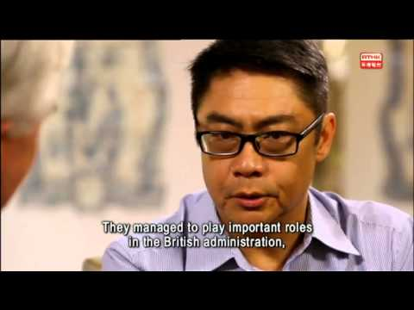
TV interview with Miguel de Senna Fernandos, Chairman of the Macanese Association, in English, but he, a lawyer, also speaks Cantonese, Portuguese and Patua:
https://www.youtube.com/results?search_query=macanese

Slide 12
What’s more…
Many mainland students came to Macao universities expecting that English is used as an MOI, but the use of English in Macau universities is uneven and varied across faculties and departments (Botha, 2013; Zhang, 2010, 2013), and in some cases code-switching is not uncommon.
Gong (2012) reports a case in which a university lecturer code-switches between Cantonese and Putonghua(Mandarin) to his class which consists of about half of local students and another half from the Mainland. The lecturer only speaks English when referring to the class notes and the textbooks which are in English.
Interestingly, there is little indication that the universities (e.g. UMAC, MUST) are English-medium on their website. Having served in UMAC for more than 10 years too, I’ve never come across a clearly written and formulated MOI policy.

Slide 13
And don’t forget those who left…
The small size, monolithic economy and political turmoil have constantly driven people away from Macao for study and job opportunities.
Many Macao-born citizens came to HK, among other places, including:

Slide 14
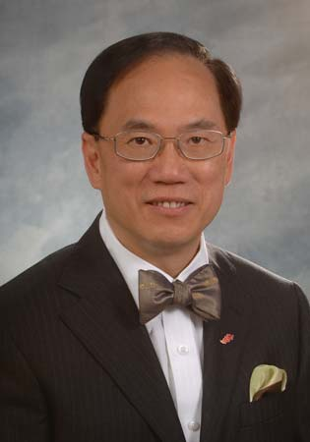
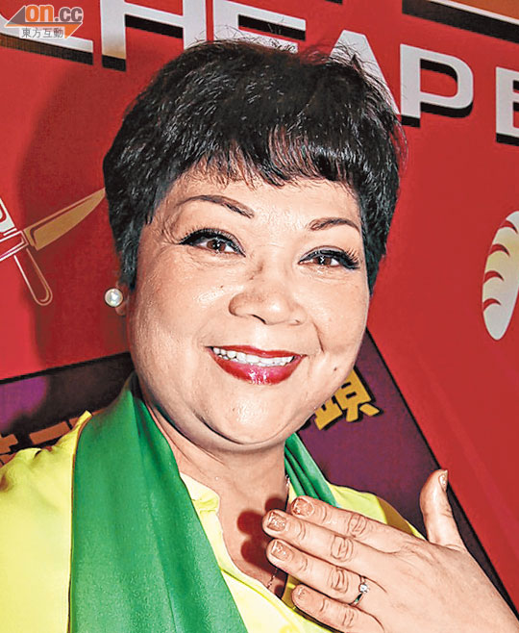
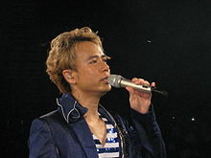
HK celebrities who originated from Macau
Do you know that they were born in Macau?

Slide 15
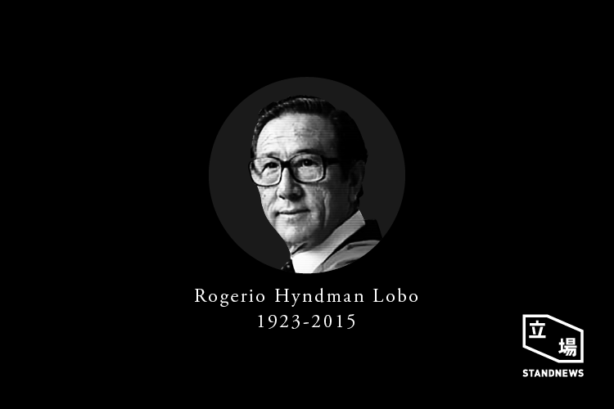
Among them…Sir Rogerio/Roger Lobo
Macanese, born in Macao in 1923, moved to HK in 1941, became a politician and champion of democratic govt in HK.

Slide 16
Sir Rogerio/Roger Lobo
“I studied under the Jesuits in the seminary. When I left school, I wanted to go to the United States but when I told my father about this, he said: ‘How can you go to the States? You don’t speak English.’ He was right. We learnt Portuguese, French and Latin at school but never English” (McGivering, 1999: 72).
“In 1941, when the war came to Asia, I was eighteen. I’d been over Hong Kong trying to brush up on my English so that I could go to America” (McGivering, 1999: 74).

Slide 17
English is important for leaving Macau, but…
In recent decades, quite a lot of youngsters also went to Taiwan and Mainland China where English is not necessarily used pervasively.
Recently, the head of our Global Affairs Office has always spammed us with email messages about his visits to Macao-born citizens who became accomplished scientists in China and the States.

Slide 18
English in Macao
Lobo’s quotation suggests that English or English education wasn’t really popular before WWII.
Long before the English-speaking expatriates came in recent years, some British traders came to Macau on route to Guangzhou (e.g. Robert Morrison the missionary who died in Canton but buried in Macao).
There was a small American-British population in Macau in late 1700’s until the 1800’s (Kingsley-Bolton, 2003).
These are English speakers.
Some kind of Chinese pidgin English was spoken in Macau between the British and the Chinese (Kingsley-Bolton, 2003).

Slide 19
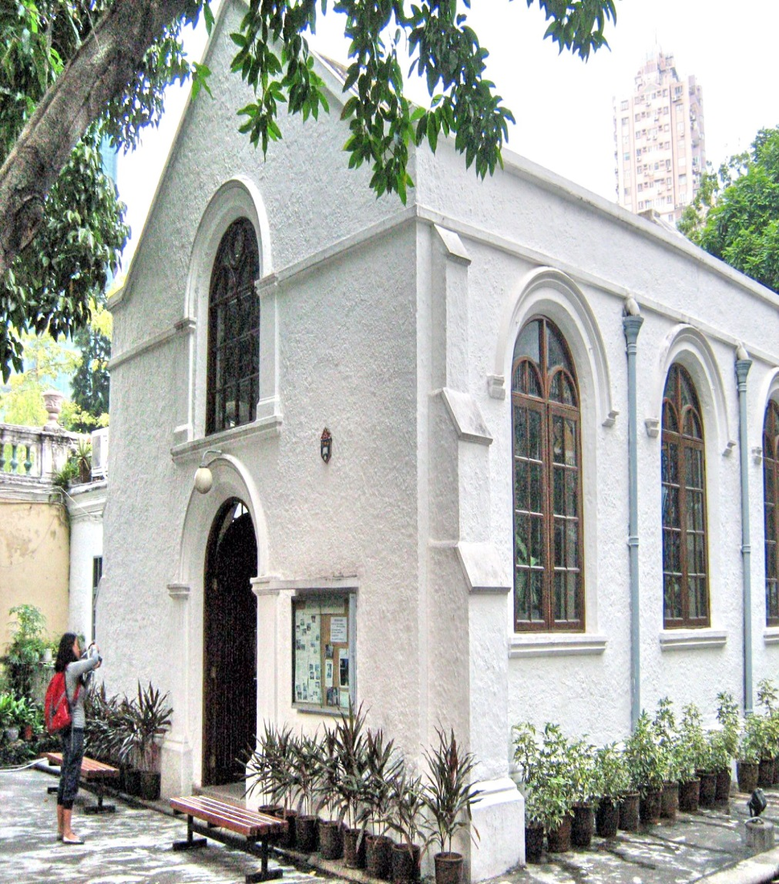
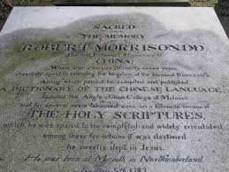
Old Protestant Cemetery in Macao

Slide 20
English in Macao
English is also the language of the expatriates including managers in casinos/hotels and university lecturers.
Most secondary schools in Macao are privately-run. Although the more prestigious ones, mostly run by Catholic missionaries, are English-medium, many of them also have a Chinese section.
Very few English teachers, however, are from the Inner Circle. Many are locals and quite a lot of them are the more educated Filipinos.
Teachers do not necessarily speak English only (i.e. CS---Pui, 2009), but so far there hasn’t been government policy or much public discourse advocating “English only” practice.

Slide 21
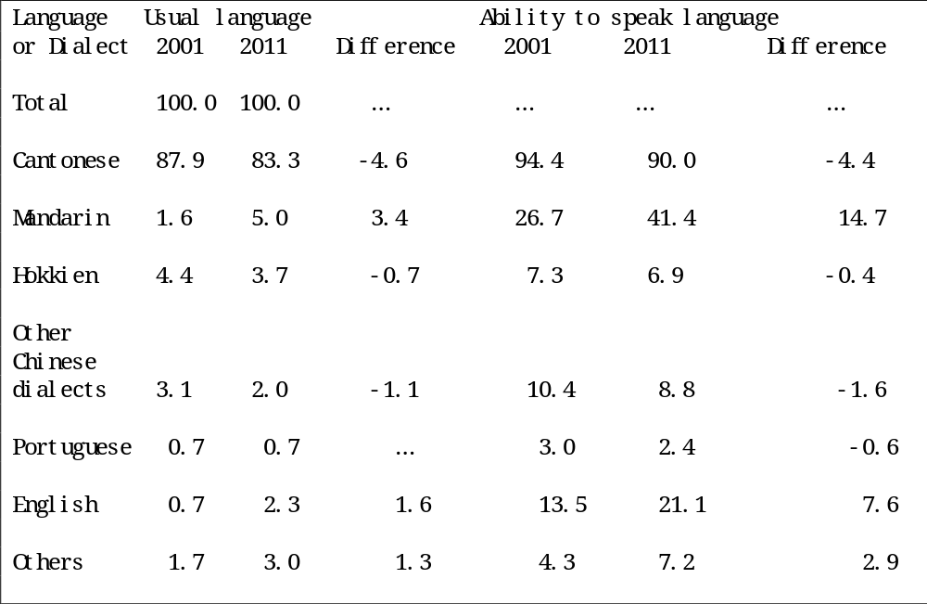
Language ability of the Macau population (DSEC, 2012)

Slide 22
Language ability of the Macau population (DSEC, 2012)
Most people speak Cantonese as their usual language in 2011 (i.e. 83.3%), but very few people speak English as their usual language (i.e. 2.3%) (= “the language an individual mostly uses at home”, p.50 of “Results of 2011 Population Census”).
However, a lot more people claim to know or speak English although they don’t speak it as usual language, presumably as their second language used in workplace or school (i.e. 21.1 – 2.3 % = 18.8%).
Notwithstanding, even more people claim to speak Mandarin (Putonghua) as their second language (i.e. 41.4% - 5% = 36.4%).

Slide 23
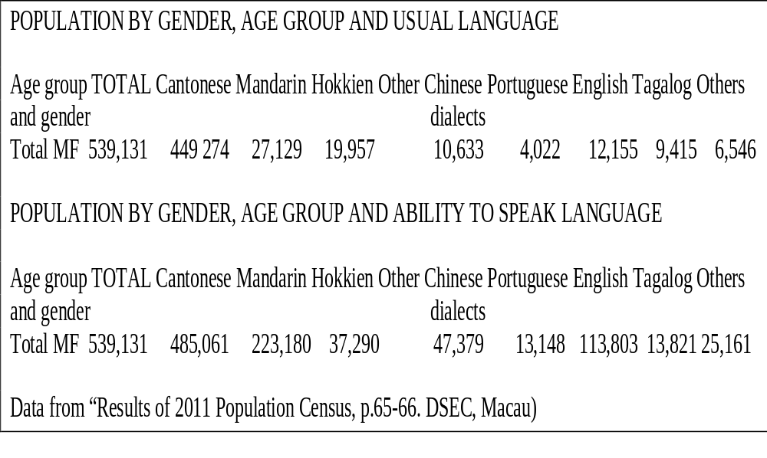
For the numbers…

Slide 24
For the numbers…
196,051 claim to speak Mandarin as non-usual-language speakers, and the corresponding figures are 101,648 for English, 9,126 for Portuguese and 35,787 for Cantonese.
The number for English non-usual-language speakers has risen as back in the 2006 by-census only 65,874 respondents claim to speak English as a second language.
The percentage over total population (492,291 in 2006 by-census) has also increased mildly, that is, 13.38% compared to 18.8% in the 2010 Census.

Slide 25
Official Languages
Portuguese had been the sole official language before the 1999 Handover.
Chinese was decided to be the official language of the future Macau SAR in the Joint Declaration (1987) alongside Portuguese.
This is stated in the Basic Law governing the Macau Special Administrative Region, promulgated in 1993:
“In addition to the Chinese language, Portuguese may also be used as an official language by the executive authorities legislature and judiciary of the Macao Special Administrative Region”
(Article 9 in Chapter 1)

Slide 26
Official Languages
In fact, the local Macau government issued a decree in December, 1991 declaring that Chinese became an official language.
With many high-ranking government officials being non-Chinese-speaking Portuguese before the handover, Chinese became more prominent in govt documents and signage only after 1999 (Moody, 2008).
Portuguese is still used in government documents and appears in a lot of official signage, mostly alongside written Chinese.
Portuguese remains important in the domain of law: a new law still has to be drafted in Portuguese first before it is translated into Chinese.

Slide 27
What can we expect about the status functions and proficiency of English in Macao?
Diversity: The diversity and complexity of the population make it impossible to pin down the status and functions of English in more traditional terms such as a “High Variety” (Ferguson, 1959; Fishman, 1967) or a “language of communication” (House, 1993) based on simple, clear-cut dichotomies (i.e. vs the “Low Variety” or the “language of identification). That is, it can be “High” or “Low”, “the language of communication” or “the language of identification” depending on the context and the speakers.
Moving towards Superdiversity? (Blommaert and Rampton, 2011)

Slide 28
What can we expect about the status functions and proficiency of English in Macao?
Variation: There may be huge inter-group and intra-group variations among Macao people in their use, exposure and proficiency in English.
“Truncated Proficiency” (Blommaert and Backus, 2011): People in the service counters may have mastered several English phrases but not enough to sustain a longer conversation.
Exposure to different accents and varieties of English
“Misfires” in speaking English

Slide 29
What can we expect about the status functions and proficiency of English in Macao?
Polycentricity (Blommaert, 2010): Cantonese, English and Portuguese are all dominant in different domains and among various groups (but not exclusively used or absolutely dominant).
More specifically for English, its value and market seem to have hinged upon dealing with “outsiders” (tourists, expatriates/managers/bosses), and offering individuals more “capital” to move abroad.
English as an out-group/international language (vs in-group/local) seems to permeate in quite a lot of public discourse, in which English is either absent or sidelined (“code-preference”---Scollon and Scollon 2003).

Slide 30
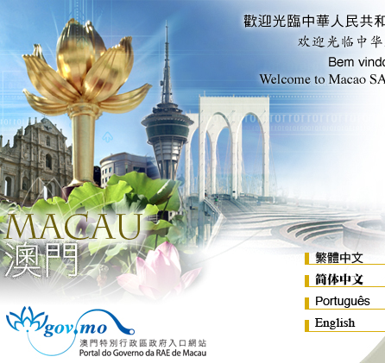
Government websites
As Moody (2008) observes, English is widely used in websites of government departments and hence a “de facto official language”. Nevertheless , it seems to be placed in a more peripheral position
(TC > SC > Portuguese> English)

Slide 31


Logos of Government Depts: No English
From the govt’s point of view, a combination of TC and Portuguese represent Macao local identity: “official bilingualism”

Slide 32
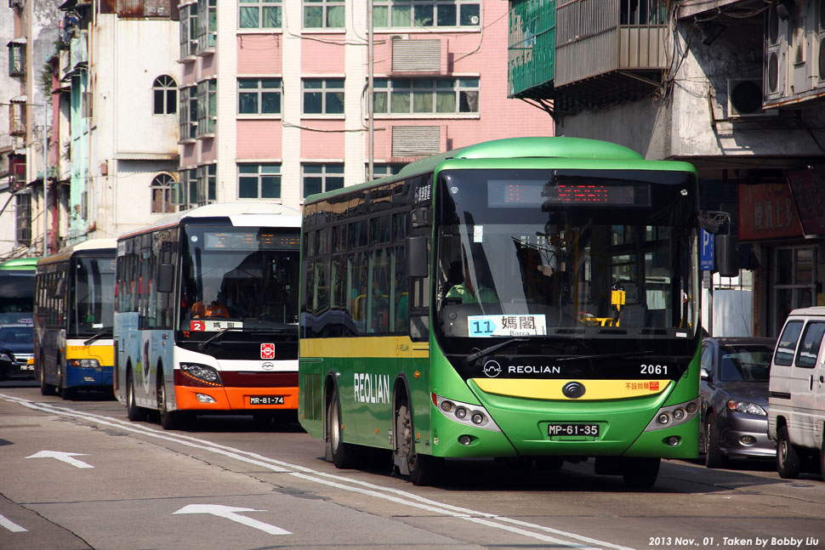
And the announcements on the buses
Cantonese > Portuguese > Putonghua > English

Slide 33
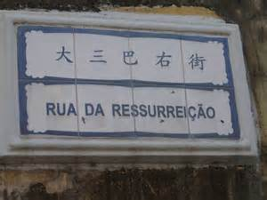
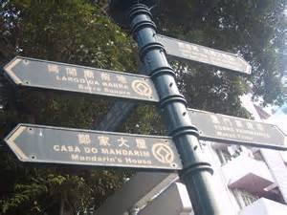
Road Signs
There is no English in the usual road signs, English appears on road signs in tourist areas only but even so it comes after Chinese and Portuguese (TC > Portuguese > (English)).

Slide 34
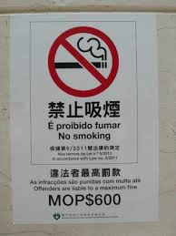
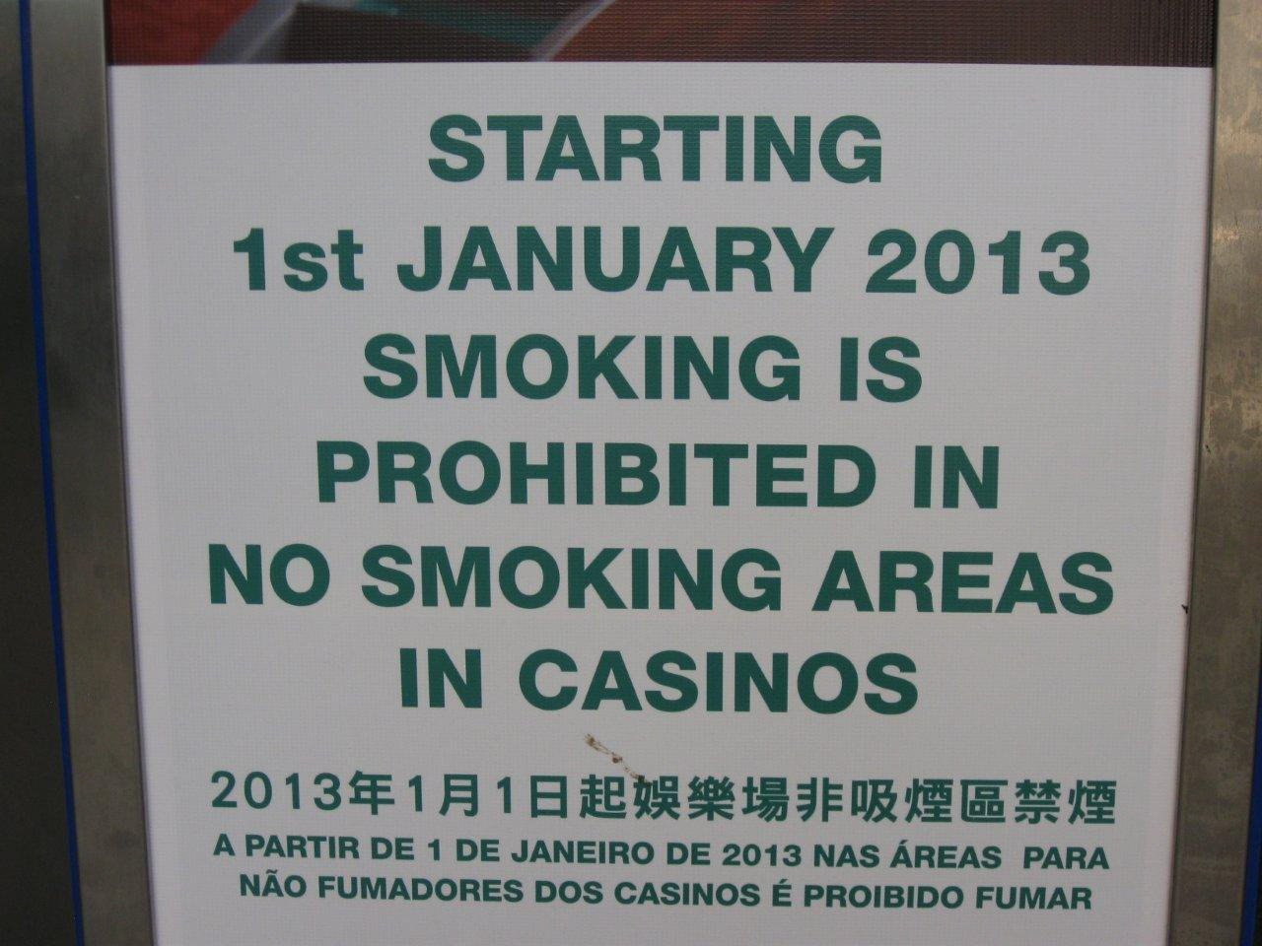
“No smoking” signs general vs specific; government vs casino

Slide 35
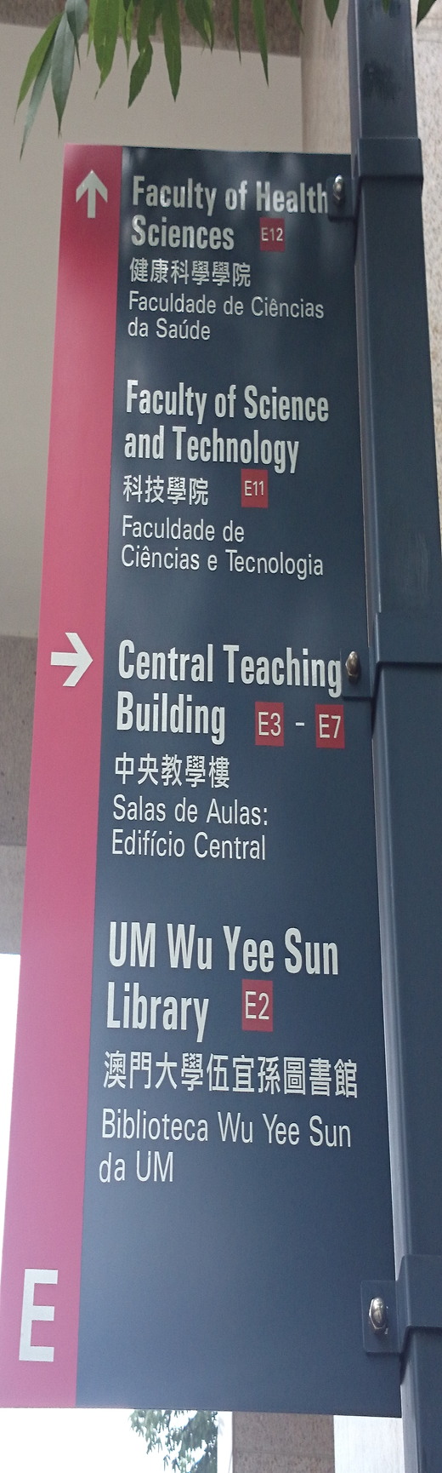
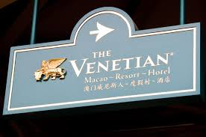
Road signs
English is much more prominent in signs in places which are supposedly more international (hotels/casinos and university) (English> Chinese (TC/SC) > (Portuguese)).
English as an upscaling device Blommaert (Blommaert, 2010; Pan, 2010)

Slide 36
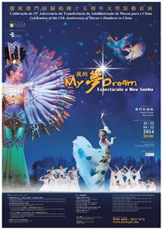

English can be more prominent than Portuguese in other public discourse

Slide 37
English can be more prominent than Portuguese in public signs
The use of English here does not imply a radical change of status from an “out-group/international” language to an “in-group/local” language in Macao as English is often used around the world as an attention-getter in media discourse (Bhatia and Ritchie, 2013).
But such usage certainly may be seen as a step towards the localization English in Macao; notice that the shows advertised are not really shows of “Western” culture, with which the English language is often associated, and the target audience are not explicitly tourists from abroad.

Slide 38
Reflections
English cannot be only an out-group language in reality, as it is increasingly used in school, the workplace and everyday transactions amidst a multilingual environment, with more English speakers (imported labour and foreign expatriates) settling down in Macao. And of course for English-speaking expatriates it is their in-group language.
English is also clearly an asset and “symbolic capital” for local graduates to find a job locally in Macao, if the company is seen as a “foreign” one. This explains students’ strong motivation to learn English (Botha, 2013; Yan, 2013; Young, 2007, 2009).
At the same time, there is every possibility that certain groups of people seldom use English and have had very little exposure to it (e.g. construction workers imported from mainland China).

Slide 39
Reflections
The ambivalence and optionality of English in public signs suggest that non-Chinese, non-Portuguese residents (again the imported labour, e.g. the Filipinos) are somehow marginalized.
Much as Macao aspires to become an international city and portrays its image as one, there is a strong sense of localness which makes life inconvenient if not difficult for English speakers in Macao (e.g. The first Cantonese phrases my English-speaking colleagues learn is their address and the university so that they can communicate with the taxi drivers; the next ones are probably the names of food/drink they like to eat in a Chinese restaurant ).
Pressure on Macao to become more commercialized and internationalized on various fronts (tourism, culture, education), at least projecting an image of it, would put more value on English at the expense of Portuguese, which has already been found in some of the public signs.

Slide 40
References
Bhatia, T.K. and W.C. Ritchie (2013). Bilingualism and Multilingualism in the Global Media and Advertising. In T.K. Bhatia and W.C. Ritchie, The Handbook of Bilingualism and Multilingualism (pp.565-597). Chichester: Wiley-Blackwell .
Blommaert, J. (2010). The Sociolinguistics of Globalization. Cambridge: CUP.
Blommaert, J. and Backus, A. (2011). Repertoires revisited: ‘Knowing language’ in
superdiversity. Working Papers in Urban Language and Literacies: Paper 65.
Blommaert, J. and Rampton, B. (2011) Language and Superdiversity. Diversities, 13:2.
Botha, W. (2013). English-medium instruction at a university in Macau: Policy and realities. World Englishes 32(4): 461–475.
DSEJ (2007). Global Results of By-Census 2006. DSEJ, Macao Government.
DSEJ (2012). Results of 2011 Population Census. DSEJ, Macao Government.
DSEJ (2015a). Demographic Statistics, 1st Quarter, 2015. DSEJ, Macao Government.
DSEJ (2015b). Visitors’ Arrival by Place of Residence, 1st Quarter, 2015. DSEJ, Macao Government.
Ferguson, C. (1959). Diglossia. Word, 15, 425-340.
Fishman, J. (1967). Bilingualism with and without diglossia; diglossia with and without bilingualism. Journal of Social Issues, 23 (2), 29-38.
Gong, M. (2012). A Study of Code-switching in Classroom Discourse at the University of Macau. MA thesis. Department of English, University of Macau.
House, J. (2003). English as a lingua franca: A threat to multilingualism? Journal of Sociolinguistics, 7, 4, 556–578.

Slide 41
References
Man-Cheong, I. (2014). Macao: an early modern cosmopolis. In Wei, George C.X. (ed.), Macao—The Formation of a Global City, pp.143-155. Oxon and New York: Routledge.
Moody, A. (2008). Macau English: status, functions and forms. English Today 34(3).3–15.
McGivering, J. (1999). Macao Remembers. Oxford/New York: Oxford University Press.
Noronha, Manuel, A. and Chaplin, Ian (2012). A survey of Portuguese language allegiance among the Macanese and the Macanese diaspora. Portuguese Studies Review 20(1): 113-135.
Pan, Lin (2010). Dissecting multilingual Beijing: the space and scale of vernacular
globalization. Visual Communication 9, 67-90.
Pui, W. (2009). Analysing the Code Switching Phenomenon in a Form 1 English Classroom in Macau: A Qualitative Case Study. MA thesis, Faculty of Education, University of Macau.
Scollon, R. and Scollon, S.W. (2003). Discourses in Place. Abington, Oxon: Routledge.
Yan, X. (2013). A Study of Macao Tertiary Students’ Attitudes to Languages, Language Planning and Language Policy in Macao. Doctoral Dissertation, University of Macau
Young, C, M-Y. (2006). Macao students’ attitudes toward English: a post-1999 survey. World Englishes 25(3).479–490.
Young, C. M-Y. (2009). Multilingual education in Macau. International Journal of Multilingualism 6(4): 412-425.
Zhang, K. (2010). A Sociolinguistic Study of Mainland Chinese Students in Macao: Language Choice, Language Attitudes and Identity. MA Dissertation. Macao: Department of English, The University of Macau.
Zhang, K. (2013). Mainland Chinese students' English use in Macao. English Today 29(02): 54-59.

Slide 42
Thank you so much!
谢谢！
多謝!
Obrigado!

