Slide 1
‘What does that blood mean?’
The Sanguine Physiology of Dracula
Professor William Hughes
University of Macau

Slide 2
‘In God’s name what does this mean?’ … ‘Dr Seward, Dr Van Helsing, what is it? What has happened? What is wrong? Mina, dear, what is it? What does that blood mean?’

Slide 3
Blood is Thicker than Water
At the banquet, on the end of the hall was the legend in gigantic letters:
‘Blood is thicker than water’
– the phrase that became historic when Admiral Erben was in China. It will be remembered that whilst a flotilla of British boats were attacking a fort on the river and had met a reverse they were aided by the crew of an American ship of war. They were on a mud flat at the mercy of the Chinese, who were wiping them out. But the crew of the neutral vessel – unaided by their officers, who had of course to show an appearance of neutrality in accord with the wisdom of international law – put off their boats and took them off. On protest being made, the answer was given in the above phrase.

Slide 4
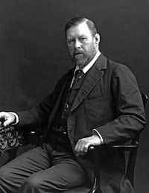
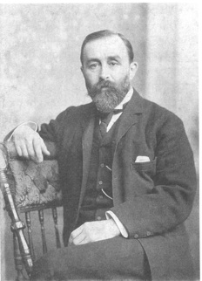
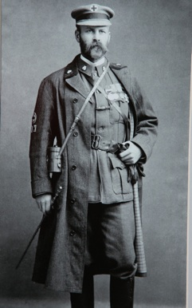
Bram, William and George Stoker

Slide 5
What is vampirism?

Slide 6
What is vampirism?
A physical act

Slide 7
What is vampirism?
A physical act
It ‘feeds’ the vampire

Slide 8
What is vampirism?
A physical act
It ‘feeds’ the vampire
It drains the body of the victim

Slide 9
What is vampirism?
A physical act
It ‘feeds’ the vampire
It drains the body of the victim
It may be something very conventional...

Slide 10
What is vampirism?
A physical act
It ‘feeds’ the vampire
It drains the body of the victim
It may be something very conventional...
and literally physical

Slide 11
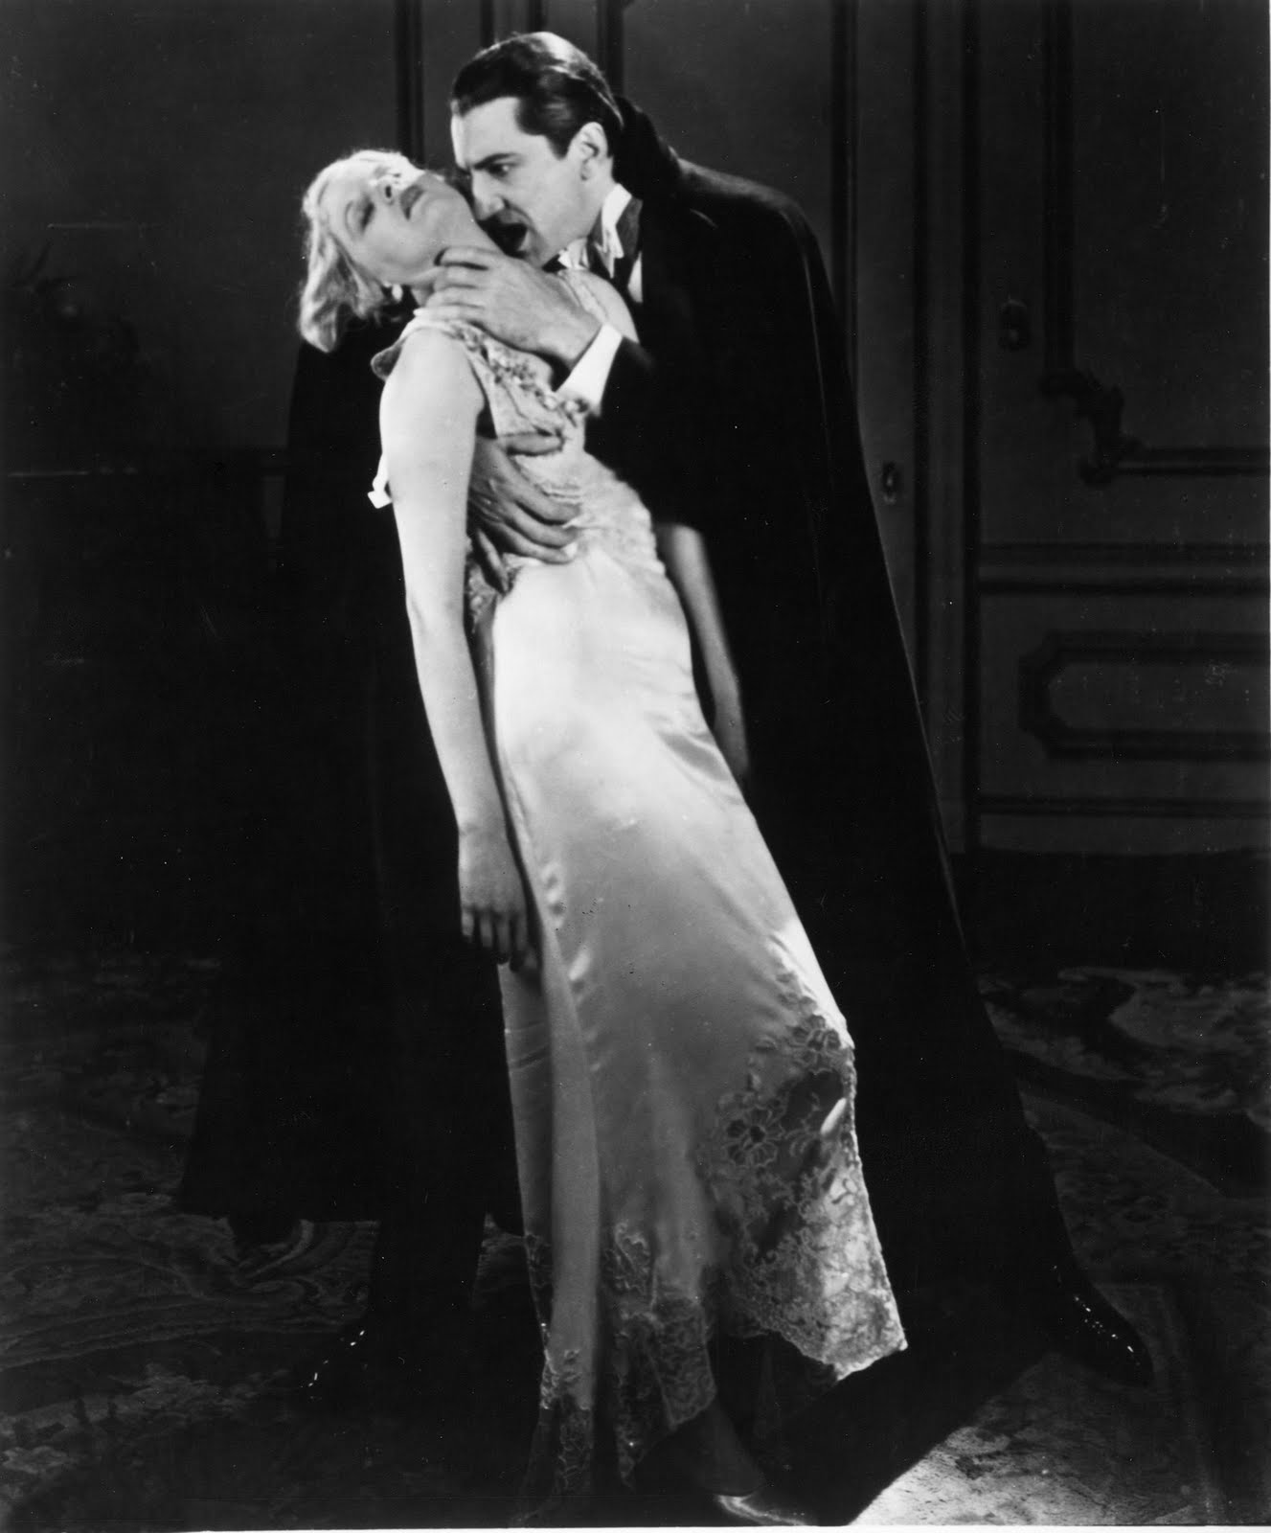

Dracula

Slide 12
‘Of nervous prostration following on great loss or waste of blood.’
Dracula, Chapter 14

Slide 13
You are clever man, friend John: you reason well and your wit is bold; but you are too prejudiced. You do not let your eyes see nor your ears hear, and that which is outside your daily life is not of account to you.
Dracula, Chapter 14

Slide 14
The Symptoms of Lucy
She was ghastly, chalkily pale; the red seemed to have gone even from her lips and gums, and the bones of her face stood out prominently; her breathing was painful to see or hear.
Seward’s Diary, 7 September. Chapter 10

Slide 15
The Symptoms of Lucy
She was ghastly, chalkily pale; the red seemed to have gone even from her lips and gums, and the bones of her face stood out prominently; her breathing was painful to see or hear.
Seward’s Diary, 7 September. Chapter 10
The pallor of anaemia is very marked; the face becomes white ... If the lips and gums be examined ... They will be found to be pale and bloodless, also. Debility and weakness are often extreme, the patients feel languid, heavy, and disinclined to make the slightest exertion. They are troubled with frequent sighing and yawning, are sleepy, dull and low-spirited.
Cassell’s Family Doctor, 1897

Slide 16
The Symptoms of Lucy
Van Helsing to Arthur Holmwood
‘Young miss is bad, very bad. She wants blood, and blood she must have or die. My friend John and I have consulted; and we are about to perform what we call transfusion of blood – to transfer from full veins of one to the empty veins which pine for him.’
Seward’s Diary, 7 September. Chapter 10

Slide 17
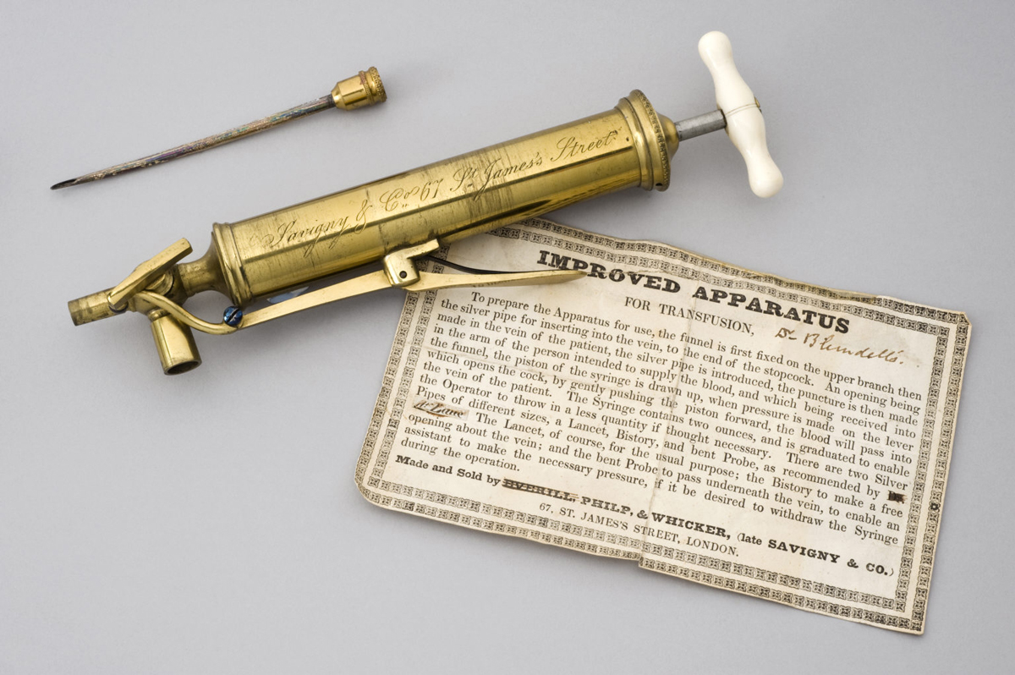
The Transfusion of Blood
Blundell’s apparatus for the transfusion of blood

Slide 18
The Transfusion of Blood
... with swiftness, but with absolute method, Van Helsing performed the operation. As the transfusion went on, something like life seemed to come back to poor Lucy’s cheeks, and through Arthur’s growing pallor the joy of his face seemed absolutely to shine. After a bit I began to grow anxious, for the loss of blood was telling on Arthur, strong man as he was. It gave me an idea of what a terrible strain Lucy’s system must have undergone that what weakened Arthur only partially restored her.
Seward’s Diary, 7 September. Chapter 10

Slide 19
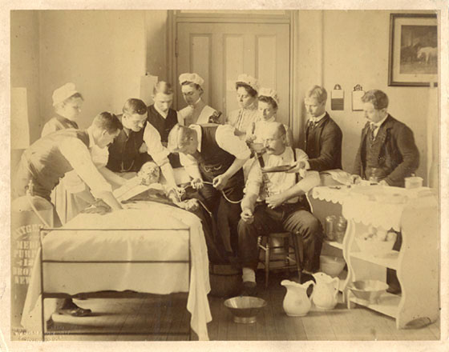
The Transfusion of Blood

Slide 20
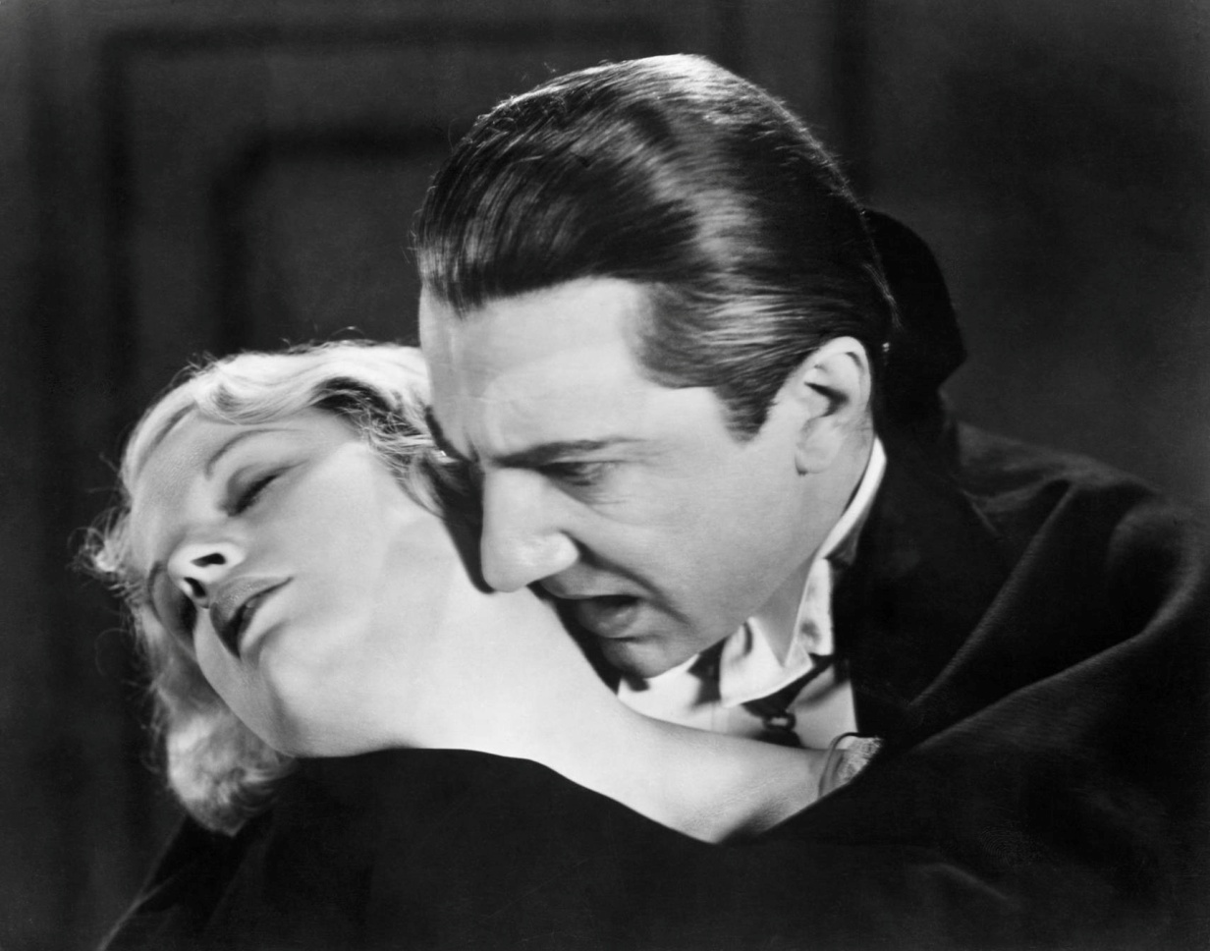
Dracula
Where does a vampire bite?

Slide 21
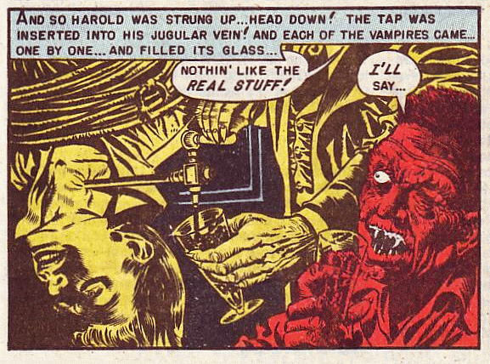
The Jugular Vein
‘Midnight Mess’, Tales from the Crypt, 35, 1 February 1954.

Slide 22
Dracula
Just over the external jugular vein there were two punctures, not large, but not wholesome looking. There was no sign of disease, but the edges were white and worn-looking, as if by some trituration. It at once occurred to me that this wound, or whatever it was, might be the means of that manifest loss of blood; but I abandoned the idea as soon as formed, for such a thing could not be. The whole bed must have been drenched to a scarlet with the blood which the girl must have lost to leave such a pallor as she had before the transfusion.
Seward’s Journal, 7 September. Chapter 10

Slide 23
Dracula
Just over the external jugular vein there were two punctures, not large, but not wholesome looking. There was no sign of disease, but the edges were white and worn-looking, as if by some trituration.

Slide 24
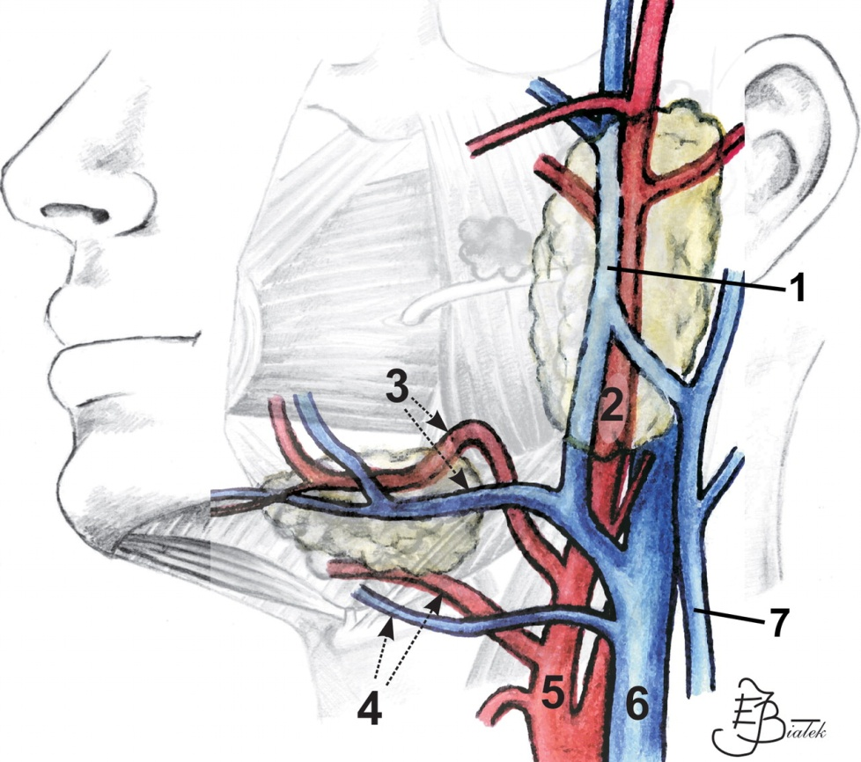
Dracula
Just over the external jugular vein there were two punctures, not large, but not wholesome looking. There was no sign of disease, but the edges were white and worn-looking, as if by some trituration.

Slide 25
Lucy’s Dream
... I have a vague memory of something long and dark with red eyes ... and something very sweet and very bitter all around me at once, and then I seemed sinking into deep green water, and there was a singing in my ears, as I have heard there is to drowning men; and then everything seemed passing away from me; my soul seemed to go out from my body and float about the air.
Mina Murray’s journal, 18 August. Chapter 8.

Slide 26
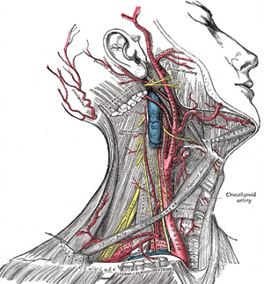
Where does a vampire bite?

Slide 27
William Carpenter,
Principles of Mental Physiology (1874)
... the effect is immediate and decided. There is felt a soft humming in the ears; a sense of tingling steals over the body; and, in a few seconds, complete unconsciousness and insensibility supervene, and continue so long as the pressure is maintained. On its removal, there is confusion of thought, with return of the tingling sensation, and in a few seconds consciousness is restored. The mind dreams with much activity, and a few seconds appear as hours, from the number and rapid succession of thoughts passing through the brain.

Slide 28






Carpe noctem
Follow William Hughes on Twitter: @esmedunae
Follow Gothic at the University of Macau on Twitter: @UMGothic
Follow UMGothic on Facebook at https://www.facebook.com/groups/335553131073618/

